Slide 1
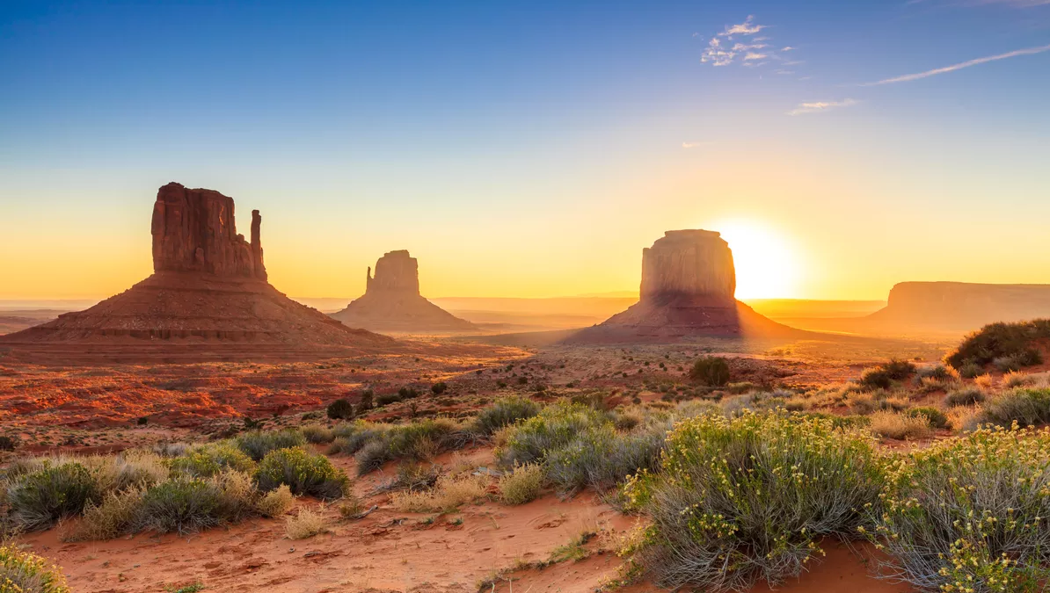


FRANCE
MARKET UPDATE FY23

Slide 2
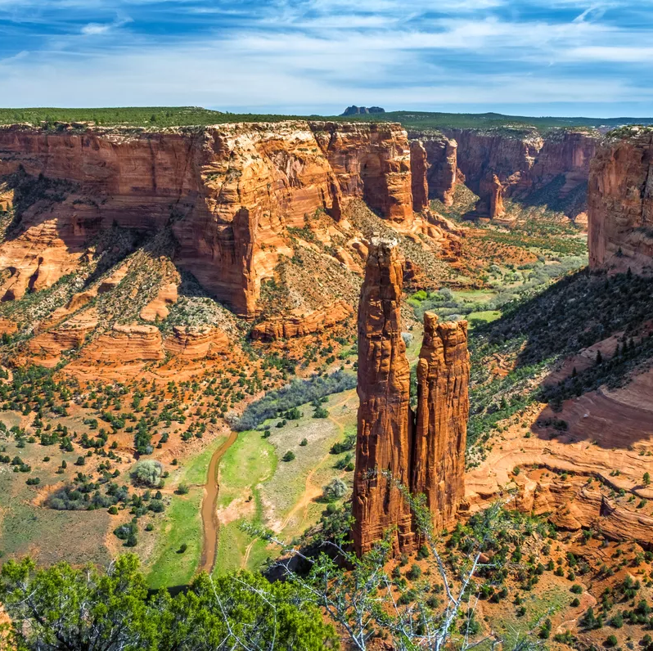
COUNTRY OVERVIEW

Slide 3

COUNTRY PROFILE
In 2023, France is the 7th largest economy in the world
GDP: $2.78 trillion
GDP per capita: $38,046 in 2022, GDP increased by 2.5% in volume terms after 6.4% in 2021. In 2022, despite the sharp slowdown in activity, the purchasing power of disposable income increased by +0.2%
Unemployment rate in Q1 2023 is at 7.1%
Inflation rate was 5.1% in May 2023 (vs. 5.2% on average in 2022)
In June 2023, both the business climate in France and the employment climate remain stable
Source: data.worldbank - tradingeconomics.com and INSEE

Slide 4

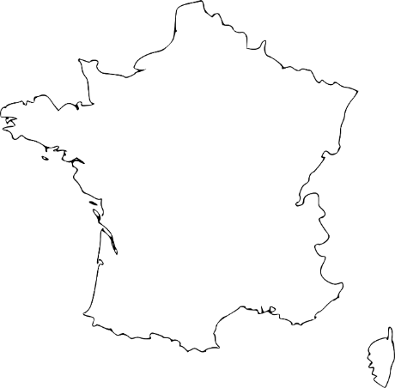


FRANCE: DEMOGRAPHICS
#1 PARIS
2.1 millions
Metropolitan area: 10.8 millions
#4 LILLE
Metropolitan area:
1.05 million
Population: 68 millions
Capital city: Paris with 2.1 millions residents
#2 LYON
Metropolitan area: 1.7 million
#6 BORDEAUX
Metropolitan area: 994 900
France is the 3rd most populated country in the European Union
#5 TOULOUSE
Metropolitan area: 1.04 million
#7 NICE
Metropolitan area: 955 150
#3 MARSEILLE
Metropolitan area: 1.6 million
Source : INSEE 2020
Notes:
Rajouter picto

Slide 5






FRENCH TRAVELER PROFILE
TRAVEL REVENGE
Catching up on lost time during covid, travel as often as possible
DECISION MAKING CONSIDERATIONS
Trip cost, weather, security level
TRAVEL TRENDS
NATURE LOVERS
The desire to go back to basics and wide-open spaces
FAVORITE ACTIVITIES
Sightseeing, eating out, relaxing, entertainment, shopping, sports
AUTHENTICITY & DIVERSITY
Discovering a new culture & reconnecting with traditions
ECO-FRIENDLY TRIPS
For greater respect of the environment
Source: Les 10 principales tendances du tourisme 2023, Travel Insight (June 2023)

Slide 6






FRENCH TRAVELER PROFILE
NEED OF REASSURANCE
Travelers subscribe more insurance policies than before to secure
their trips
TRAVEL INSPIRATION
Recommendation by a relative, TV/series or social media
(Instagram, TikTok)
BOOKING BEHAVIOUR
LOW SEASON TRAVEL
Always more destinations to explore, lower rates
ADVANCED BOOKINGS
Trips are planned further ahead
PROFESSIONAL SERVICE
More people rely on travel operators for best advice and assistance
during their trip
TRAVEL COMPROMISES
Travel more often but less longer to spread holiday budget

Slide 7
FRENCH TRAVELERS’ FAVORITE DESTINATIONS*
Top long-haul destinations in May 2023
Top medium-haul destinations in May 2023
Mauritius
United States
Dominican Republic
Mexico
Thailand
Canada
United Arab Emirates
Tanzania
Spain
Greece
Tunisia
Egypt
Italy
Morocco
Turkey
Portugal
*Exclusively booked through travel operators
Source: Baromètre Orchestra/L’Echo Touristique, May 2023

Slide 8




FRENCH TRAVELERS TO THE U.S.
France is the 5th inbound market with 1.31 million French visitors in 2022
1.55 million French visitors are expected in 2023
The U.S. remains one of the top choices among long-haul destinations for French travelers
44% of French travelers are likely to travel to the U.S. in the next 2 years
Source: Brand USA Market Intelligence Study 2021

Slide 9



FRENCH TRAVELERS LIKELY TO VISIT THE U.S.
Top 5 motivations
Travel party
Duration of next trip
57%
Cultural &
Historical Attractions
16%
16%
Solo
1-6 nights
56%
Urban Attractions
44%
Couple
39%
7-13 nights
52%
Local Lifestyle
38%
Family
36%
14-20 nights
48%
Dining & Gastronomy
7%
9%
Family adults
21+ nights
45%
Beaches & Seaside Attractions
10%
Friends
Source: Brand USA Market Intelligence Study 2021

Slide 10
MAIN AIR CONNECTIONS FROM FRANCE
AIRLINE | FROM | VIA
AIR FRANCE | PARIS CDG | Atlanta, Chicago, Dallas, Denver, Detroit, Los Angeles, New York JFK, Philadelphia
AMERICAN AIRLINES | PARIS CDG | Chicago, Dallas, New York JFK, Philadelphia
DELTA AIR LINES | PARIS CDG | Atlanta, Cincinnati, Detroit, Los Angeles, Minneapolis St Paul, New York JFK, Salt Lake City
UNITED AIR LINES | PARIS CDG | Chicago, Newark, San Francisco, Washington D.C
BRITISH AIRWAYS | PARIS CDG | London
LUFTHANSA | PARIS CDG | Frankfurt
AIR CANADA | PARIS CDG | Montreal, Toronto
AIR TAHITI NUI | PARIS CDG | Los Angeles, Seattle
FRENCH BEE | PARIS ORY | Los Angeles, San Francisco

Slide 11

TOP 5 REASONS TO TARGET THE FRENCH MARKET
France is the 5th inbound market with 1.31 million French visitors in 2022
Recovery is very strong: agencies and tour operators are doubling their activity in 2023
French travelers are booking ahead of time (about 6 months) and prefer flexible booking policies with insurances
French travelers are “experience seekers” and “memories makers”, they want to have unforgettable vacation and try new activities
Travel is source of well-being for 96% of French people.
Top 5 favorite activities: rest and do nothing (45%) ; sightseeing (41%) ; go on an adventure (18%) ; play sports (18%) ; meet new people (14%)

Slide 12
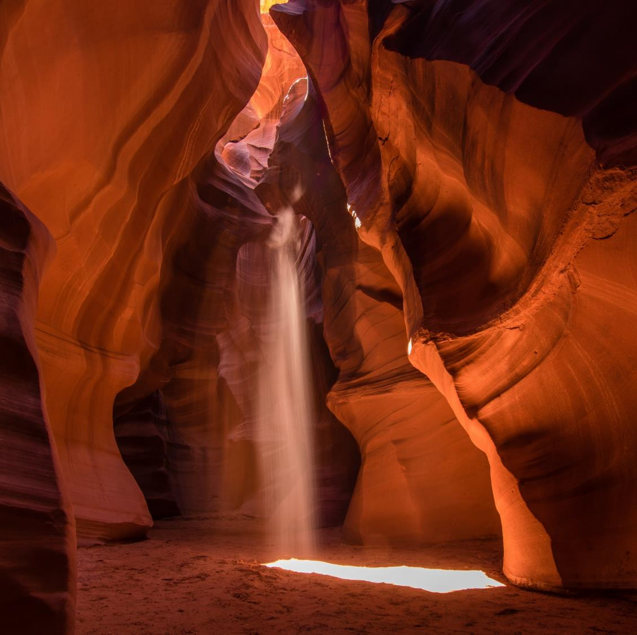
TRADE ACHIEVEMENTS &
ACTIVITIES

Slide 13


KEY PERFORMANCE INDICATORS
1 group trade fam trip
125 sales calls
48 tradeshow appointments
232 travel professionals trained on Arizona
11 newsletters

Slide 14
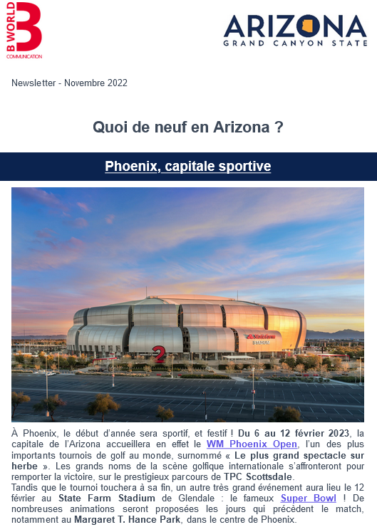
TRADE ACTIVITIES: NEWSLETTERS
MONTH | OPENING RATE | CTR
July-August 2022 | 17.77% | 3.77%
September 2022 | 17.86% | 2.65%
October 2022 | 16.42% | 1.8%
November 2022 | 19.31% | 4.23%
December 2022 | 19.55% | 1.39%
January 2023 | 17.55% | 1.89%
February 2023 | 19.86% | 1.21%
March 2023 | 20.25% | 1.59%
April 2023 | 18.06% | 0.87%
May 2023 | 17.67% | 0.71%
June 2023 | 19.47% | 0.56%

Slide 15
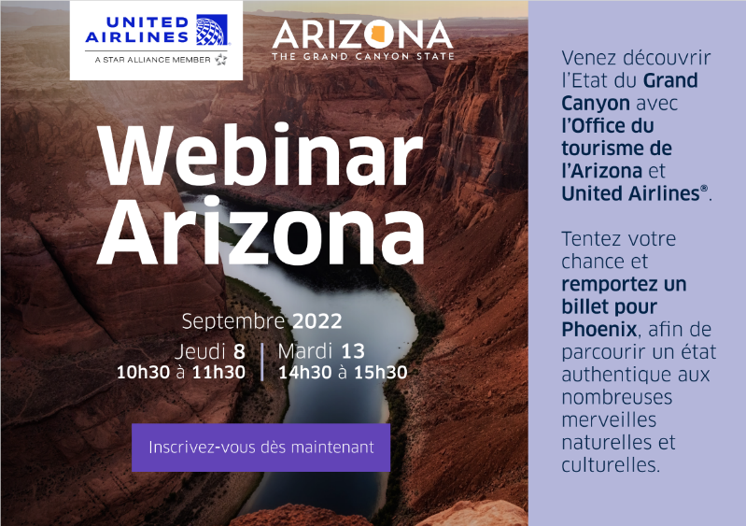
WEBINAR SERIES WITH UNITED AIRLINES
A series of 3 webinars in partnership with United Airlines in September and October 2022
72 agents attended the 3 sessions
A prize draw enabled one agent from Explorator to win a trip to Arizona, including flights with United Airlines and a 2-night stay at the Gila River Resort – Wild Horse Pass (compliments of Visit Phoenix)

Slide 16
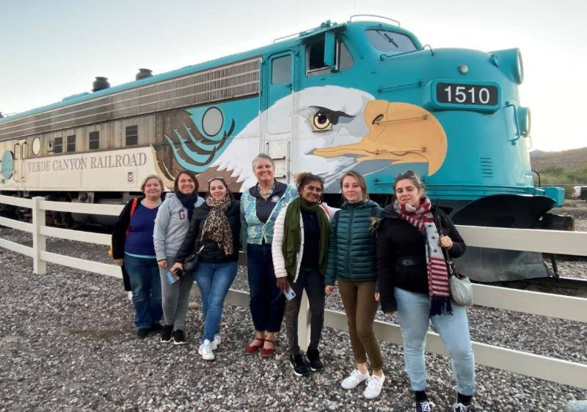



GROUP TRADE FAM TRIP
Organization of a group trade familiarization trip to Arizona from October 11th-18th, 2022
5 selected tour operators: Comptoir des Voyages, Directours, Kuoni, Marco Vasco and Sensations du Monde
Places visited: Phoenix, Scottsdale, Williams, Grand Canyon NP, Canyon de Chelly NM, Petrified Forest NP and Sedona

Slide 17
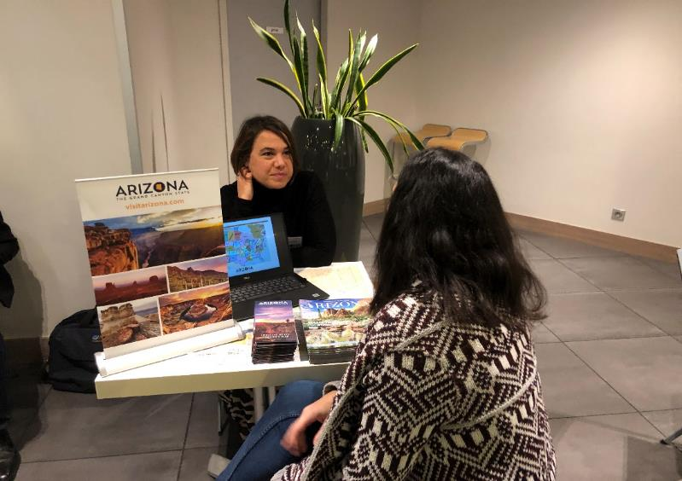


VISIT USA COMMITTEE/FRANCE
E-learning: selection of new questions to update the Arizona quiz in the Visit USA e-learning program
Advertising in the GOVUSA: placement of a full advertising page in the Visit USA 2023 Official Guide
Workshops: in November 2022, participation to the Visit USA’s workshops in Paris, Strasbourg and Toulouse
160 agents attended the workshop in Paris, about 40 in Strasbourg, and 53 in Toulouse

Slide 18
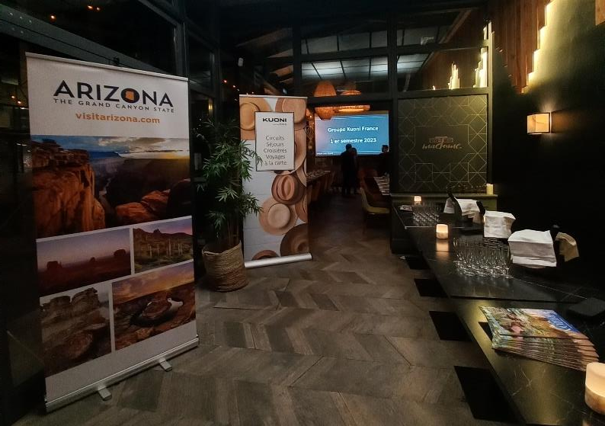

CO-OP PARTNERSHIPS
Kuoni B2B dinner: early February 2023, sponsorship of a travel trade dinner in Rouen (Normandy) in partnership with Kuoni to showcase Arizona to 30 local travel agencies
Visiteurs roadshow: sponsorship of a travel trade dinner in Nancy (Eastern France) in partnership with Visiteurs to showcase Arizona to 24 local travel agencies. Brand USA co-sponsored the event

Slide 19

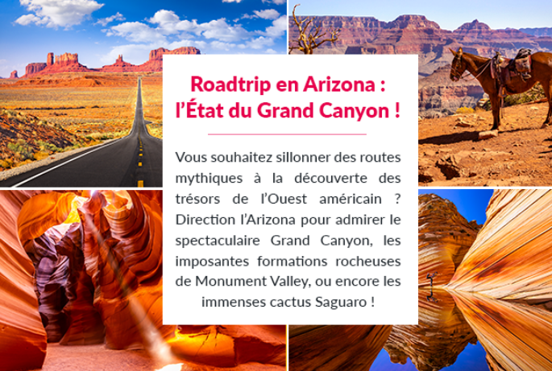


CONSUMER ACTIVITIES: MARCO VASCO
B2C partnership with Marco Vasco, one of the leading tour operators in France, January 16-30, 2023:
Native article on lefigaro.fr
Views: 6,282 – average time spent on page: 3’31
Social media
12,284 people reached – 790 reactions – 19 comments – 25 shares – 3 saves – 1,016 clicks
Newsletter insert
58,877 recipients – 29.41% opening rate – 8.03% reactivity rate – 42 booking quotes generated
New itinerary: “Balade en Arizona: Cactus, Canyons et Trésors Amérindiens”: Phoenix > Tucson > Holbrook > Canyon de Chelly > Monument Valley > Page > Grand Canyon > Williams > Seligman > Sedona > Scottsdale
Views: 2,951 – average time spent on the page: 3’04

Slide 20
CONSUMER ACTIVITIES: TRAVELZOO
B2C campaign with Travelzoo, January 19-February 8, 2023:
Creation of a mini-site, highlighting several aspects of Arizona, ranches, luxury and wellness had the biggest number of clicks + a selection of travel offers from tour operator partners
11,183 views – 2,053 clicks on editorial links – 3,637 clicks on deals
Newsletter
Standalone email: 722,047 members – 7,315 clicks
Top 20 newsletter: 749,080 members – 1,020 clicks
Social Media
1,582 people reached

Slide 21
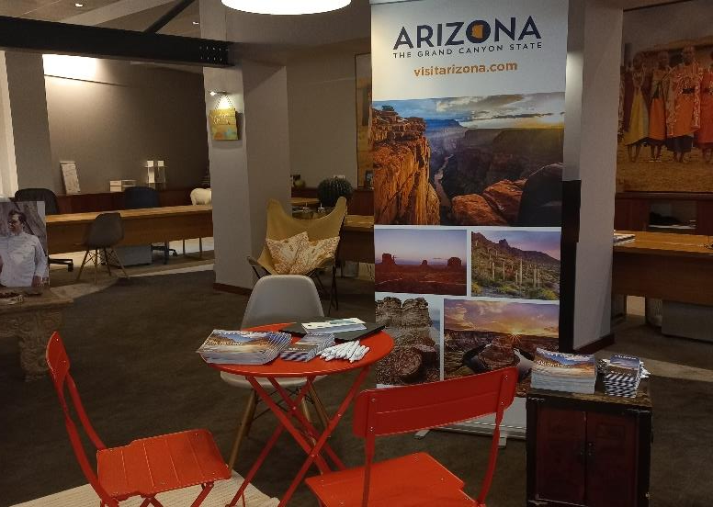


CONSUMER ACTIVITIES: LES ATELIERS DU VOYAGE
Participation to a consumer event at Les Ateliers du Voyage’s flagship store, on June 13th, 2023,
Part of Kuoni’s group, Les Ateliers du Voyage is an upscale tour operator specializing in tailor-made travel
Arizona was the only U.S. destination present, alongside other destinations like Peru, India, French Polynesia…
40 of their top clients attended the event

Slide 22
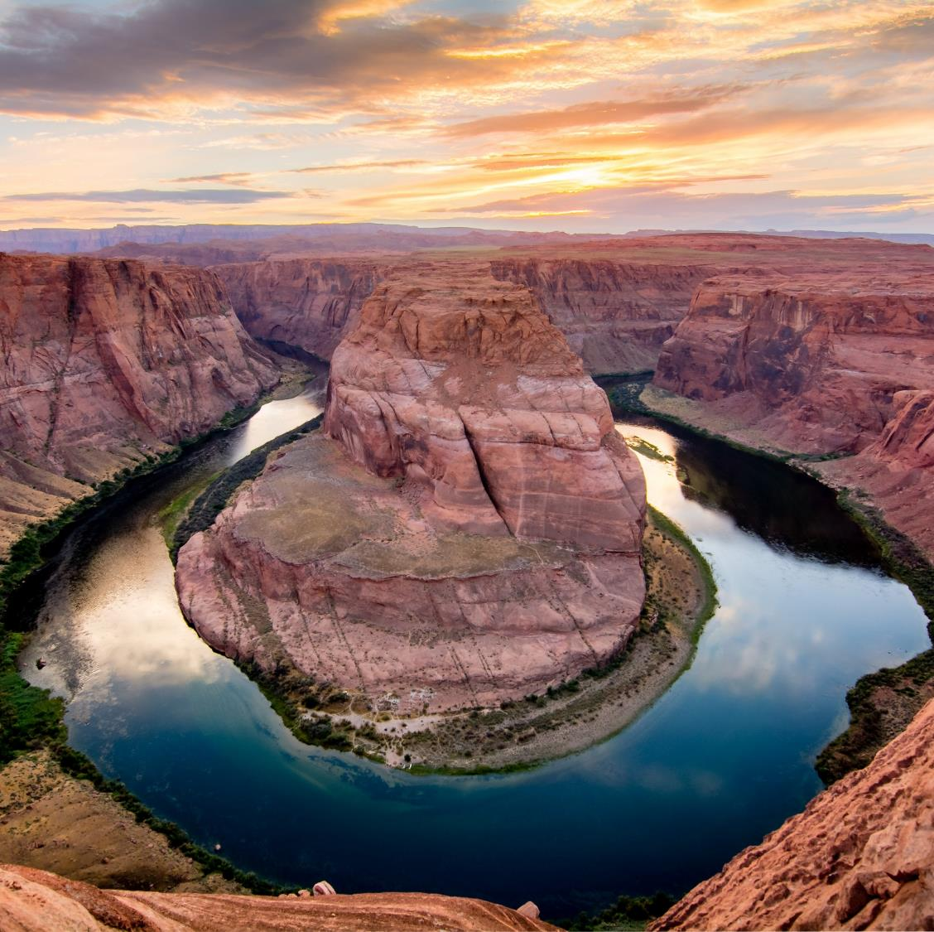
PR ACHIEVEMENTS &
ACTIVITIES

Slide 23


KEY PERFORMANCE INDICATORS
16 journalists and photographers hosted during individual and group press trips
13 press releases and newsletters translated and distributed
28.09% average monthly opening rate
31 journalists and influencers hosted during AOT France Trade & Media Mission
119 generated placements (articles/broadcasts/social posts)
43,573,397 total media reach
$1,472,623 total generated media value

Slide 24
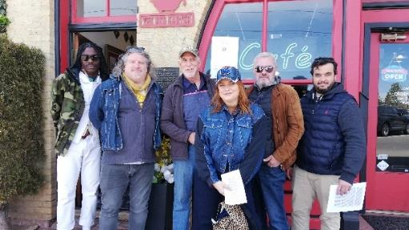
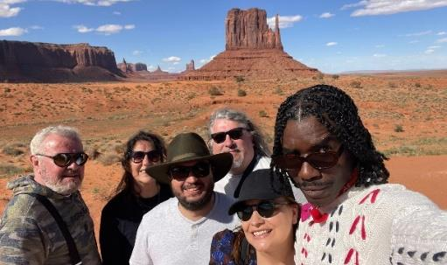
GROUP PRESS TRIP
On 4-10 May 2023, BWC escorted a group press trip with 5 qualified French chief editors from online publications
Magali Bertin, Grazia.fr – Patrick Biagini, VoyagerLuxe.com – Xavier Bonnet, L’IndigoMag.com – Vincent Charretier, Masculin.com – Pascal K. Douglas, Paul.e magazine
The itinerary focused on iconic parks/canyons and Route 66, including Flagstaff, Grand Canyon, Monument Valley, Canyon de Chelly, Williams, Winslow and Glendale

Slide 25
INDIVIDUAL PRESS TRIPS
MEDIA | DATES | NAMES
Voyage Voyage | 19-26 July 2022 | Fiona Le Brun and Guillaume Flandre
Figaro Magazine | 9-22 October 2022 | Marine Sanclemente and Eric Martin
Les Echos Série Limitée | 30 August-4 September 2022 | François Simon
Marie France | 6-15 September 2022 | Valerie Rodrigue and Brice Charton
Gala & Voyage de Luxe | 15-23 May 2023 | Antoine Lorgnier and Laurence Nicolas
France 5 TV | 31 May-9 June 2023 | Clément Champiat and Olivier Nathan

Slide 26



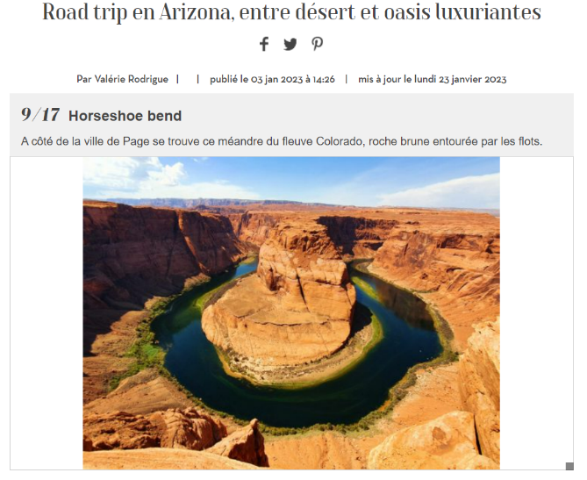
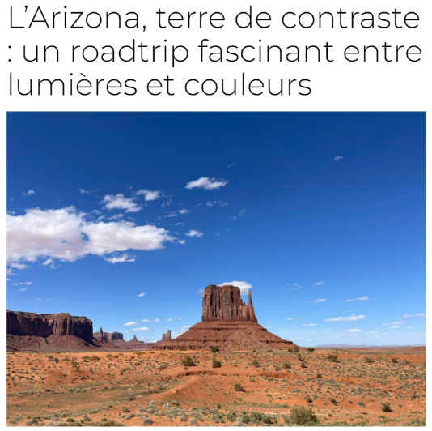
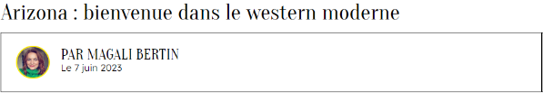

COVERAGE HIGHLIGHTS

Slide 27
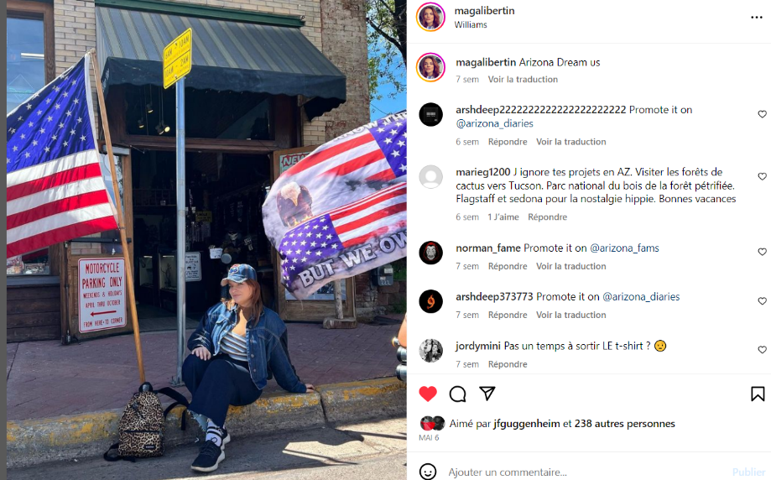
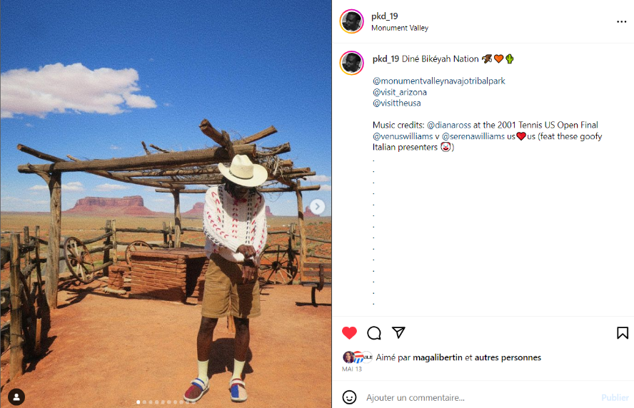
SOCIAL MEDIA HIGHLIGHTS
@magalibertin – 36.9K followers
@pkd_19 – 8.34K followers

Slide 28
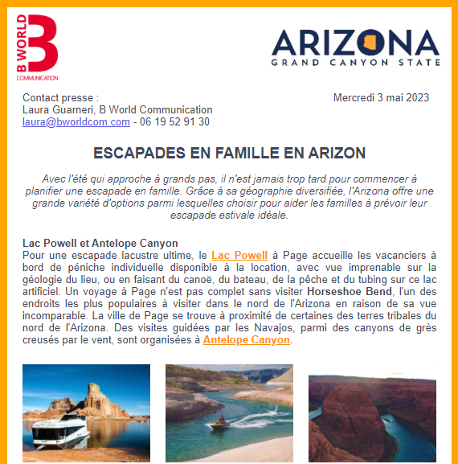

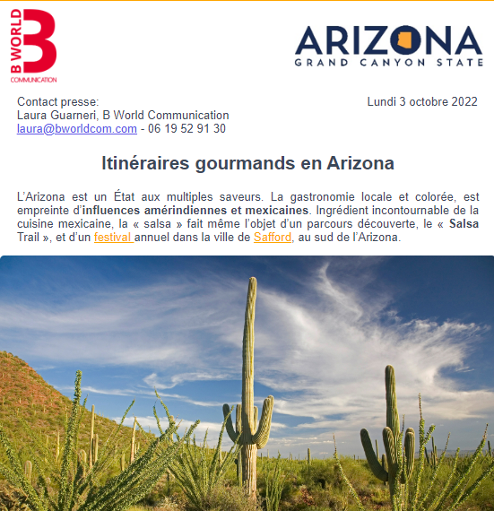
PRESS RELEASES & NEWSLETTERS
13 press releases and newsletters distributed throughout FY23
Various themes: culinary trails, historic trains, caves, caverns & mines, family summer getaways…

Slide 29

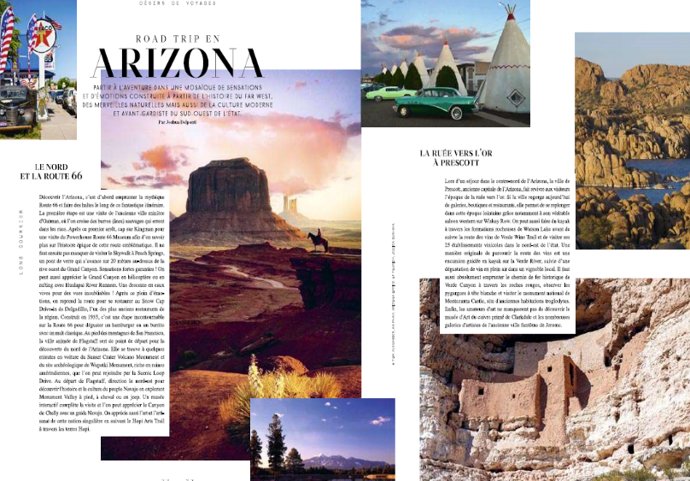
DÉSIRS DE VOYAGES AD CAMPAIGN
Placement of a full-page four-color advertisement in the September-November 2022 issue of Désirs de Voyages magazine
The campaign included an additional full-page advertisement, with a direct link to Visit Arizona French website
Distribution during IFTM-Top Resa annual B2B travel show in Paris (29,475 visitors)

Slide 30

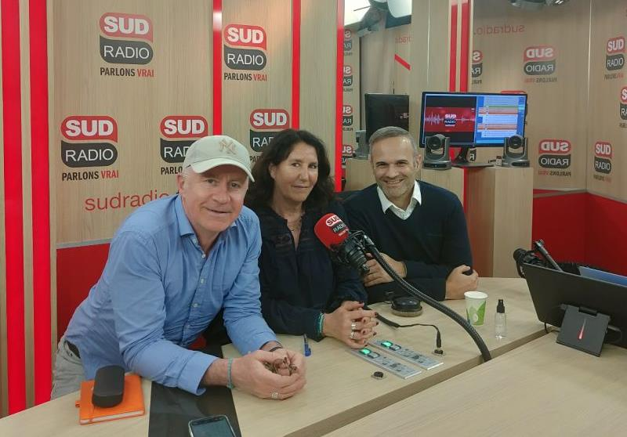

SUD RADIO CAMPAIGN
Implementation of a radio campaign with Sud Radio, (aud. 1.97 million listeners weekly, including 380 000 people in Paris Île-de-France region), in April 2023
Collaboration with Laura Guarneri from B World Communication, a tour operator and a French expatriate artist living in Phoenix
The campaign included a 45-minute radio program entirely dedicated to Arizona, fifteen 30-second radio spots, digital usage rights of podcasts and videos, display of the campaign on Sud Radio website and mobile app, YouTube, Amazon and Google connected speakers

Slide 31
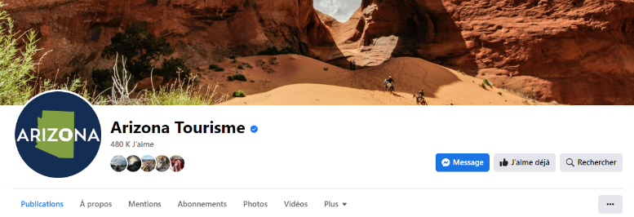
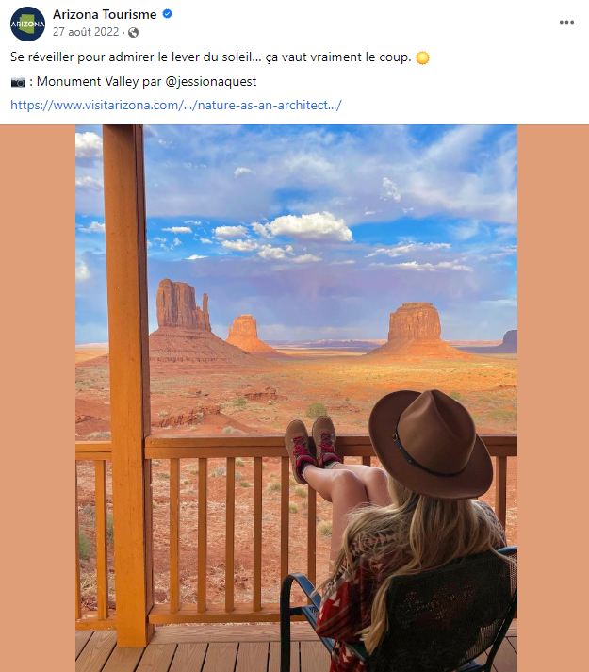
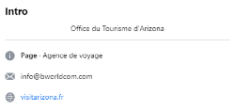
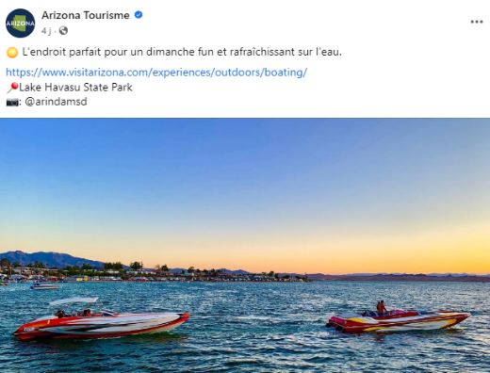
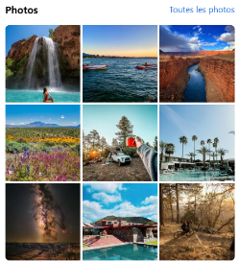
SOCIAL MEDIA: FACEBOOK
2 to 3 posts / week
Top post
124
17
2 450

Slide 32
SOCIAL MEDIA: FACEBOOK
 | FY19 | FY20 | FY21 | FY22 | FY23 | Evolution vs N-1
Page likes (year end) | 5,131 | 5,282 | 5,370 | 7,578 | 7,208 | -4.76%
Followers (year end) | 4,912 | 5,077 | 5,178 | 113,585* | 5,675 | +4.51%
Total reach of the page | N/A | 85,649 | 45,797 | 71,919 | 83,694 | +16.45%
Total engagement | 3,639 | 6,290 | 3,001 | 4,912 | 4,742 | -3.30%
Videos /minutes viewed | 494 | 773 | 1,329 | N/A | N/A | N/A
Average engagement rate | 6% | 9.2% | 6.5% | 6.67% | 6.92% | +3.75%
*NOTE: The huge increase of fans, interactions and reach in FY22 is explained by the fact that Herrmann Global sponsored 4 posts in December running in January on behalf of AOT.

Slide 33
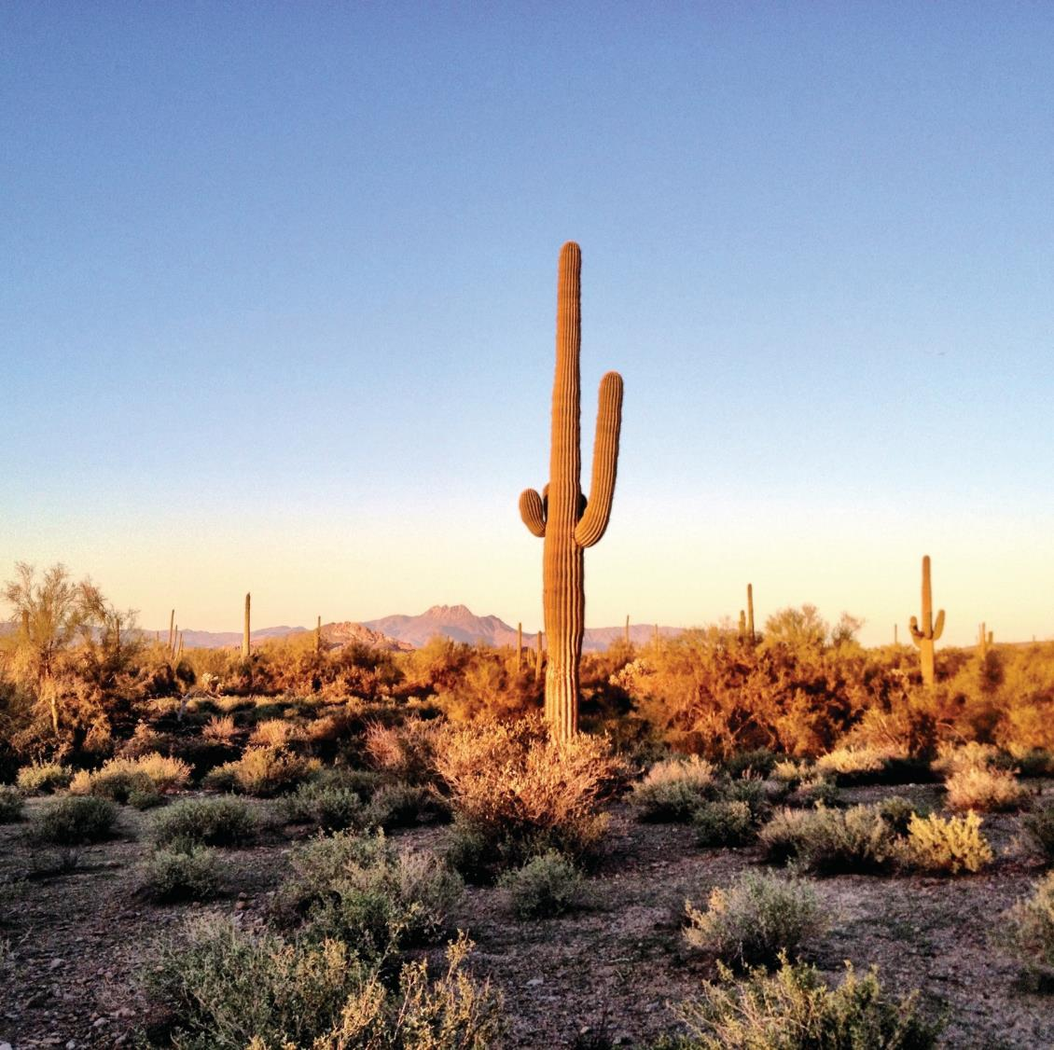
TRADE & MEDIA MISSION

Slide 34
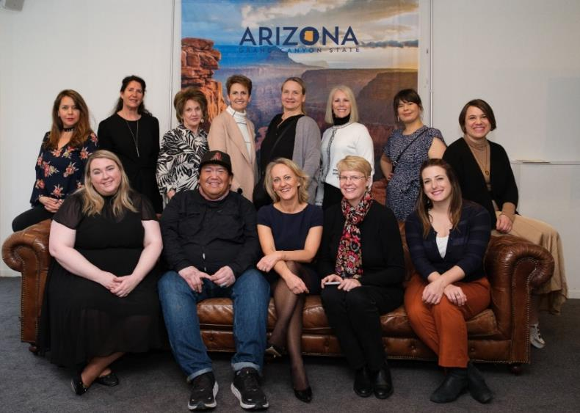



TRADE & MEDIA MISSION
B World Communication hosted a Trade & Media Mission in Paris on March 20th and 21st, 2023, to showcase Arizona to key French media, influencers, and travel professionals
7 partners were part of the delegation with AOT : Antelope Canyon Tours, Discover Flagstaff, Experience Scottsdale, Experience Williams, Cottonwood, Prescott, Visit Glendale, Visit Phoenix, Visit Tucson
BWC organized several media events, as well as meetings and trainings with tour operators and a VIP event

Slide 35

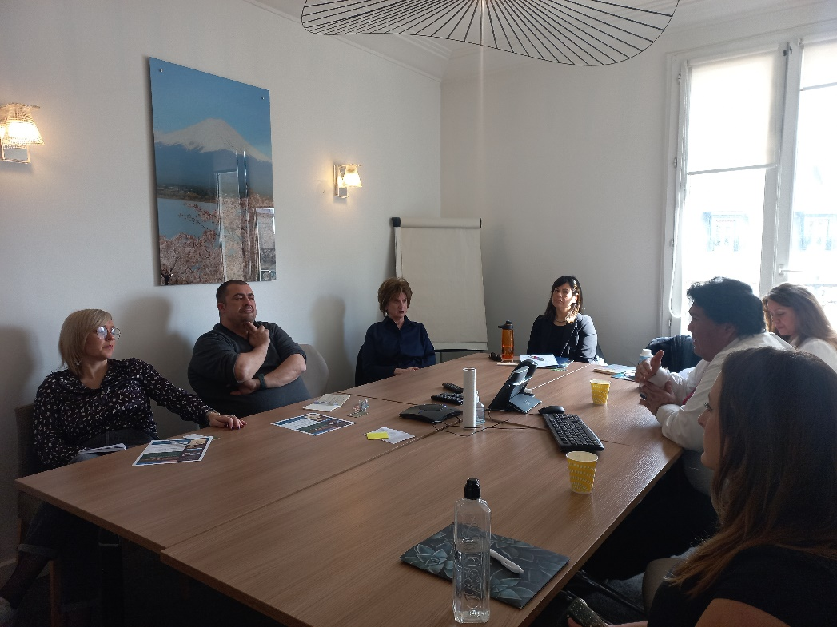
TRADE MISSION
March 20th:
Training sessions at Les Maisons du Voyage (9 agents) and Visiteurs (4 agents)
Trade luncheon with Kelly Tran (AZ Product Manager) from Voyageurs du Monde
Trade meeting with Delphine Pavy (US Product Manager) from Les Carnets de Magellan
March 21st:
Training sessions at Worldia (6 agents) and Cercle des Voyages (8 agents)
Lunch with Gregoire Dutoit (Country Manager) and Anthony Ouinas (Leisure Sales Manager) from United Airlines

Slide 36
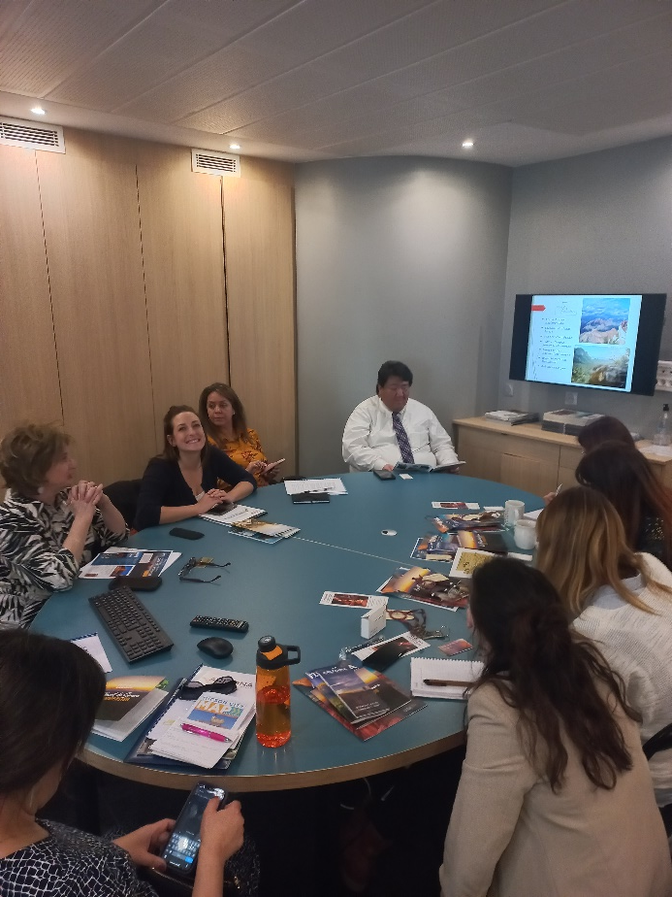
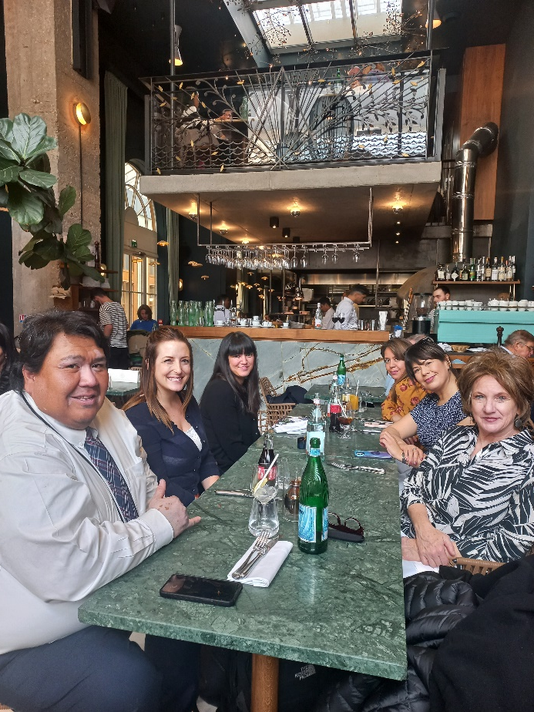
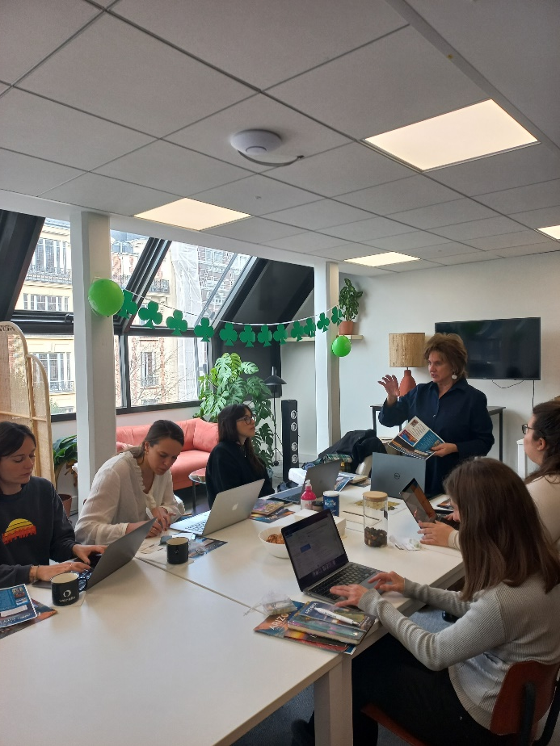
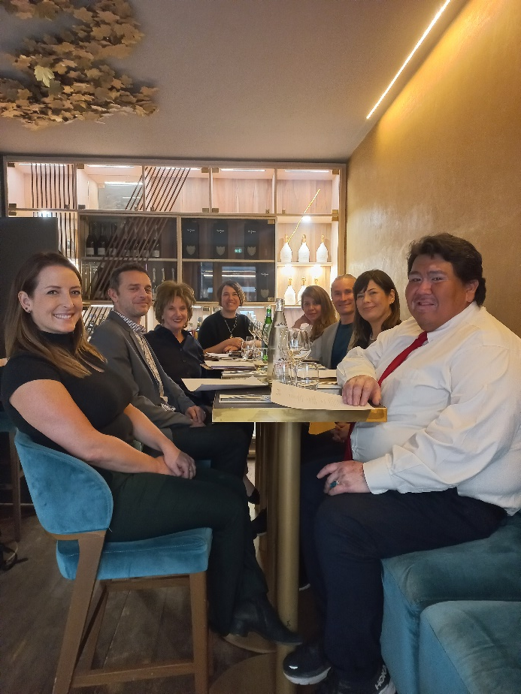
TRADE MISSION
Training Visiteurs
Lunch Voyageurs du Monde
Training Worldia
Lunch United Airlines

Slide 37

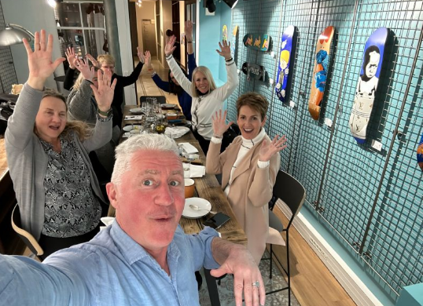



MEDIA MISSION
Media workshop: on March 20th at Le Patio Opera venue with delegates having one table each displaying their brochures and material. The workshop was attended by 7 French media representatives
Media luncheon: on March 20th at Le Shack restaurant with 3 travel writers and AOT + media delegation
Media breakfast: on March 21st at Café Zen with 3 journalists and influencers
Media luncheon: on March 21st at The Hoxton Hotel with 4 travel writers and influencers

Slide 38
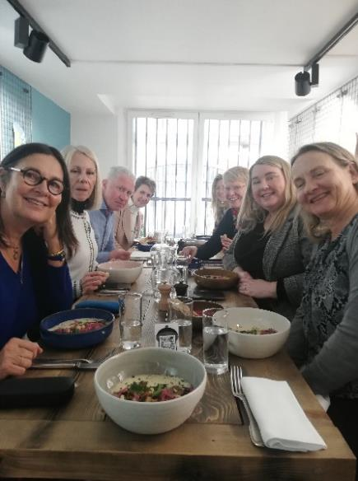
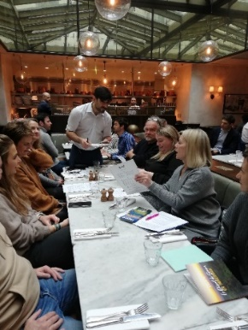
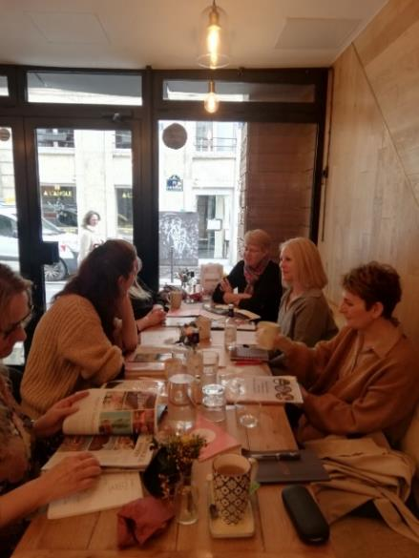
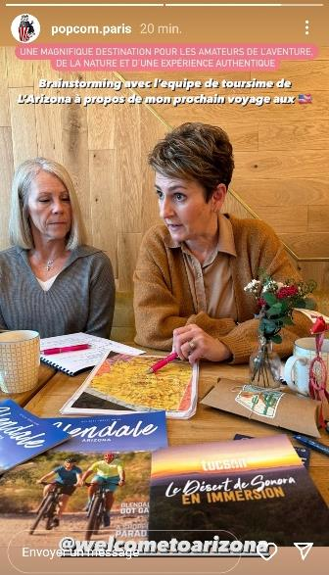
MEDIA MISSION
Media luncheons
Media breakfast

Slide 39

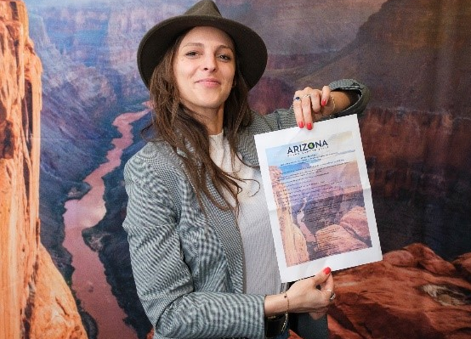



VIP EVENT: MEDIA & TRADE
March 20th , at Le Patio Opéra, from 6:30pm to 10:30pm
60 French travel professionals, travel agents and media representatives
Prize draw: 1st prize: a trip for two including air tickets and 8-night accommodation ; 2nd prize: an Arizona-branded vest ; 3rd prize: a gift basket from Discover Flagstaff
Photo call with a large-scale backdrop of the Grand Canyon with AOT’s logo
Laura Simonetta from Marco Vasco, winner of the 1st prize

Slide 40
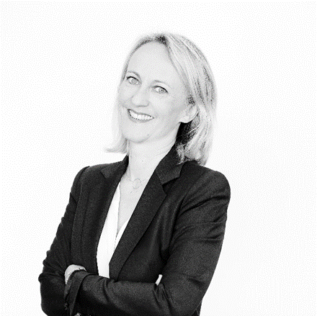
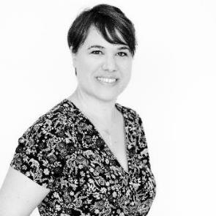
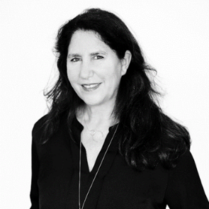
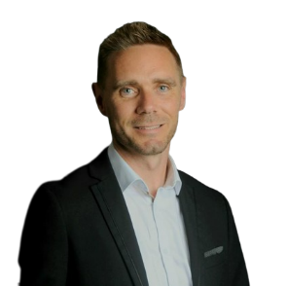

B WORLD
COMMUNICATION
28 rue de l’Amiral Hamelin
75116 Paris – France
Barbara BOLTOUKHINE
Managing Director
Nelly GAULIER
France Trade Manager
bworldcommunication.com
Laura GUARNERI
France PR Manager
Yohann ROBERT
France Social Media Manager

