Slide 1
FY23 US/Domestic Market
GCOT ’23
July 2023

Slide 2
Earned Media:
July 2022-June 2023
Total Impressions:
3,524,807,616 Total Ad Value: $466,880,839
Total Articles Generated:
157
Top-Tier Media Coverage Includes:
The Globe & Mail
AARP
Boston Globe
Brides
Conde Nast Traveler
Daily Beast
Fodor’s
Food & Wine
MSN
Men’s Journal
National Geographic
Newsweek
Paste Magazine
Reader’s Digest
Robb Report
Thrillist
Travel Awaits
Travel + Leisure
TripSavvy
Outdoors Wire
USA Today
Via

Slide 3
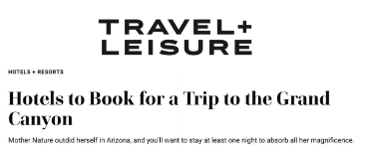
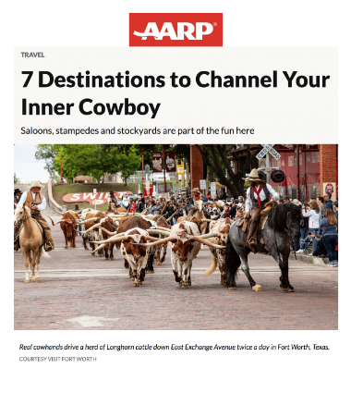
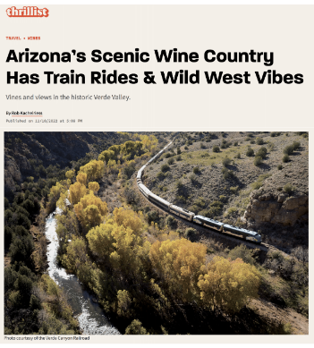
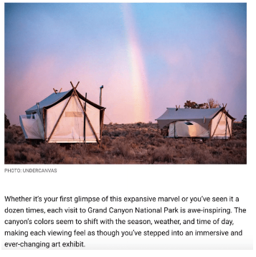
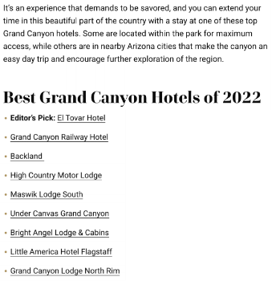
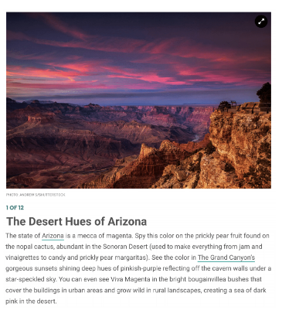
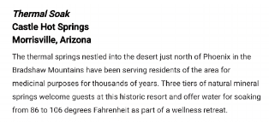
Top Earned Media Articles | FY ‘22 –’23
AARP
Thrillist
Travel + Leisure
Newsweek
Fodor’s

Slide 4
IT Public Relations

