Slide 1
UK Market Update 2023 – Black Diamond

Slide 2
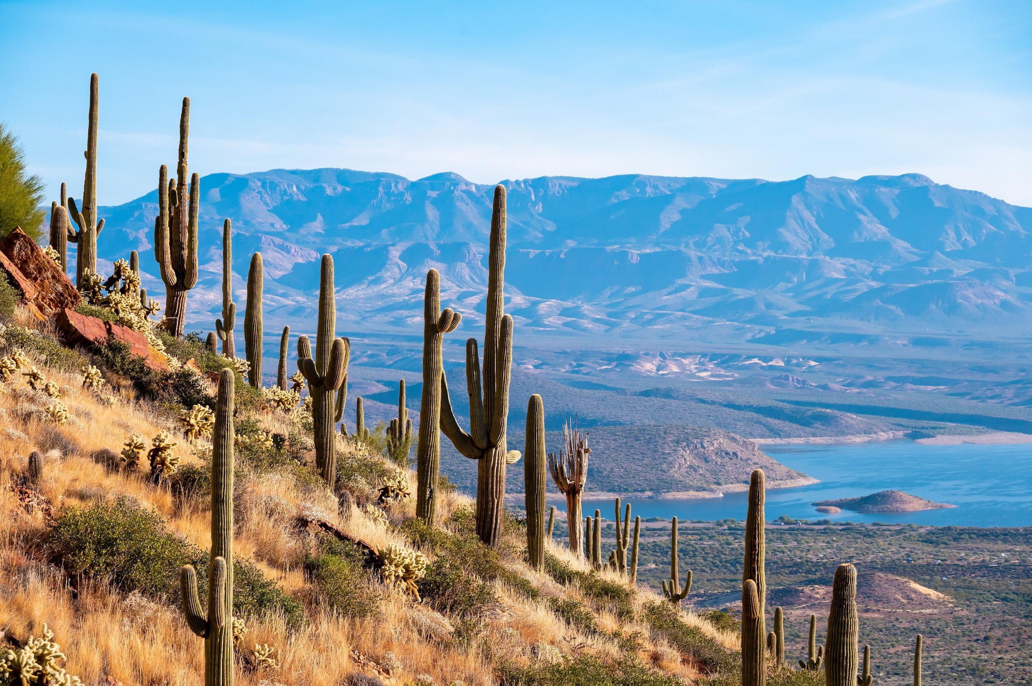
TRADE

Slide 3
Trade Activity - KPI Overview (1 July 2022 - 30 June 2023)
Total number of sales calls: 136
Total number of agents trained:
159
Total number of trade show appointments: 51
Total number of online training sign ups:
121

Slide 4
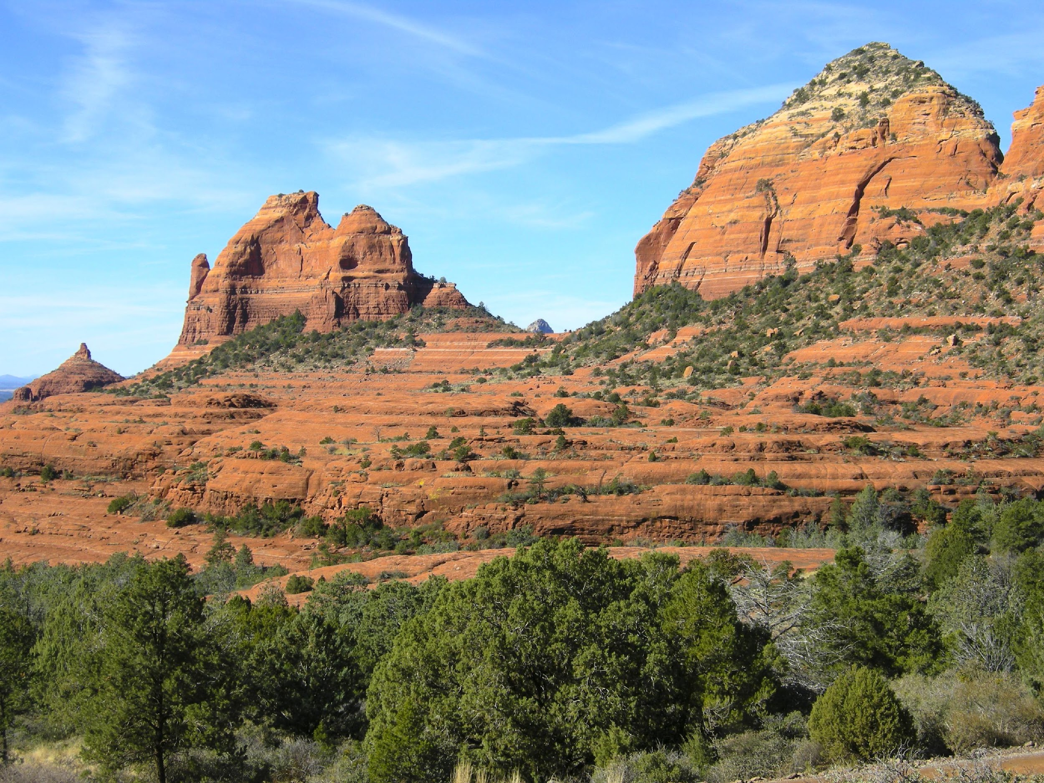
Tour Operator Trainings
Black Diamond conducted training sessions with key tour operator partners, as well as attending training events to meet with and train regional, independent travel agents.
All training sessions covered varied destination news and information, fun facts, suggested activities and experiences, and itinerary recommendations.
Some key training initiatives conducted Nov-Jun:
Travel Bulletin webinar – 38 agents
Hablo training event, London – 95 agents
Lusso training event, Bath - 20 agents

Slide 5
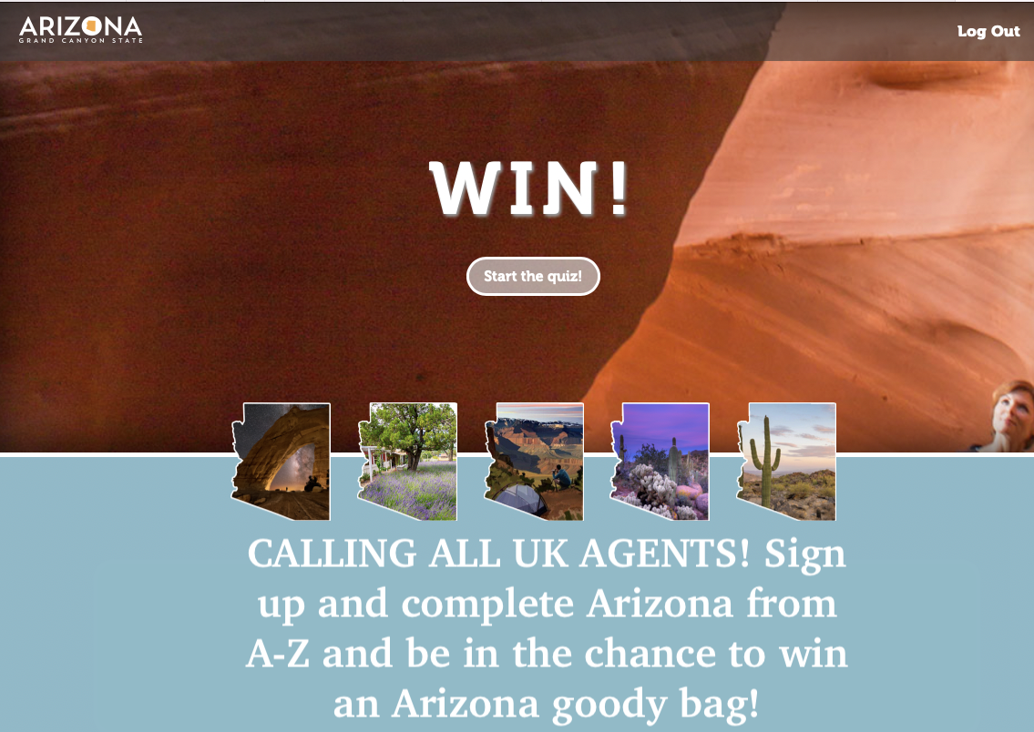
Online Training Programme
Black Diamond generated 45 new sign up’s to the training platform Arizona From A-Z between November ‘22 and June ‘23.
The training platform was actively promoted in trade newsletters, during trade show appointments, virtual or in-person training sessions and email comms.
Between 21st April – 30th June, Black Diamond ran an incentive to drive awareness to the training platform and encourage agents to sign up and complete the training. X3 winners were selected during the incentive period and won AOT promotional items.

Slide 6
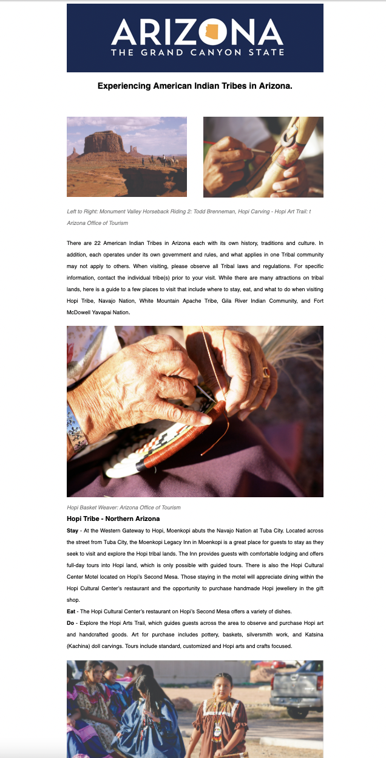
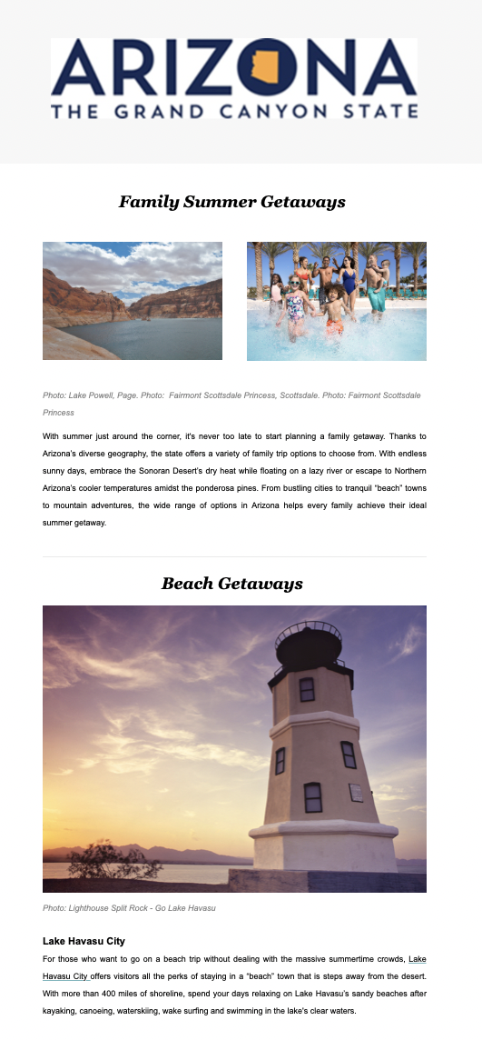
Trade Newsletters
Black Diamond created and distributed a bi-monthly trade newsletter to database of over 3,500 active and engaged travel agents and industry professionals.
Each newsletter incorporated destination news, updates and a range of themes showcasing Arizona’s vast and diverse landscape and tourism offerings.

Slide 7
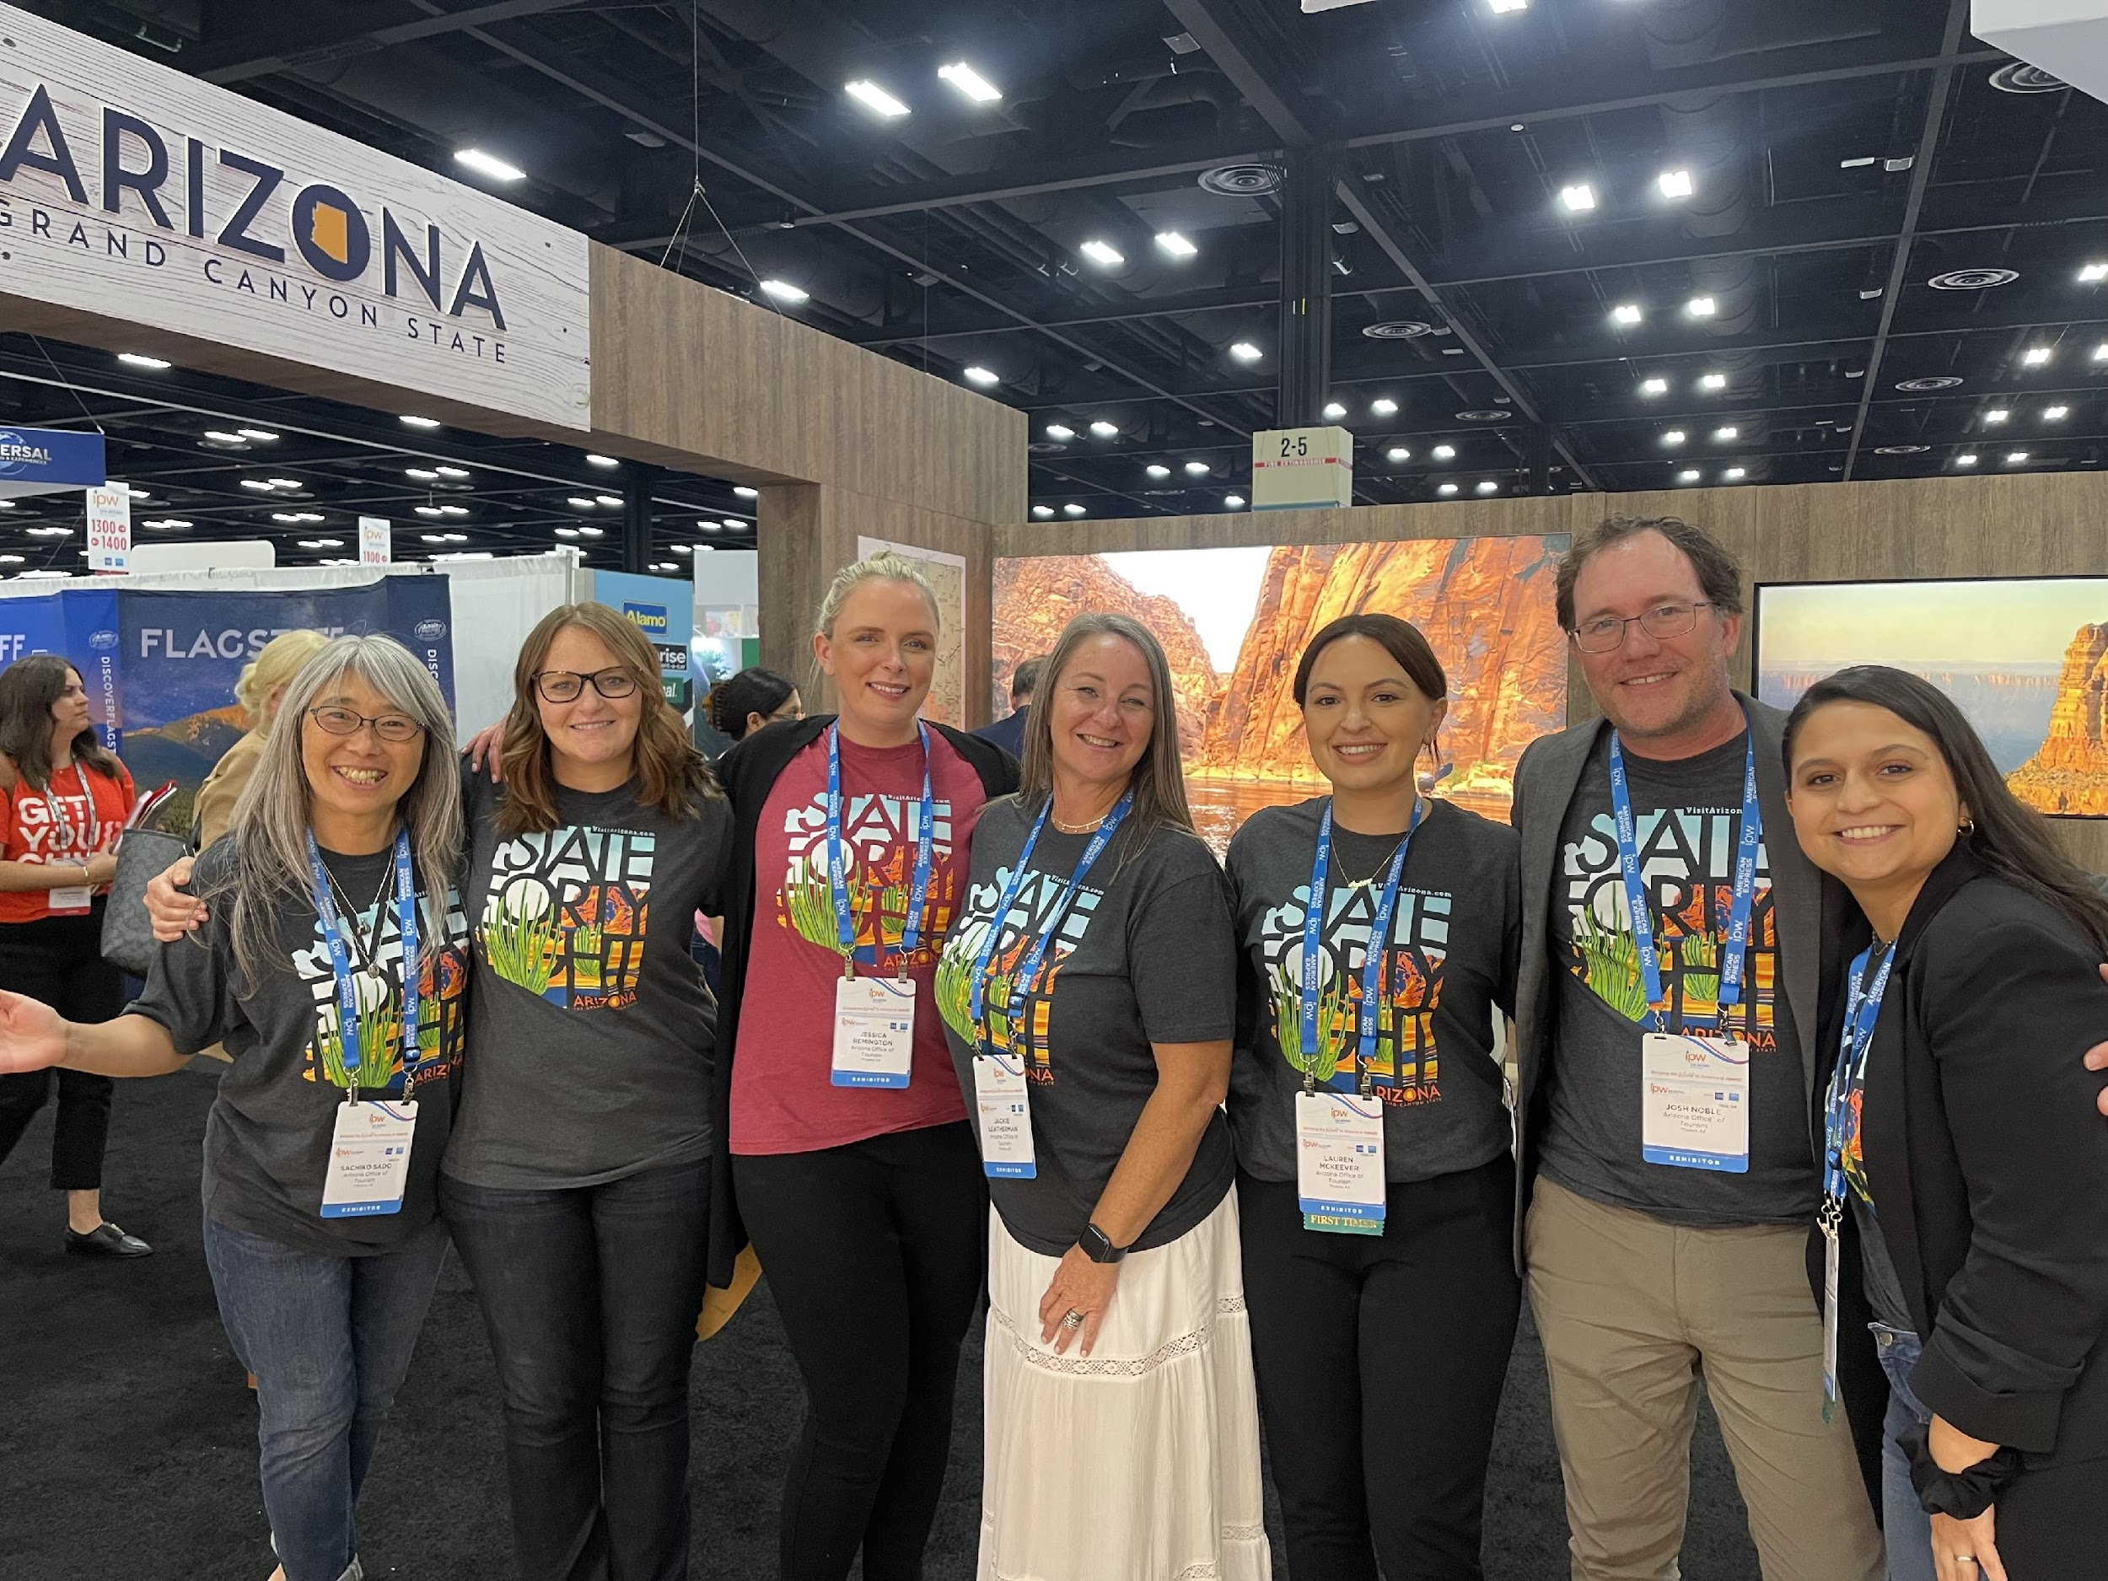
Trade Shows
Black Diamond attended two trade shows representing AOT and had the opportunity to meet with both existing and new tour operator partners to discuss business to date, training and co-op opportunities as well as sharing destination news and information to allow for product development.
14th March 2023 – Unite Visit USA, London
19 trade show appointments
22nd – 24th May 2023 – IPW, San Antonio
23 trade show appointments

Slide 8
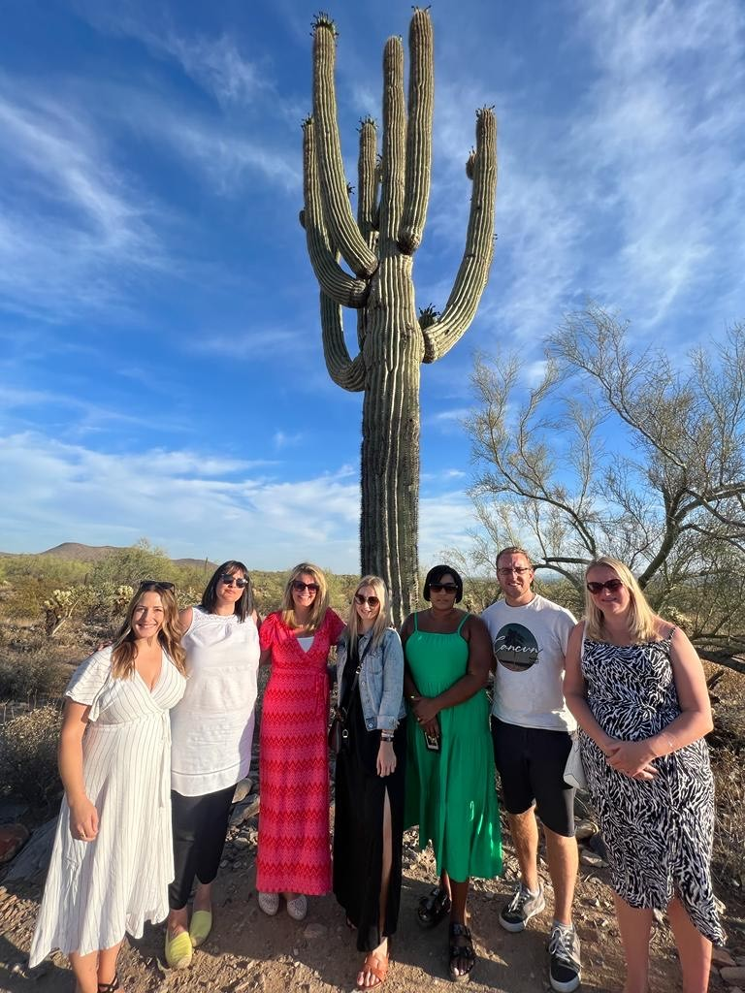
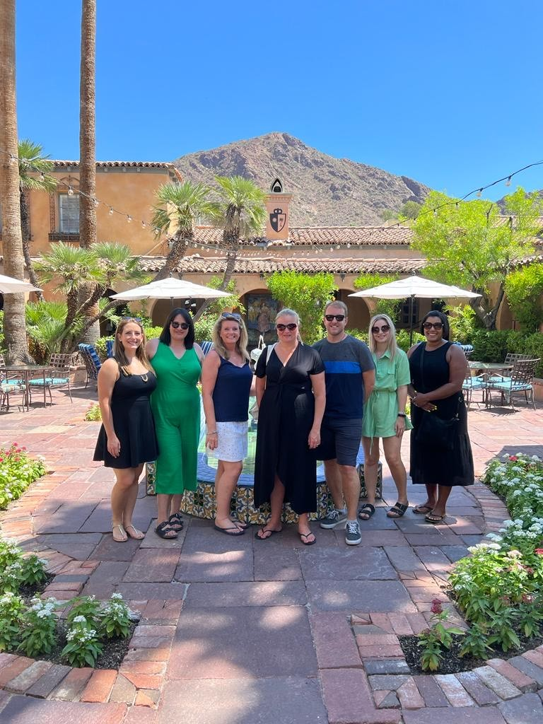
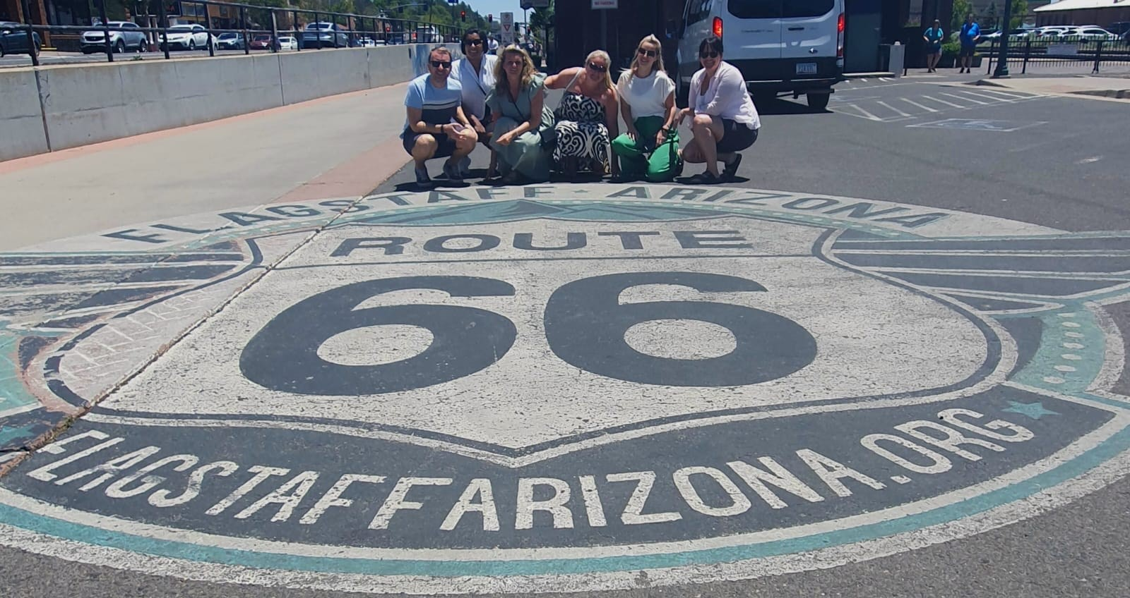
FAM Trip
On the 13th June 2023, Black Diamond hosted a FAM trip to Arizona with 5 sales staff from the following tour operators:
American Road Trip Company
American Sky
Bon Voyage
Lusso Travel
Trailfinders
Over the five days, the group experienced the amazing destination and took part in some fantastic experiences. A few highlights from the trip were, an incredible hosted dinner at Atria in Flagstaff, horseback riding through the desert in Tucson as well as fact filled jeep safari through the desert in Sedona. Over the five days we visited the following destinations: Phoenix, Flagstaff, Sedona, Tucson and Scottsdale.

Slide 9
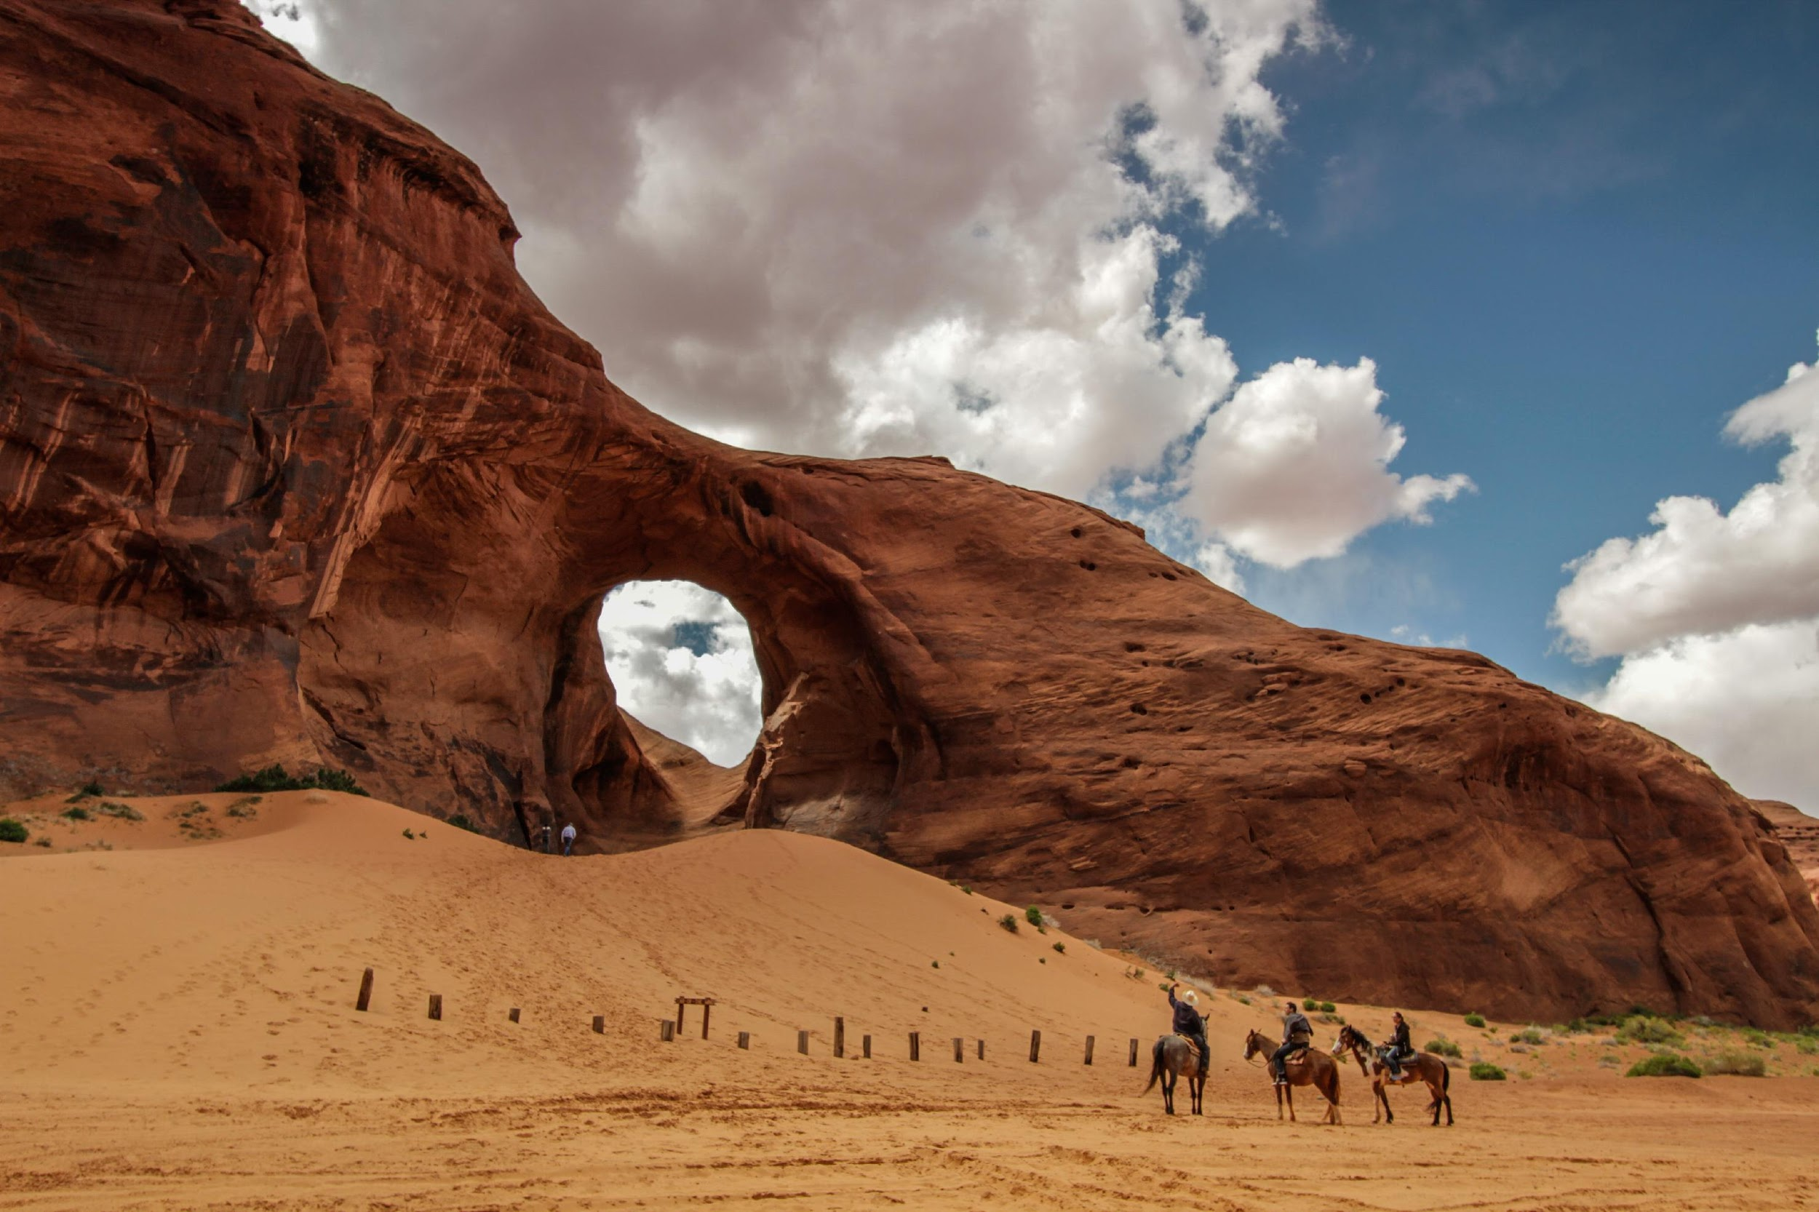
PR

Slide 10
Public Relations - KPI Overview (1 July 2022 - 30 June 2023)
Total number of media hosted: 10
Total coverage AVE:
$1,112,307
Total circulation:
$85,501,127
Total number of pieces:
156

Slide 11
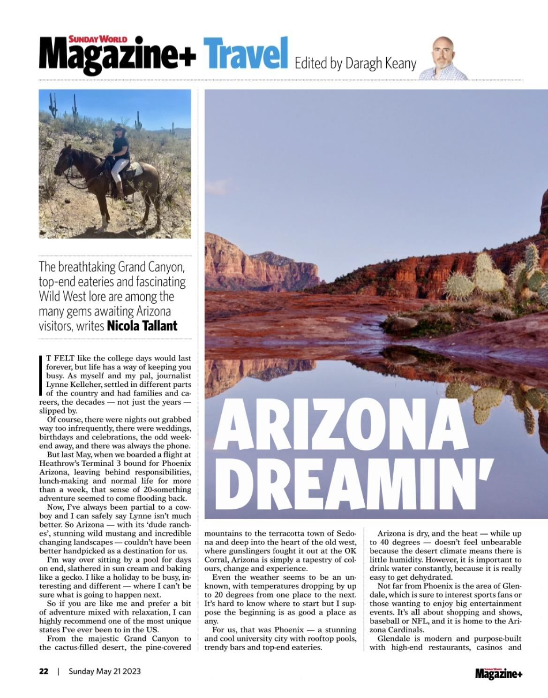
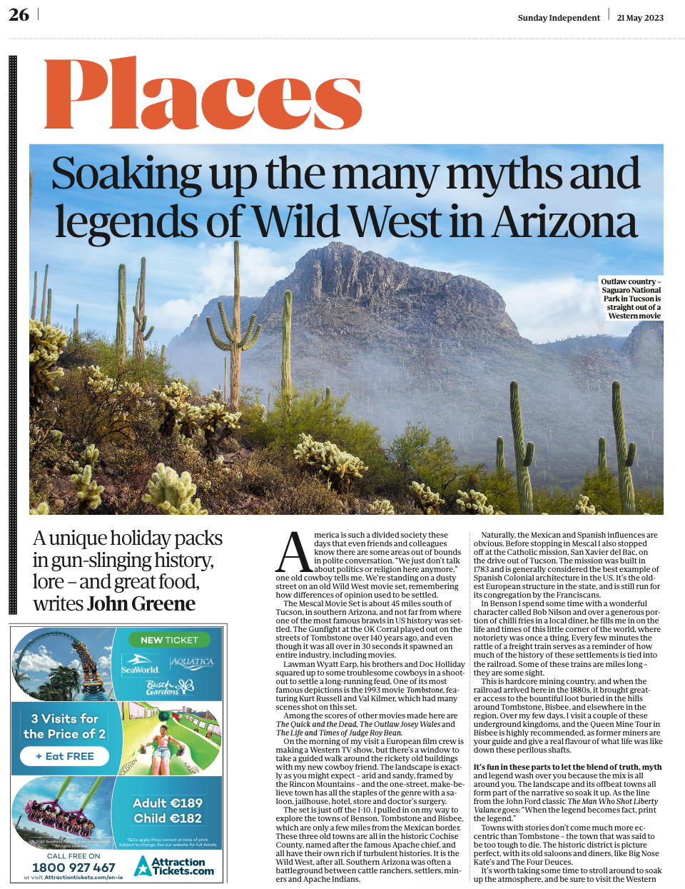
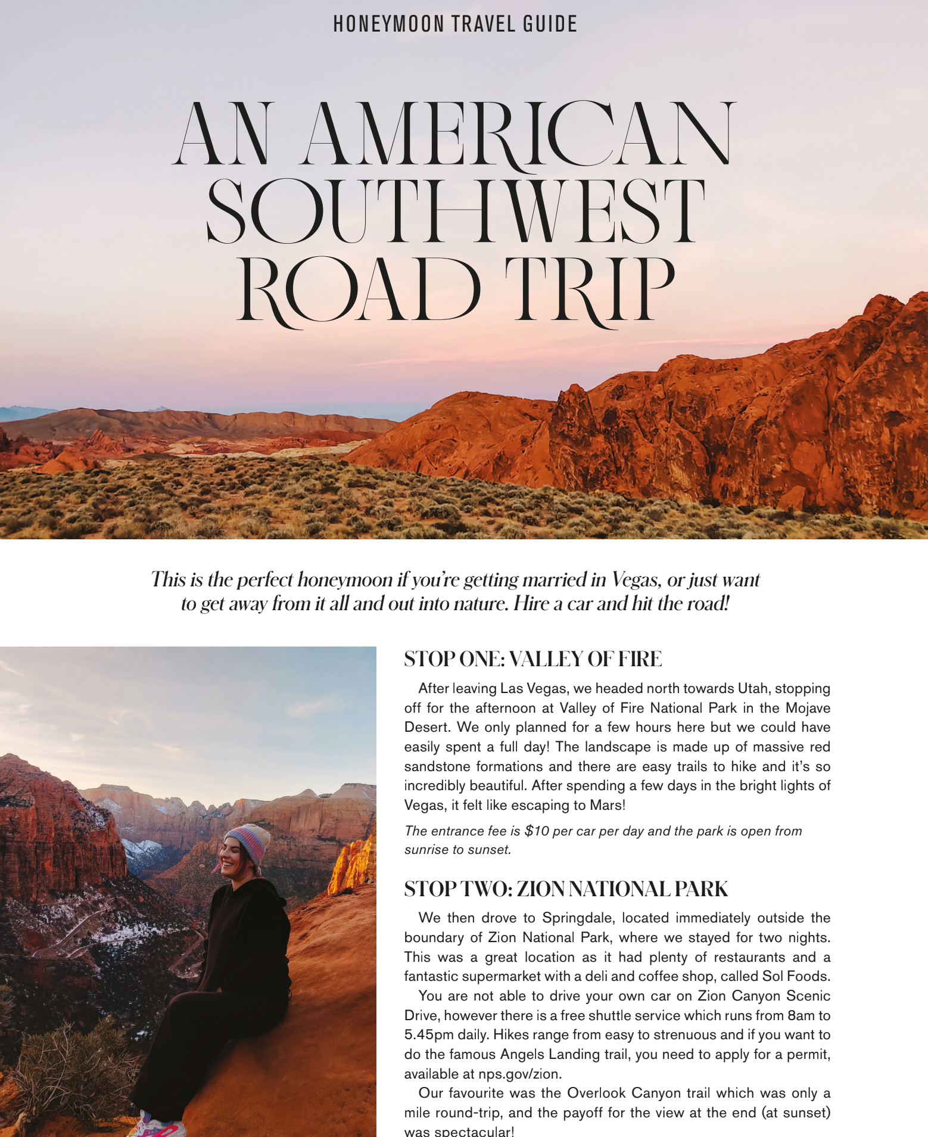
Coverage Highlights

Slide 12
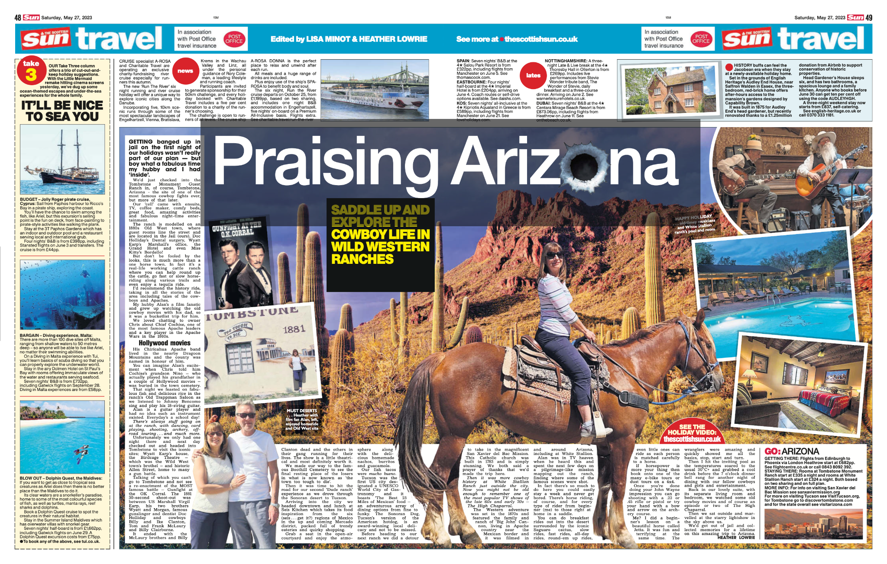
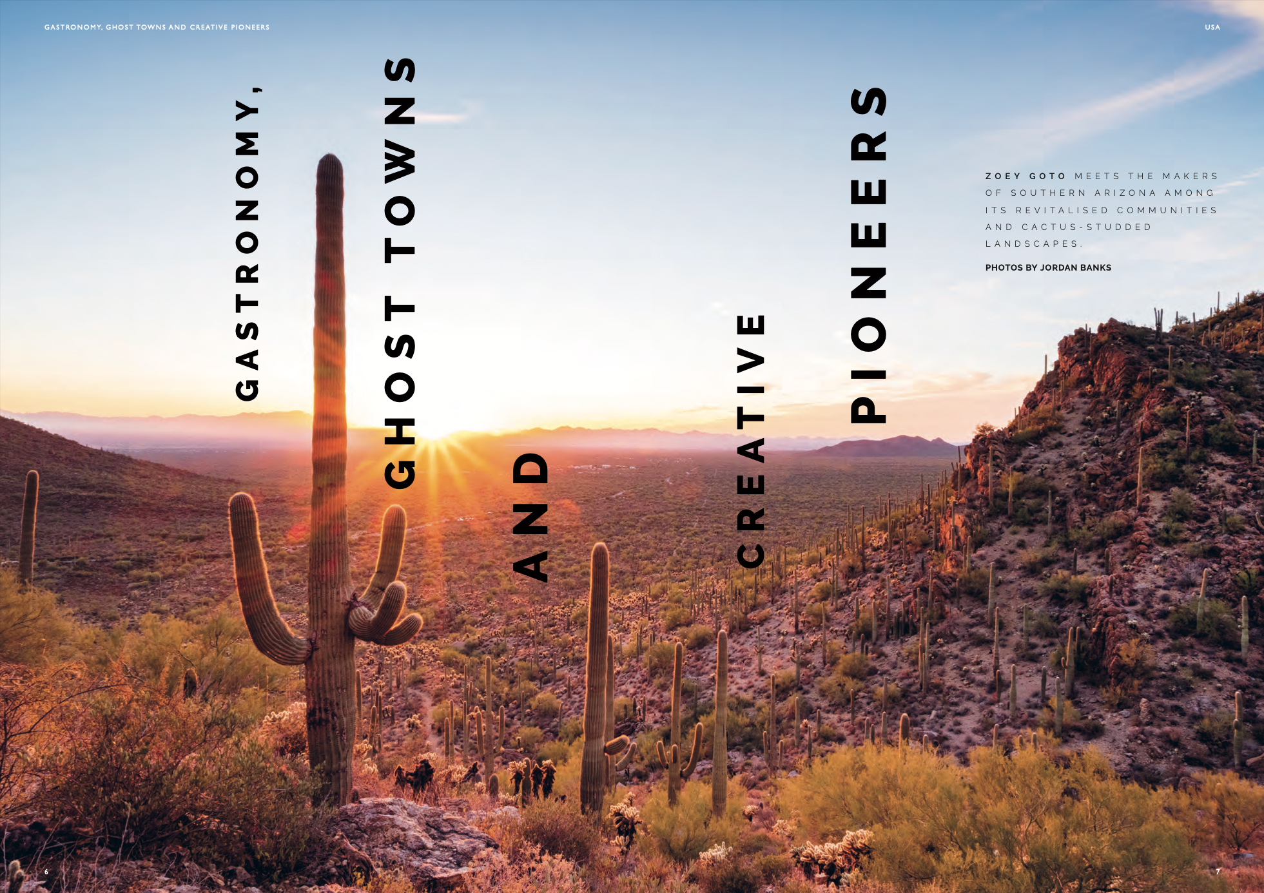
Coverage Highlights

Slide 13
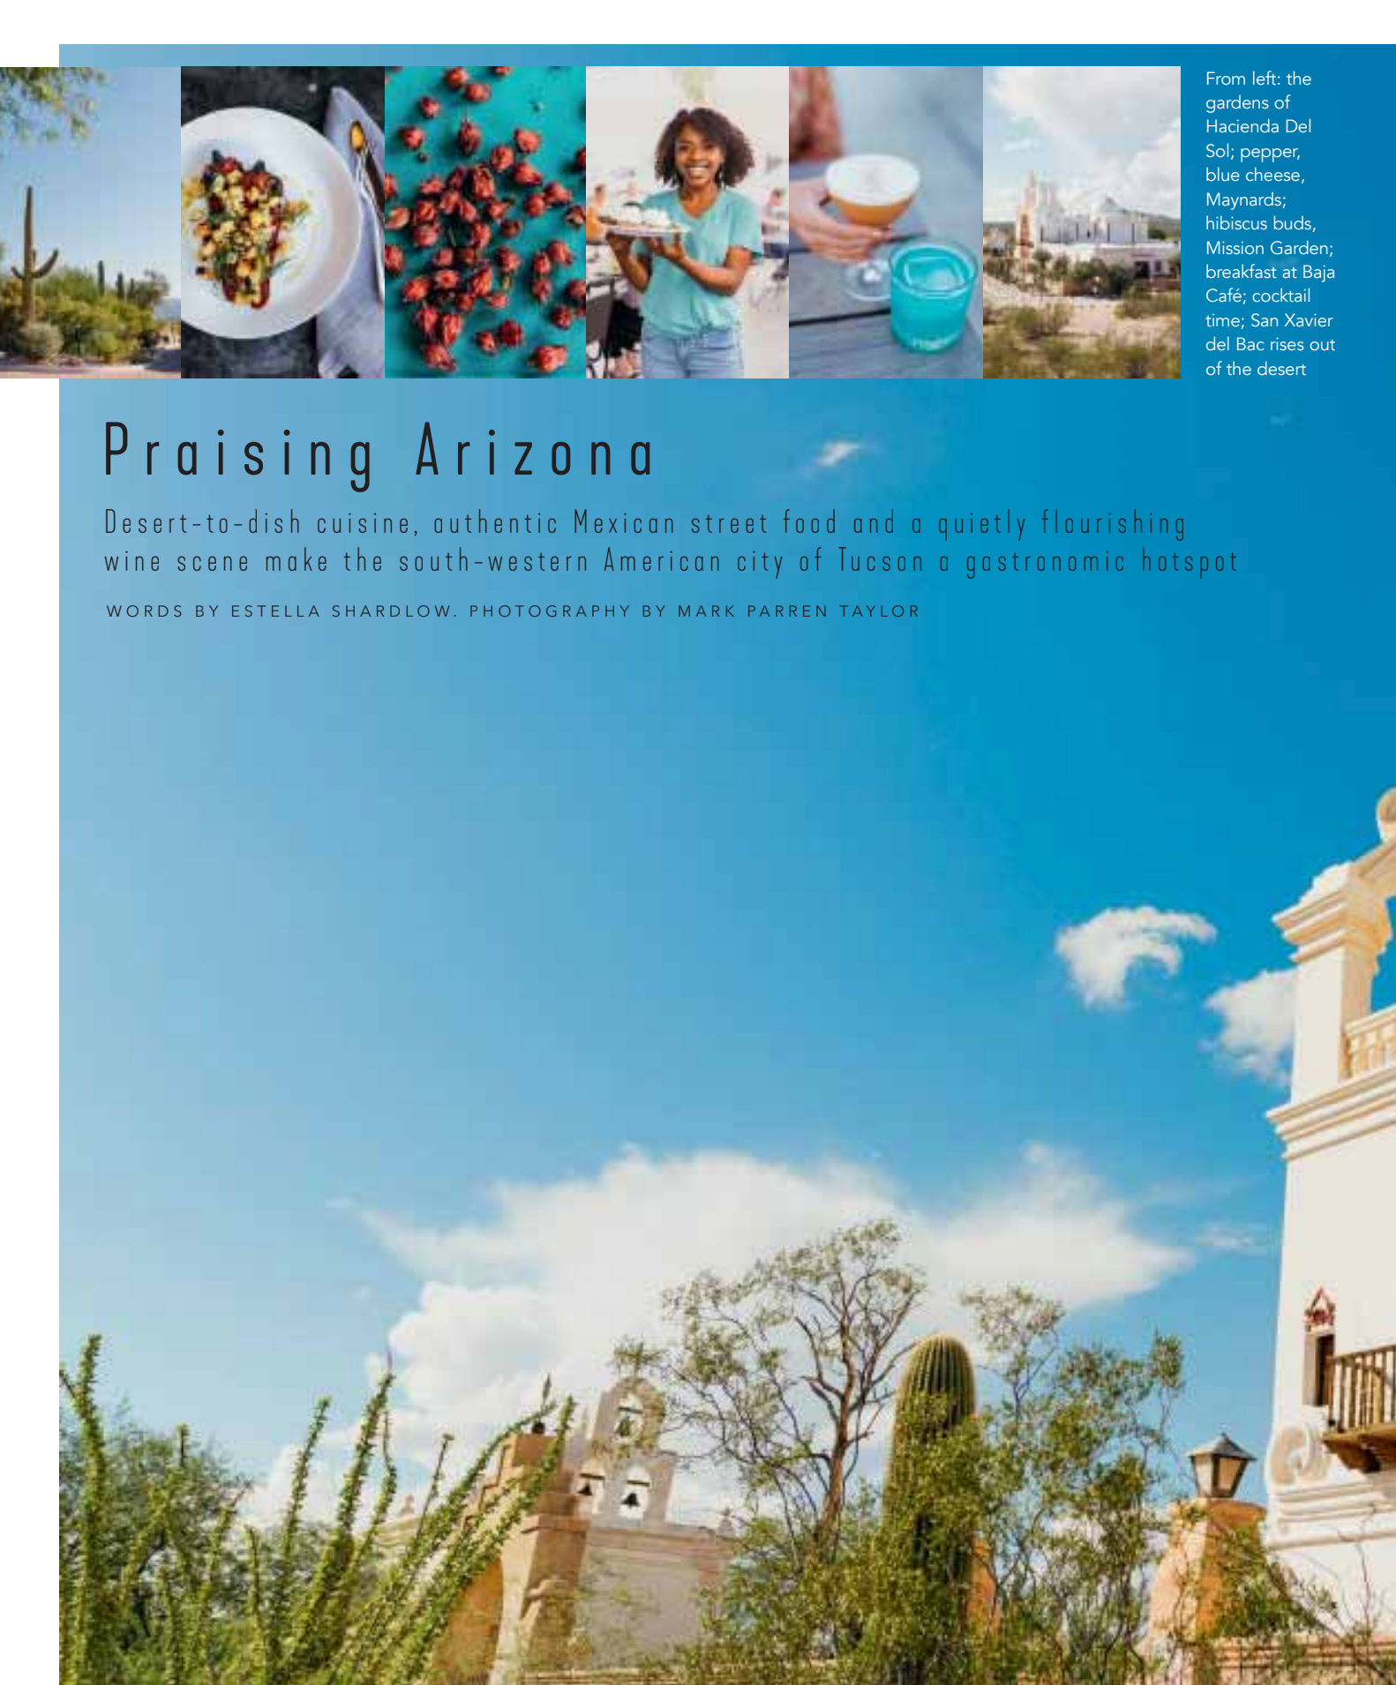
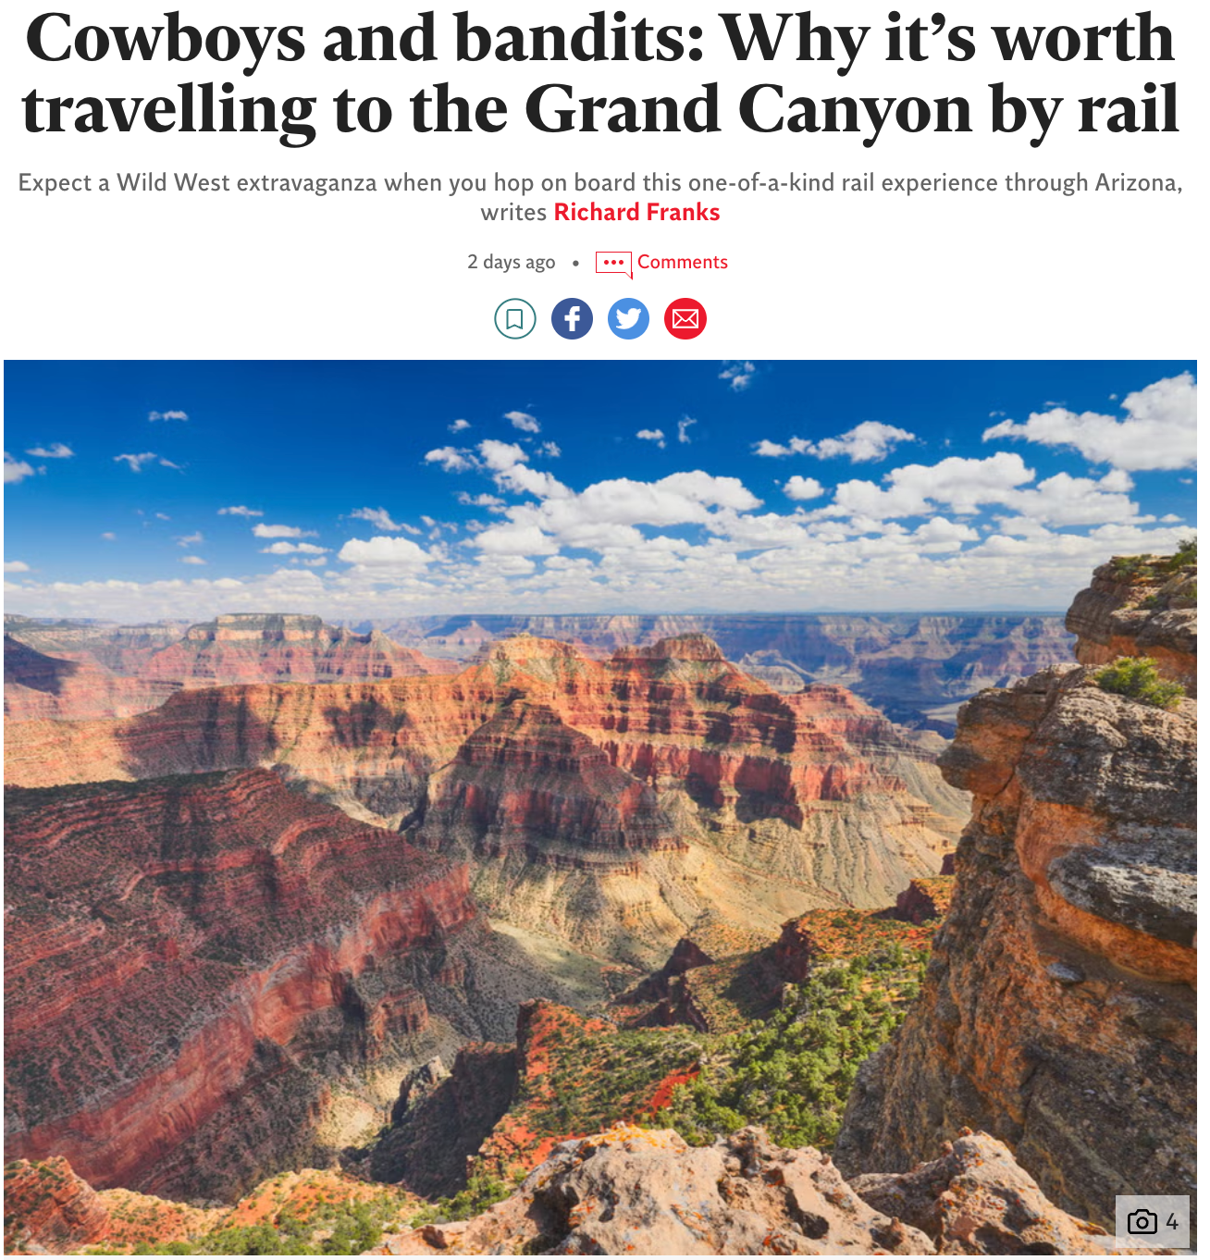
Coverage Highlights

Slide 14
Press Trip Overview
Individual visits (10):
Estella Shardlow - Food & Travel
Heather Lowrie - The Scottish Sun
James Darven - loveFOOD.com, Wanderlust, Daily Mail
Joanna Whitehead – The Independent
John Greene - Irish Independent
Jordan Banks - JRNY
Lauren Jarvis
Mark Taylor - Food & Travel
Richard Franks - The Independent & Adventure.com
Zoey Goto - JRNY

Slide 15
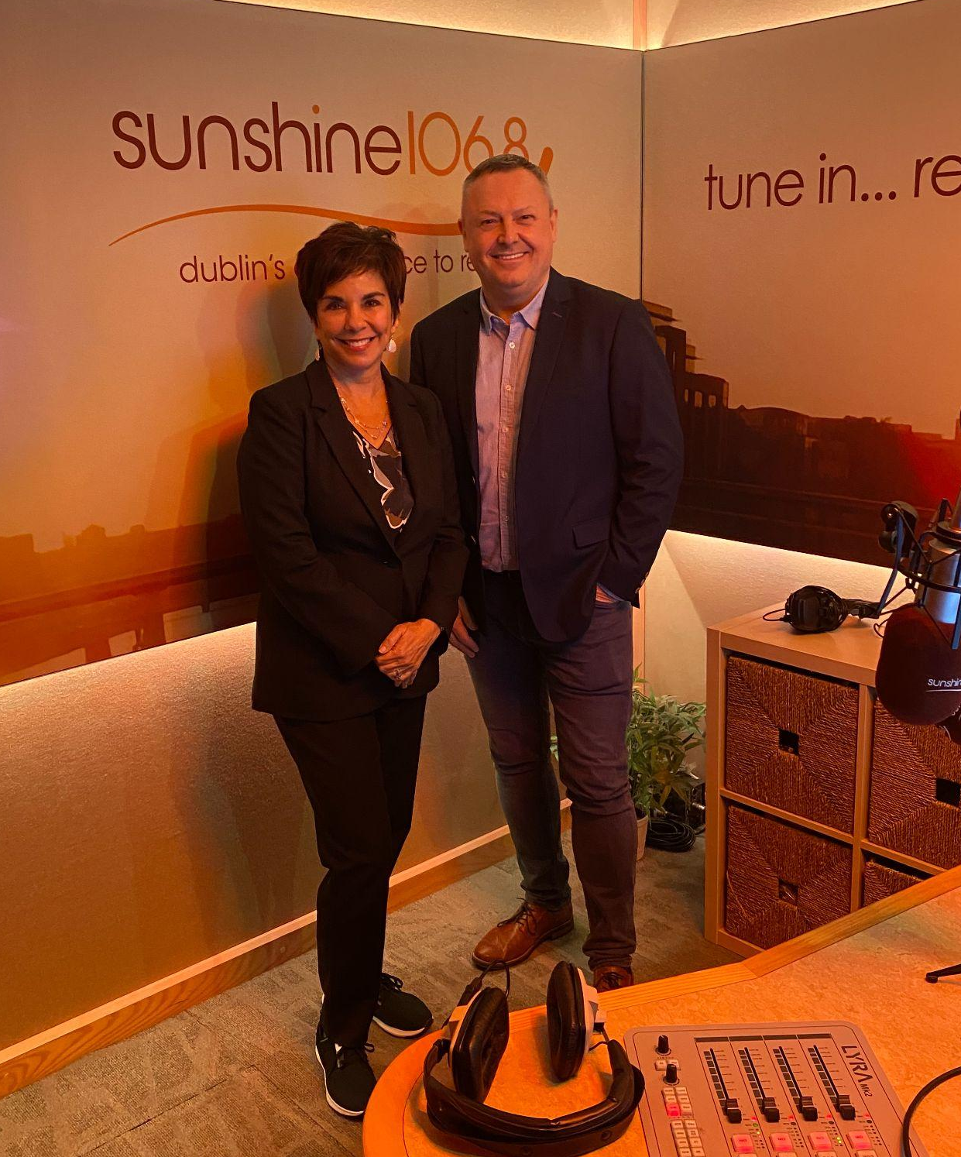
Dublin Media Mission
Executive Director of the Arizona Office of Tourism, Lisa Urias and the Director of Media Relations, Kim Todd visited Dublin for a mini-media mission along with Mary Rittman from Visit Tucson and Laura McMurchie from Experience Scottsdale.
Black Diamond arranged for Lisa Urias to have an interview with radio presenter Ed Finn on Travel Talk show on Sunshine Radio, one of Ireland’s most listened to radio stations. Following the radio interview the AOT team and delegates met at BANG! Restaurant and Bar for an exclusive media lunch with top-tier Irish media. Each of the delegates sat next to the media to allow for 1-2-1 contact time.
Media in attendance:
Ann Mooney, The Irish Sun
Catherine Murphy, Freelance
Daragh Keany, Sunday World
Ed Finn, Sunshine Radio - Travel Talk Show
Fionn Davenport, Ireland’s Travel Trade Network
Isabel Conway, Freelance
Nicola Brady, Freelance
Siobhan O’Connor, Irish Mirror

Slide 16
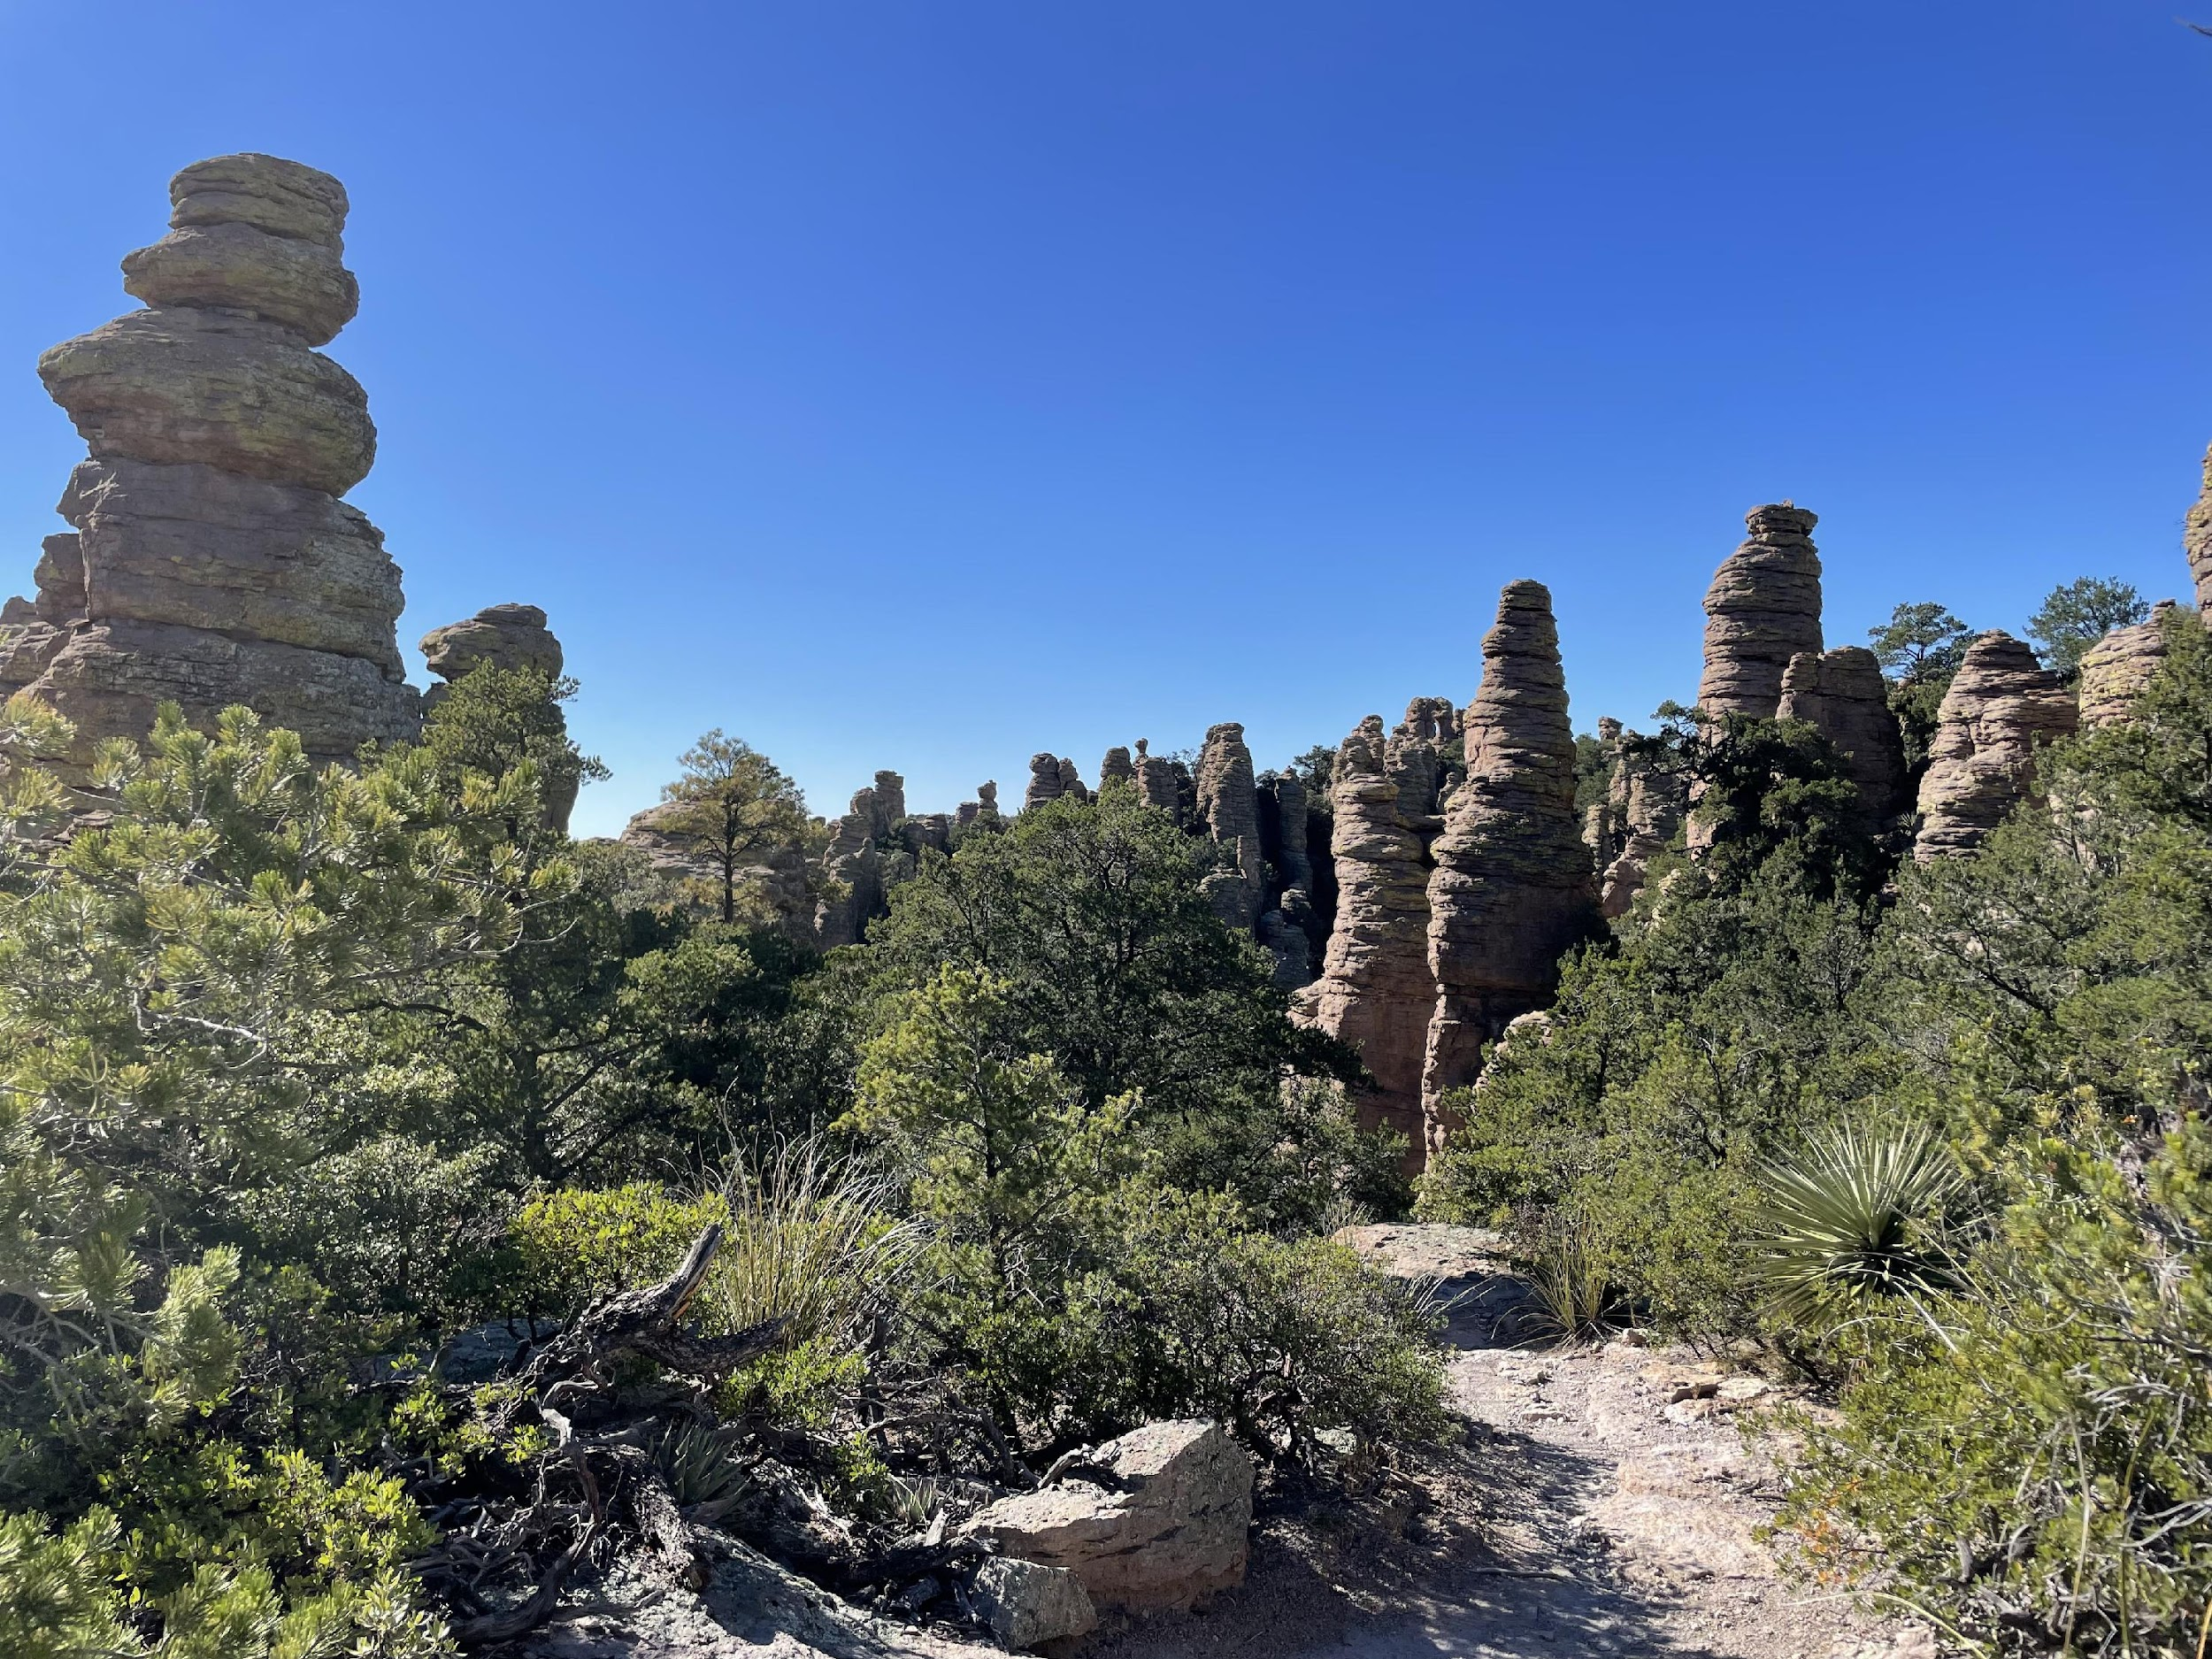
JOINT ACTIVITY

Slide 17
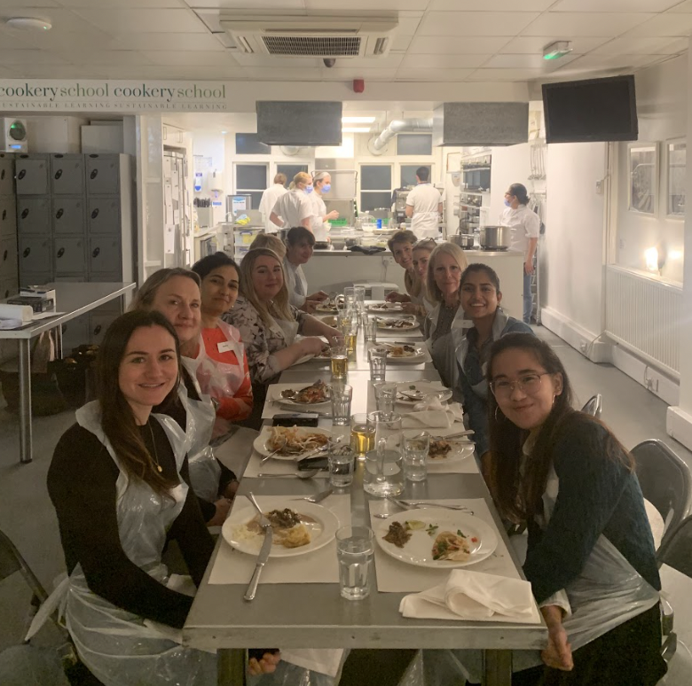
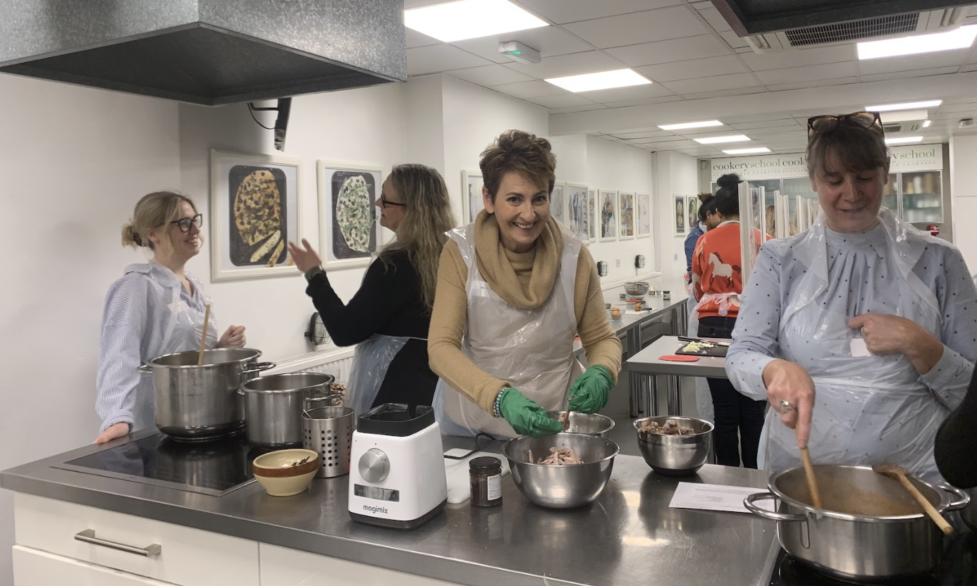
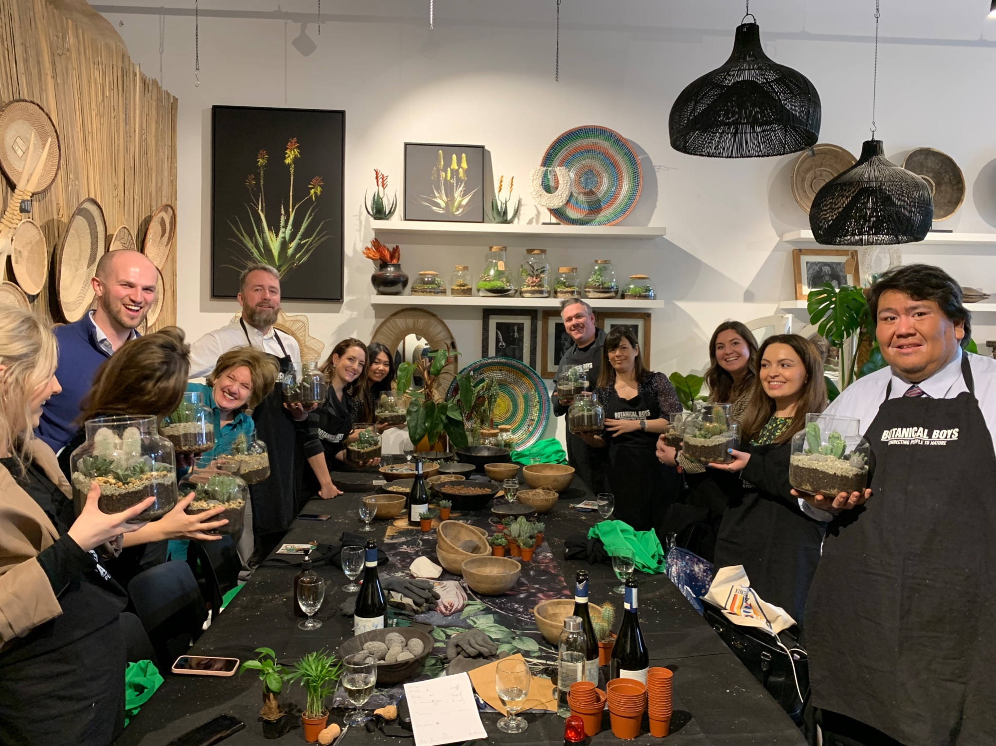
Sales and Media Mission
During the month of March, the Arizona Office of Tourism 2023 Sales and Media Mission took place from Wednesday 22nd to Thursday 23rd, the first mission to be hosted by Black Diamond. The mission took place at a range of different venues across London, with a mixture of activities with Trade and Media guests.
The Black Diamond and AOT team were joined by partners destinations including Visit Tucson, Visit Phoenix, Discover Flagstaff, Experience Scottsdale, Antelope Canyon Tours, Williams Cottonwood and Prescott and Visit Glendale.
The two-day mission consisted of two product manager workshops, two media workshops and a joint trade and media evening event. Across all events AOT and partners met with 30 trade and 24 media.

Slide 18
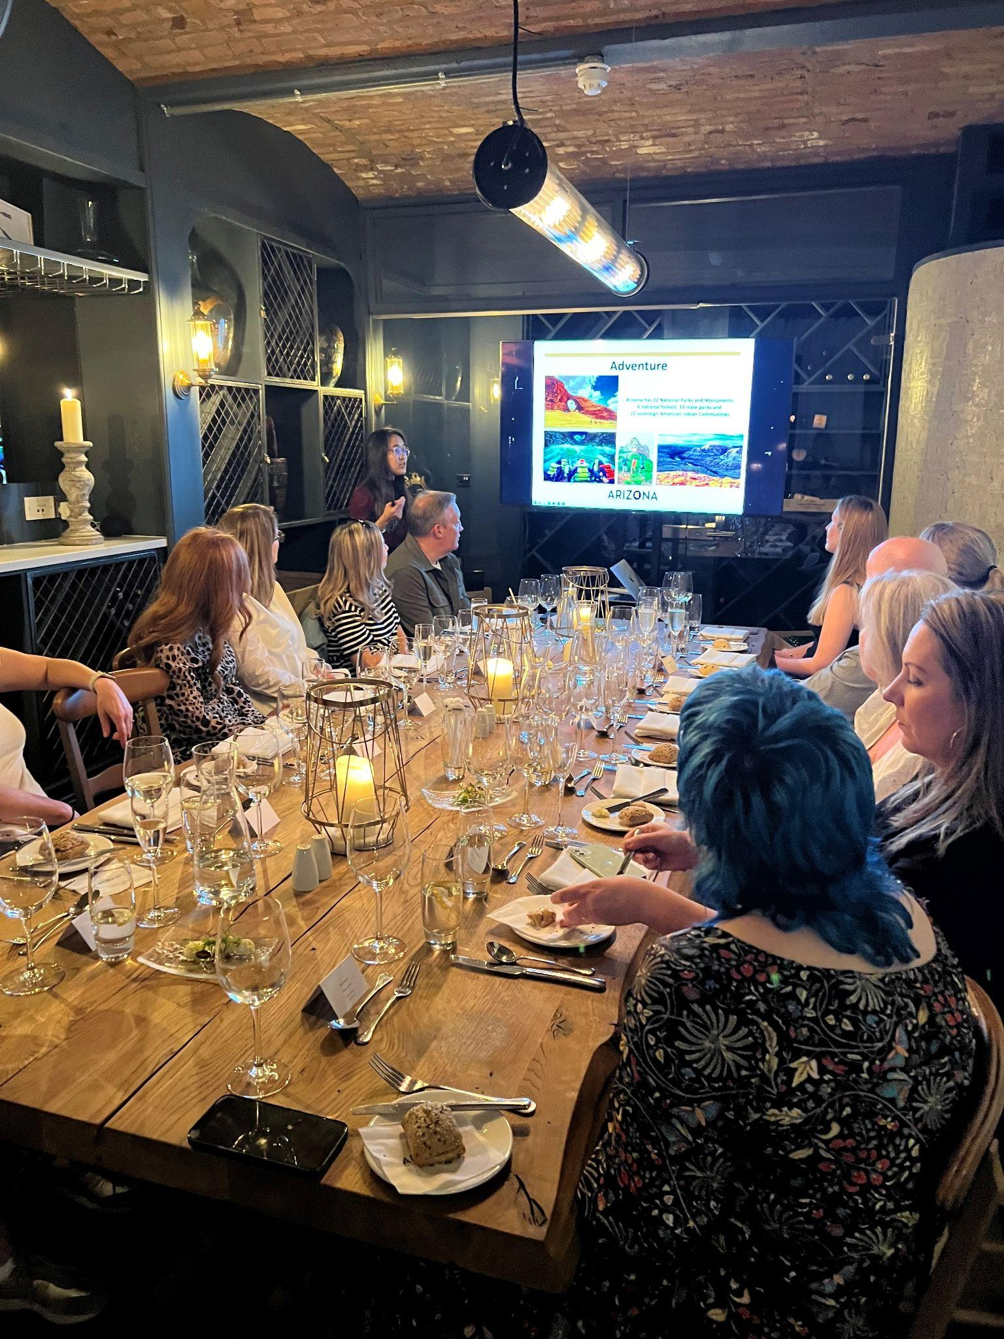
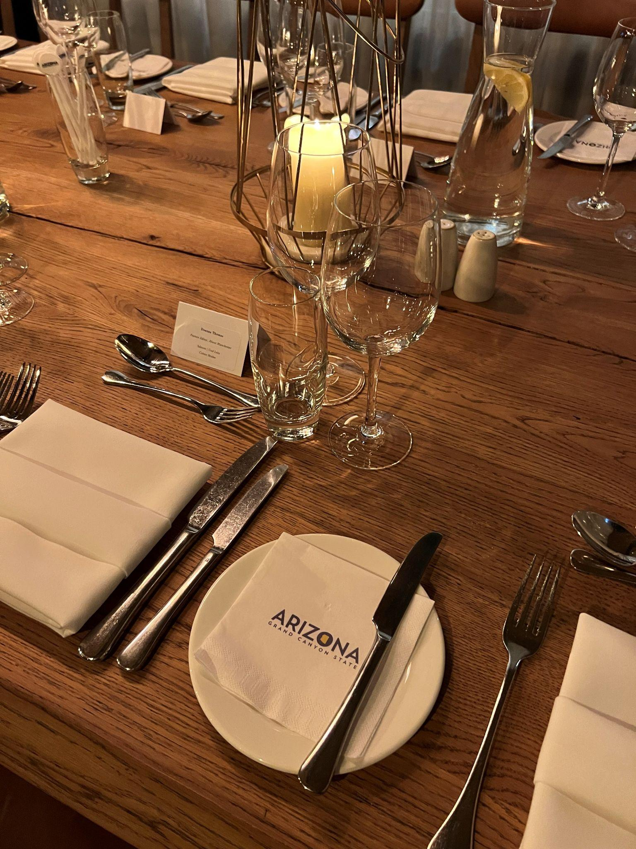
Trade and Media Event, Manchester
Black Diamond arranged a private dinner event at King Street Townhouse to meet with Trade and Media based in Manchester.
Black Diamond started the event with a presentation, sharing information on the lesser-known aspects of Arizona and new developments for 2023 and 2024.
Media Attendees:
Ailish McDonnell, VIVA Manchester
Cathay Toogood, Freelance
Deanna Thomas, About Manchester
Emma Chadwick, - VIVA Manchester
Kelly Bishop, Freelance
Louisa Gregson, Freelance
Trade Attendees:
Sarah Gibbons - Lusso Travel
Clare Sheldrick - Lusso Travel
Danielle Williams - Travel Counsellors
Chris Nielsen - American Road Trip Company
Maria Garcia - FC Travel
Steve Blackburn - North America Travel Services

