Slide 1
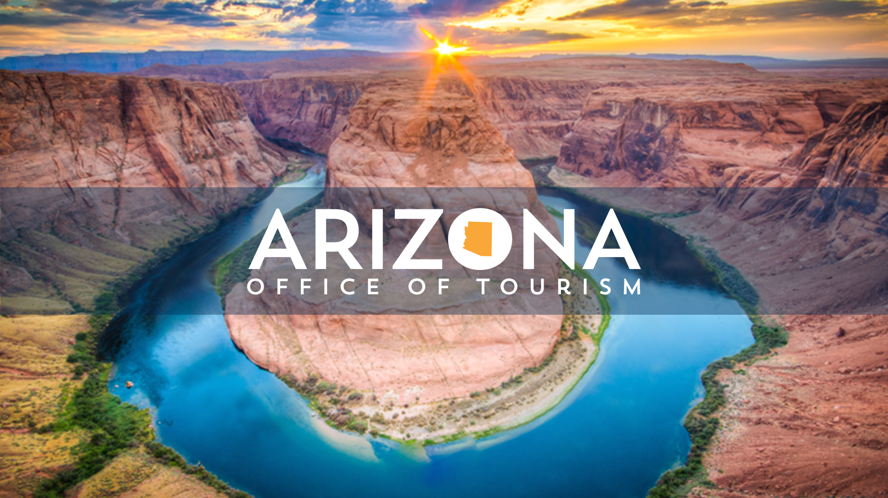

Market Update

Slide 2






General
Facts
Currency exchange
MXN vs USD is determined by market forces (floating exchange rate/free float regime)
Official name: Estados Unidos Mexicanos
Population: 132.9 million
80 million
Labor force
Mexico is among the world's 14 largest economies; 2nd in Latin America.
Mexico is the 2nd inbound market for U.S.A. with 12,534,501 arrivals in 2022.
Arizona is the 9th destination for Mexicans, and Phoenix is the 14th top city.
29 Average age
52% Female
48% Male
2.8%
Unemployment
7.82%
2022 Inflation rate
Sources: National Travel and Tourism Office 2022, Destination Insights by Google

Slide 3

AVERAGE
49%
CONTENT
BY
FORMAT TYPE
DIGITAL ERA
36%
87% of travelers use social media to share their travel experience
26%
12%

Slide 4





79% OF THE
POPULATION IS CONNECTED
100.6 MILLION
INTERNET USERS
OWN:
99%
62%
49%
41%
27%
MOST USED
SOCIAL MEDIA
92.9%
92.2%
Smartphone
Laptop
Desktop
Tablet
Smart tv
CONNECT ON:
90%
70%
40%
32%
45%
PAYMENT METHOD ONLINE SHOPPING
VIDEO CONTENT
79.4%
73.6%
53.7%
33%
67%
97%
Music videos
Movies
Mobile Wallets
46%
Debit and credit cards
86%
84%
Movie trailers
Tv series
7%
Bank transfers
6%
Source: Digital 2023: Mexico
Cash-On-Delivery

Slide 5





Local Market
____
Insights
100.6 Million
internet users.
Thursday
is the preferred
travel departure
day for Mexicans.
1 in 3 consumers planning upcoming business travel.
1 in 2 likely to travel internationally in the next 12 months.
56% of travel reservations are made through mobile devices.
70% of Internet users in Mexico have access and share their trip planning to social media.
Source: 1st Party Expedia Group Booking data (Travelers) 2022
Notes:
55% of all reservations are still made through a travel agent.
Look no book market

Slide 6
LOCAL MARKET INSIGHTS
FACTORS WHEN CHOOSING A TRAVEL DESTINATION
TOP USA destinations for Mexican Travelers
Los Angeles
ACCOMMODATIONS
46%
GASTRONOMY
45.0%
ENTERTAINMENT
36%
SHOPPING
32.0%
New York
80% of Mexican travelers preferred a destination in United States.
Mexicans spend over $20 million USD in travel every year. Only Canadian and Chinese travelers spend more.
12.5 Million Mexican travelers visited the USA.
Consumers’ top priority when booking travel:
1. Atypical low pricing
2. Ability to get a full refund
3. Flexible cancellation policies
Las Vegas
Chicago
Houston
Sources: Expedia – Traveler Value Index 2023, 1st Party Expedia Group Booking data (Travelers) 2022, Destination Insights by Google

Slide 7
According to the US Department of State,
between 2013 and 2022
a total of
13´696,605 Nonimmigrant visas
were issued to Mexicans
(including Border Crossing Cards)
There is an evident recovery after the pandemic,
passing from 1.47M visas issued in 2019 to
960 K in 2020,
910 K in 2021 and
1.728 M in 2022
Source: Report of the Visa Office 2022/ U.S. Department of State - Bureau of Consular Affairs

Slide 8
Top 5 Channels Used in Destination Selection
58% Websites via computer or laptop
50% Websites or applications via mobile phone
45% Personal recommendations from family or friends
41% Websites or applications via tablet
28% Online advertising/email
Source: Brand USA Research Study, 2023

Slide 9
SOURCES USED FOR TRIP PLANNING
66.6% Airlines
31% OTA
30% Personal recommendations
10% National State/City/Travel Office
6.8 Corporate Travel Department
6.1% Travel Agency
4.7% Travel Guides
4.1% Tour Operators
Source: National Travel and Tourism Office, 2023

Slide 10
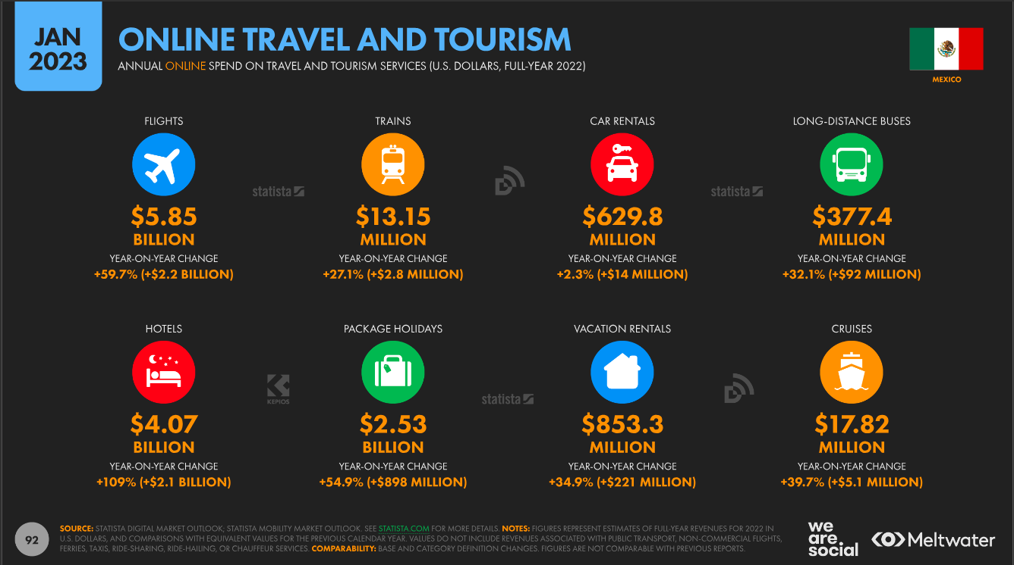
Source: Digital 2023: Mexico

Slide 11

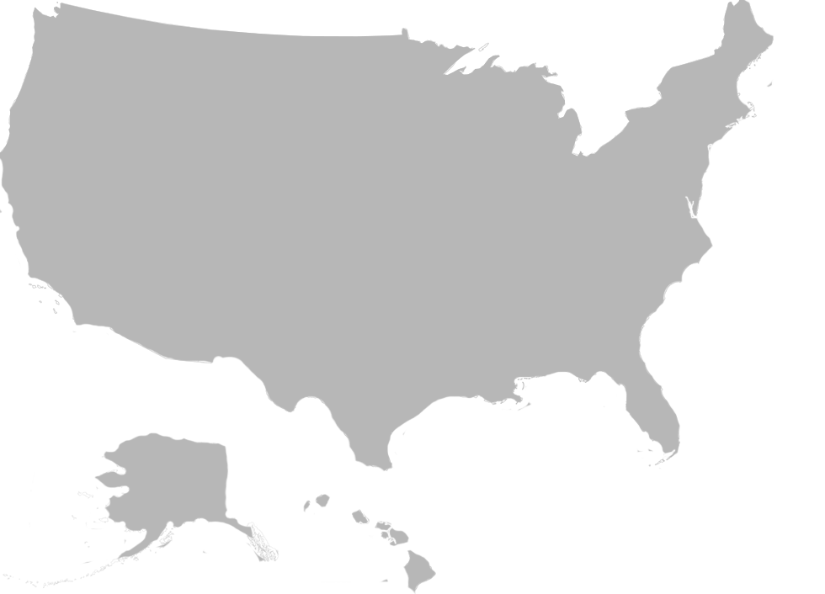
TOP ACTIVITIES WHILE TRAVELING IN THE USA
85.7% Shopping
59.5% Sightseeing
25% Amusement/Theme Parks
23.9% National Parks & Monuments
20% Experience Fine Dining
18% Art Gallery/Museum
17% Small Towns
15.1% Historic Locations
12.4% Sport Events
9.7% Cultural/Ethnic Heritage
Source: National Travel and Tourism Office, 2023

Slide 12
DETERRENTS
Thousands of people are still waiting for their visa renovation, which has become an issue, especially for the drive market.
Revenge travel is taking Mexican travelers beyond the American Continent.
Some people do not feel welcome in the USA or have concerns about their personal safety.
Despite the fact that the exchange rate seems to be positive for the Mexican traveler, there is a sense of uncertainty about the economy in the medium term; especially ahead of the elections quickly approaching.
TO VISITING
THE USA

Slide 13
22-23
OVERVIEW
End of pandemic
Eclectic year because of Mexico public policy
  Ukrainian war
  Global changes affecting everywhere
  FAA Category 2 for Mexican airlines
Connectivity
Aggressive competition
No more vaccines required to travel

Slide 14
Media
Insights
General Overview
Mexican news media still face daily attacks from a populist president. Innovation and mergers among big players have brought significant new challenges in the market, while competition from US-based media increases choices for consumers.
The relationship between the media and the president is not getting easier. Daily verbal attacks on the news industry from President Andres Manuel López Obrador (AMLO) have increased in the past year as he has continued to use his morning addresses, known as the mañaneras, to pursue his agenda.
Despite fears of recession, the Mexican economy has recovered well after COVID-19. Significant growth is forecast for the telecommunications sector, and there is optimism too for entertainment and media, despite announcements of newsroom job cuts.
Football news site SoyFutbol (part of the Debate Group) and news site La Silla Rota (part of the El Universal newspaper group, and historically the most significant player in the Mexican news market) have seen the highest audience growth this year according to figures from El Economista and Comscore.
Commercial television is still dominant in Mexico, but is increasingly threatened by internet-based streaming platforms.
The merger of Grupo Televisa with US-based Spanish-language network Univision, completed this year, has led to the creation of TelevisaUnivision … the largest Spanish-language streaming service in the world with more than 25 million monthly active users on its ad-funded tier alone.
Source: Digital News Report 2023/ Reuters Institute, University of Oxford/ Mexico

Slide 15
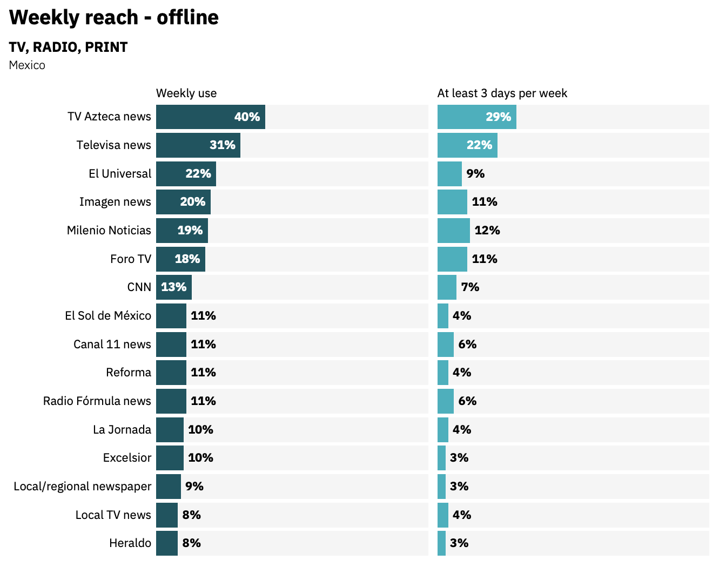
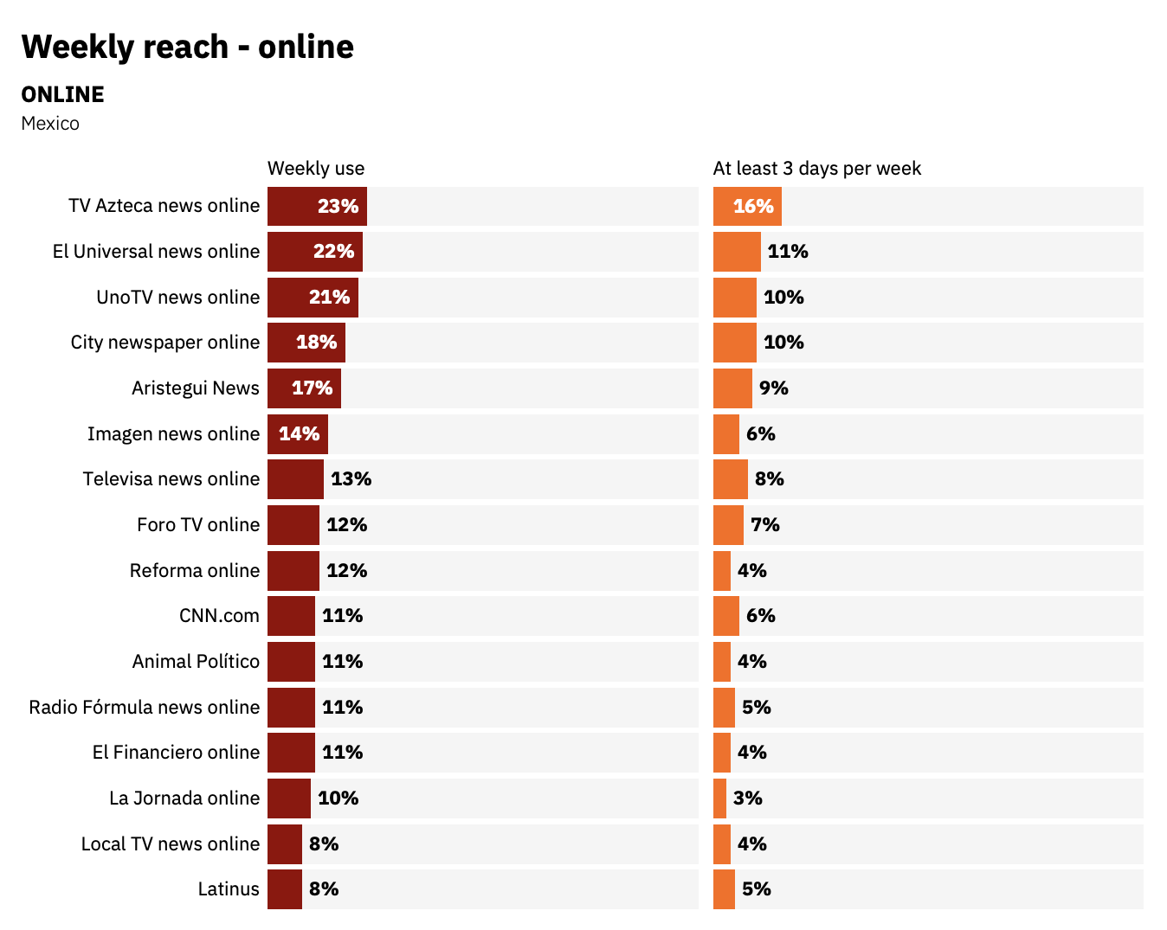
Media
Insights
Source: Digital News Report 2023/ Reuters Institute, University of Oxford/ Mexico

Slide 16
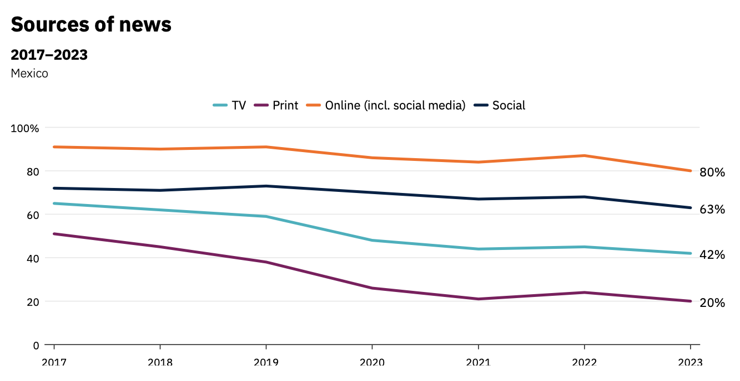
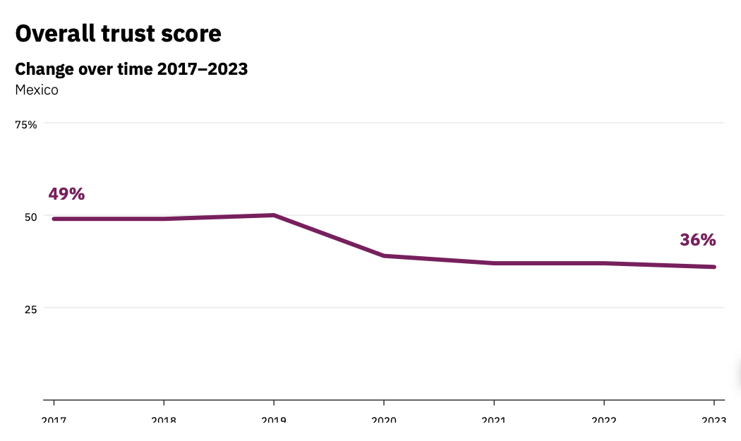
Media
Insights
Source: Digital News Report 2023/ Reuters Institute, University of Oxford/ Mexico

Slide 17
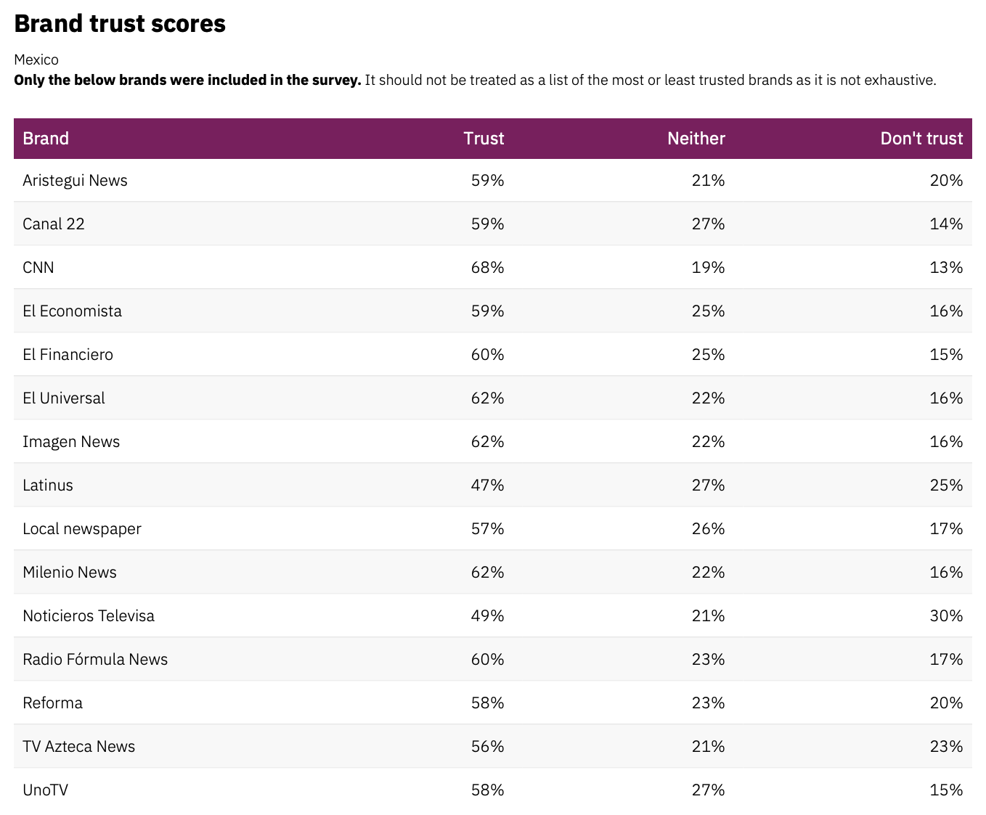
Media
Insights
Source: Digital News Report 2023/ Reuters Institute, University of Oxford/ Mexico

Slide 18
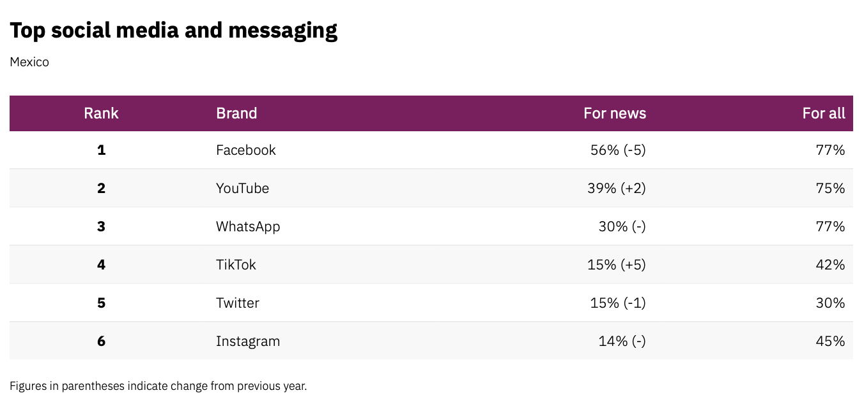
Media
Insights
Source: Digital News Report 2023/ Reuters Institute, University of Oxford/ Mexico

Slide 19
Travel Trade
Insights
6,000 Travel Agencies in México
54 tour operators; 42 in Mexico City.
Main wholesalers: Megatravel, Pe-Tra, Julia Tours, NAO Travel Collection, Euromundo, Dream Destinations, Travel Shop
Main OTAs: Price Travel, Expedia, Booking.com ,Despegar.com, Google Hotel Ads, Hoteles.com, and Bestday.com
Wholesalers with owned agencies and final Consumer exposition: Viajes Palacio, Viajes El Corte Inglés, Mundo Joven, & Viajes Sears.
18 Tour operators and OTAs included Arizona in their U.S. product (multi-cities itineraries).
Source: - Radar Turistico, 2022
- Entorno Turístico 2022

Slide 20
Flights to PHX
Cities with non-stop service to PHX:
• MEX: American Airlines (1 Daily)
• GDL: American Airlines & Volaris (1 Daily/ea)
• MTY: American Airlines (1 Daily)
• CUL: Volaris (1 Weekly)
• HMO: American Airlines (1 Weekly)
• LTO: American Airlines (1 Weekly)
• CUN: American Airlines (1 Daily)
• MZT: American Airlines (1 Daily)
• PVR: American Airlines (1 / 2 Daily)
• ZIH: American Airlines (1 Weekly)
• SJD: American Airlines (1 / 2 Daily)
45.5 %

Slide 21

Booking Demand
Outbound Market Share
Positive Growth in Sales to
North America and Europe
39% North America
37% Europe
According to Expedia, USA was the number one destination for Mexicans traveling abroad in 2022
18% South America
6% Pacific
Source: 1st Party Expedia Group Booking data (Travelers) 2022

Slide 22

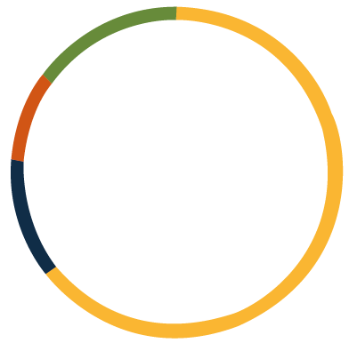

Mexican travel destinations are…
Travel agencies are located in…
Revenue for travel sales is generated in…
68% Mexico City
40% Mexico City
45% International
12% Monterrey
22% Monterrey
55% Domestic
8% Guadalajara
17% Guadalajara
12% Other
21% Other
Mexico city, Monterrey and Guadalajara
generate more than
77% of total sales.
Notes:
This slides shows where to focus our efforts an why, according to BSP, 55% of the total tickest issued in Mexico were international, 40% of those tickets were sold in CDMX, 22% in MTY, 17% in GDL.
Which means that Monterrey and guadalajara are a good focus since together they sell 39% of total revenue and they only have 20% of the total number of travel agencies nationwide.

Slide 23
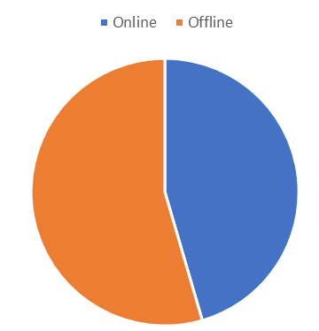
Booking trends
Online vs Offline
54.5 %
45.5 %

Slide 24
Holidays:
Easter
Summer Vacations
Xmas Season
OUTBOUND
TRAVELER MEXICO
The types of accommodation preferred by Mexicans are still following the 2021 pattern and they are listed as follows:
Resort
Hotel
All Inclusive
Apartment
Mexicans start planning their trip between 45 and 15 days in advance
Many want to prioritize relaxation, wellness, and new experiences. Self-care is now non-negotiable.
People value travel now more than ever before and will continue to make time and save money for it.
Top motivations for travel are:
49% Physical and mental health.
49% Change of scenery
46% Making up for lost time
Long Weekends
Constitution Day (February)
March 21st
Revolution Day (November)
Opportunity dates:
Children day
Independence day/weekend
Black Friday

Slide 25
Trends
Solo travelers reports show that 25% of millennials plan to travel by themselves each year.
More open to personalized travel experiences, they will seek help from travel professionals.
Travelers crave local experiences, fewer people may be settling for common place vacation activities in the coming years.
They are serious about sustainability; searches for “sustainable travel” are up 226% over the last 5 years.
Source: Top Travel Industry Trends (2023-2026)

Slide 26
Trends
Travel tech adoption accelerates, stats show that travelers who book tours and activities on their phone spend 50% more than those whose book elsewhere.
Purposeful trips are top of mind, especially when it comes to supporting small businesses and local communities.
Consumers are blending business and leisure travel, more than 50% of travelers say they would extend their business trip to enjoy time at their destination.
People take pride on finding lesser-known vacation spots before they become popular.
Source: American Express Global Travel Trends

Slide 27
Recommendations
Consider fam trips with local influencers (HMO, CUL, GDL, MTY, MEX and showcase Arizona’s jewels: Gastronomy, Sports, Outdoor activities)
Strengthen presence both with media and trade with nationwide reach, as well as key states, such as Sonora, Jalisco and Nuevo León.
The recent opening of the Monterrey-Phoenix direct flight by American Airlines is a great opportunity to reinforce our presence in such an important market.
Budget has also prevented us from inviting MORE media outlets, Travel Agents or Operators on group trips, which is the best and most efficient way to excite, involve and actually enroll them on the storytelling about AZ wonders and attractions.
Foster Alliances with partners and shopping malls to create incentives for visitors to choose Arizona, instead of other destinations (i.e. Stay one more night and get a $50 coupon in XX stores or Stay one more night in XXX and get one free in YY).
Promote aggressive activations in key markets (HMO, MTY, GDL, MEX, CUL)

Slide 28
Recommendations
Reverse Sales Missions have proven to be successful approaches to showcase Arizona and its key partners, reducing costs and multiplying Return of Investments.
23-24 will prove to be important years in terms of coverage, not only because of the drop of Covid cases aligned with the subsequent increase of travel but also because of the new attractions and developments in the area.
Social Media has become a huge influencer in the travel decision making process, always consider to have spanish speaking content or channels for Mexico market, particularly Instagram.
Continue and multiply spanish versions of all contents in destination website and collateral.
Added value of the drive market, encouraging them to do other activities, to go further and to actually know Arizona as a destination.
Allocate investments in different media outlets (especially HMO and CUL) for promotion and marketing

