Slide 2
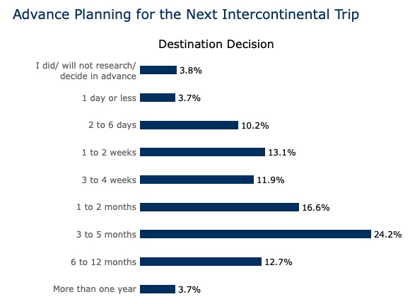
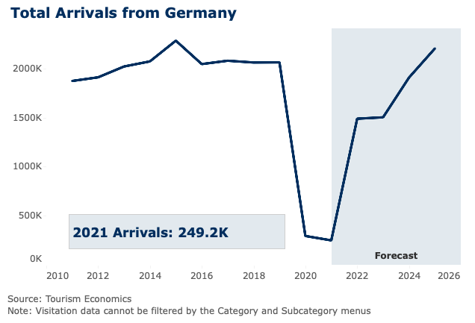
MARKET UPDATE FOR GERMANY
Overall, travel behavior in the German-speaking market has gone back to normal.

Slide 3
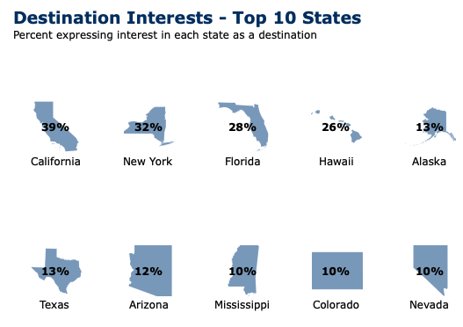
MARKET UPDATE FOR GERMANY – cont‘d
With 12% interest in the state as a travel destination, Arizona is no. 7 of the top 10 U.S. states.
Source: Brand USA

Slide 4
MARKET UPDATE FOR GERMANY – cont‘d
Local culture and outdoors/nature are under the top 3 motivations for Germans to travel to the U.S.
Source: Brand USA

Slide 5
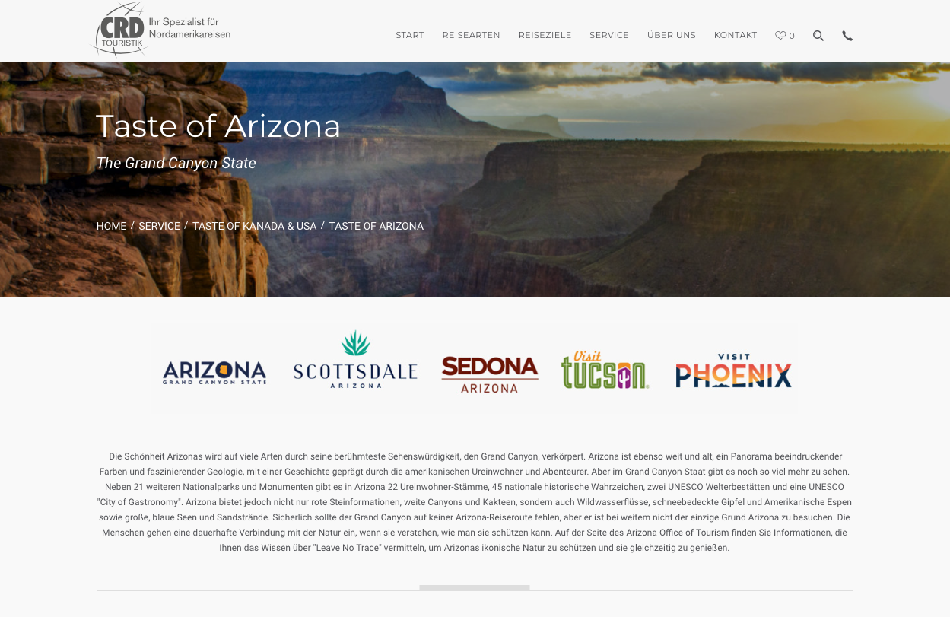
TOUR OPERATOR MARKETING
CRD Touristik – January to February 2023
Update of Taste of Arizona subpage
Fitness First fitness club campaign (duration: 1 month)
1,500 printed posters featuring AZ placed in the lockers of 15 premium clubs in Germany
500 printed flyers placed at the front desk of the selected gyms

Slide 6
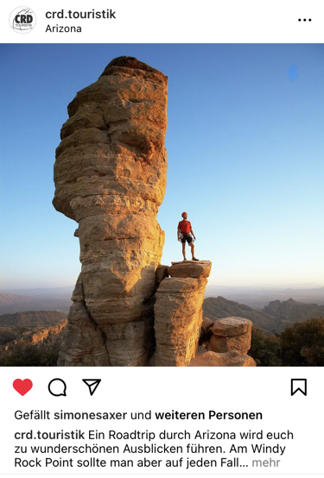
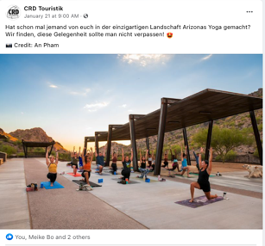
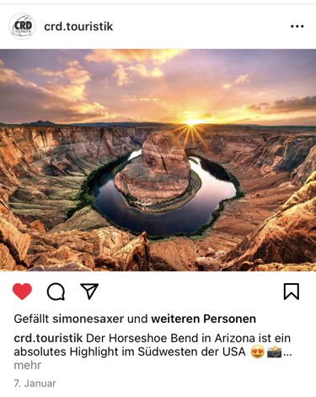
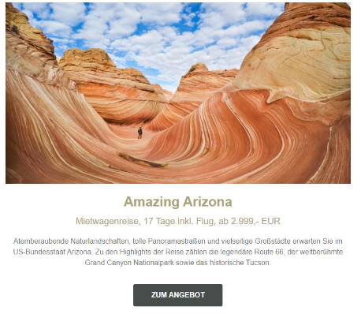
TOUR OPERATOR MARKETING
CRD Touristik – cont‘d
Facebook & Instagram posts on CRD‘s channels
FB: 5,900 fans / IG: 850 followers
Inclusion in the CRD newsletter promoting the „Amazing Arizona“ itinerary
Opening rate: 20.61%
784 clicks / CTR 4.08%

Slide 7
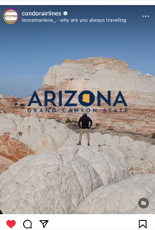
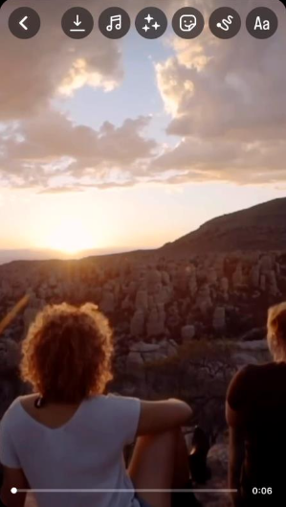
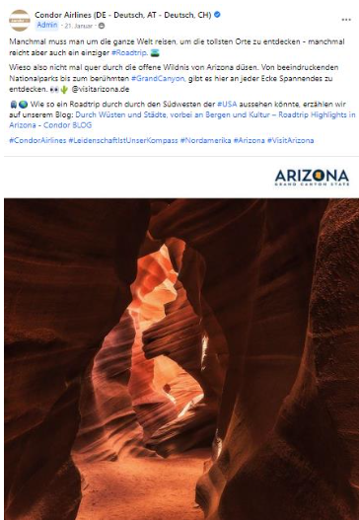
AIRLINE COOPERATION
Condor – January to March 2023
Social Media
B2C: Post on Facebook & Instagram + sponsored posts
Reach: 2,000 group members
Post in Condor‘s B2B Facebook group
Facebook: 495,000 fans / Instagram: 130,000 followers
Paid search: SEA campaign – text ads
B2C newsletter inclusion
Reach: 200,000 / Opening rate: 20%

Slide 8
AIRLINE COOPERATION
Condor – cont‘d
Online banner integration in B2B focused travel trade websites and newsletters
AZ Blog on Condor website
→ An add-on marketing package is in the works and will be completed by end of July 2023.

Slide 9
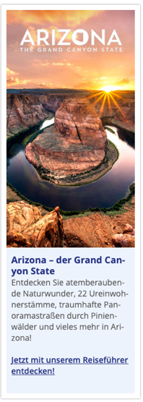
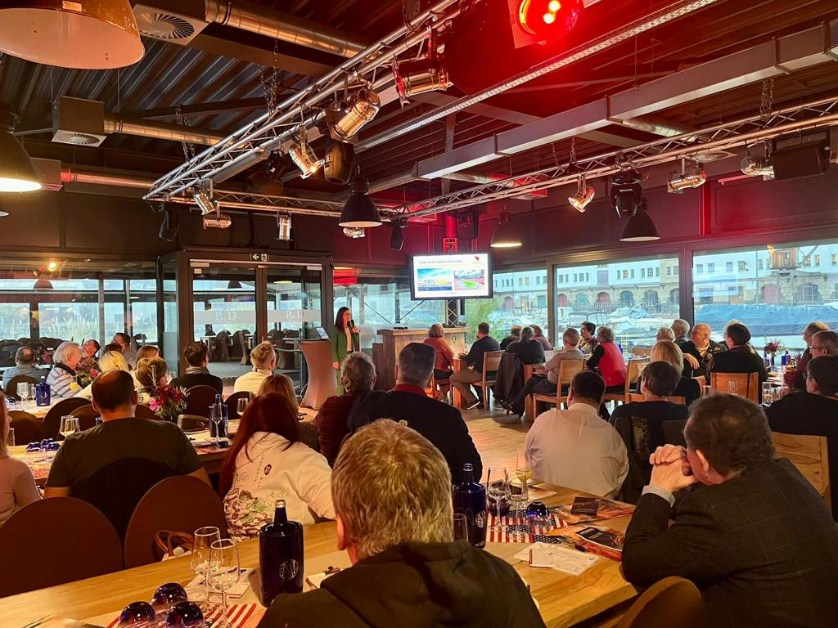
TOUR OPERATOR MARKETING
USA-Reisen.de – February 2023
Participation on behalf of AOT in a Super Bowl VIP Client Event (B2C) → The whole event was dedicated to Arizona
30-minutes AZ presentation done by TMR
50-minutes AZ product presentation done by the TO
Participants: 70 USA-Reisen clients + 3 tour operator staff members
Web banner and newsletter inclusion pre- and post-event

Slide 10
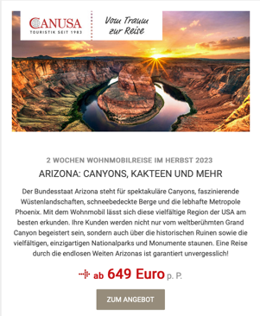
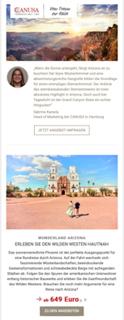
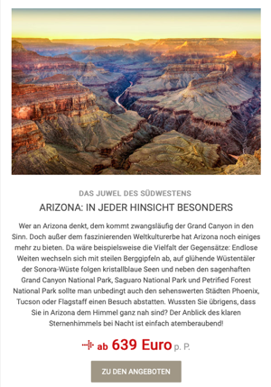
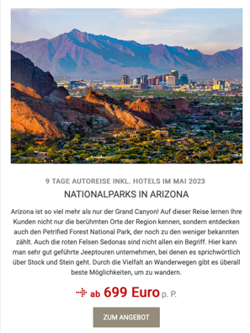
TOUR OPERATOR MARKETING
CANUSA Touristik – February to April 2023
B2B & B2C marketing package
B2B: Exclusive travel agency newsletter featuring AZ product
Recipients: 22,000 travel agencies
B2C: Newsletter article featuring an AZ itinerary & Mini newsletter incl. destination info and travel package
Recipients: 400,000 CANUSA clients

Slide 11
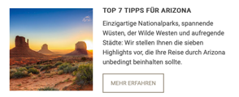
TOUR OPERATOR MARKETING
CANUSA Touristik – cont‘d
AZ „Top 7 List“ featuring seven highlights in Arizona with SEO-optimized copy on th CANUSA website
Reach: 1.3 million unique webiste visitors per year
B2C Newsletter article to promote the new Top List
Recipients: 400,000 CANUSA clients

Slide 12
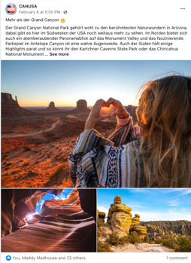
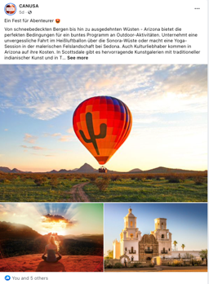
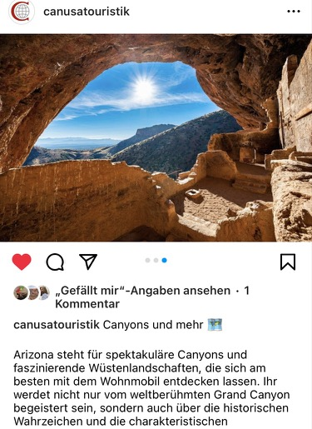
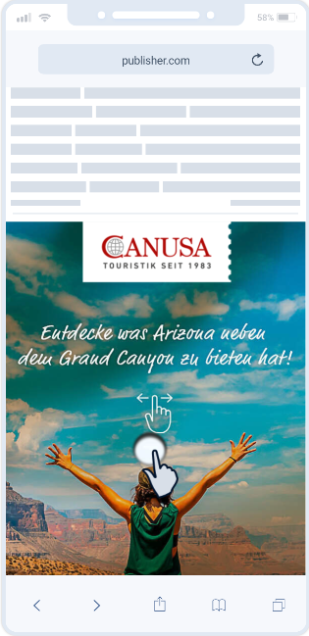
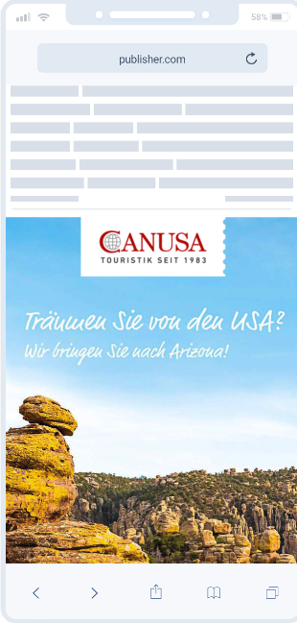
TOUR OPERATOR MARKETING
CANUSA Touristik – cont‘d
Social Media promotion to promote an AZ travel package: 2 Facebook, 2 Instagram posts, 2 stories, Pinterest ads
FB: 73,000 fans / IG: >9,600 followers / approx. 200,000 ad impressions on Pinterest
Online promotion – Scratch ads on the websites of premium content discovery networks
Reach: approx. 6 million ad impressions

Slide 13
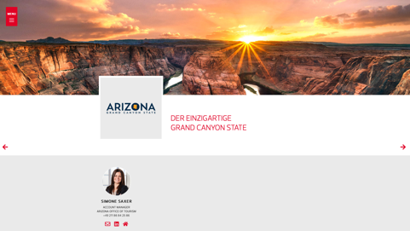
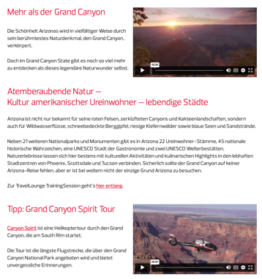
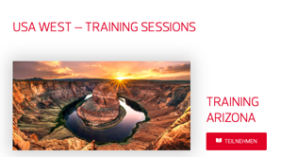
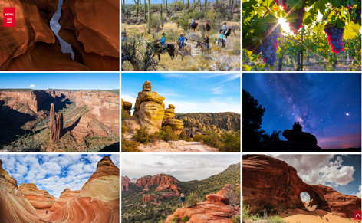
TOUR OPERATOR MARKETING
DER Touristik – Campus TravelLounge – March 2023
Participation on behalf of AOT in an online live B2B event
Event website – available for two weeks after the event → 5,864 page views
Creation of an AZ landing page with destination info, images, video
Inclusion of a pre-recorded 20-minutes AZ webinar
Live event features → 315 live participants
Online panel with other USA West partners to introduce the destinations
Q&A session to answer the participants‘ questions

Slide 14
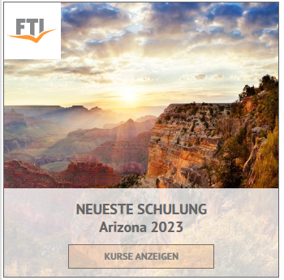
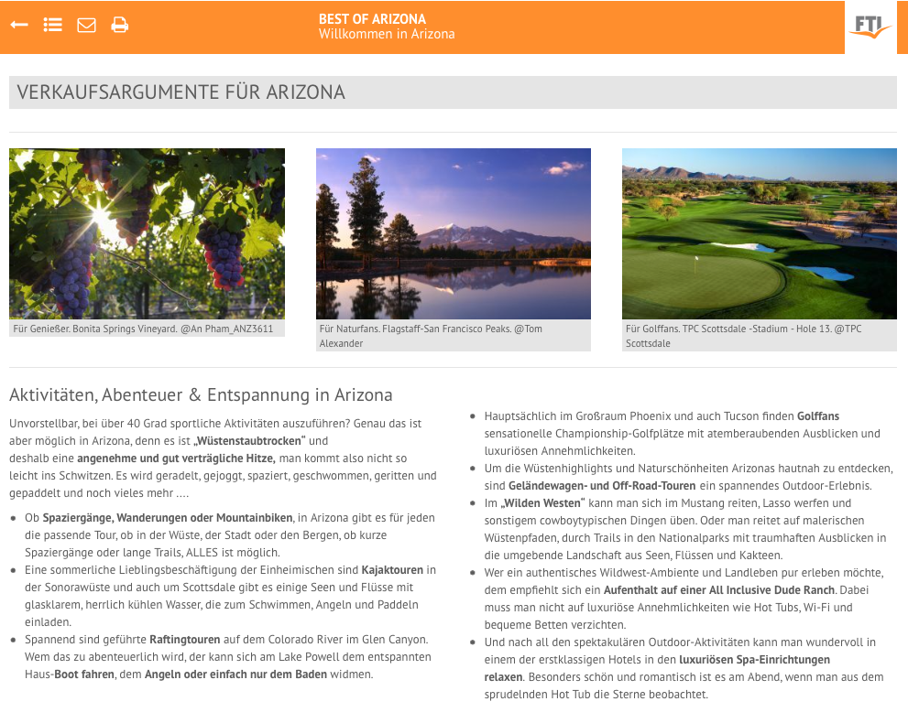
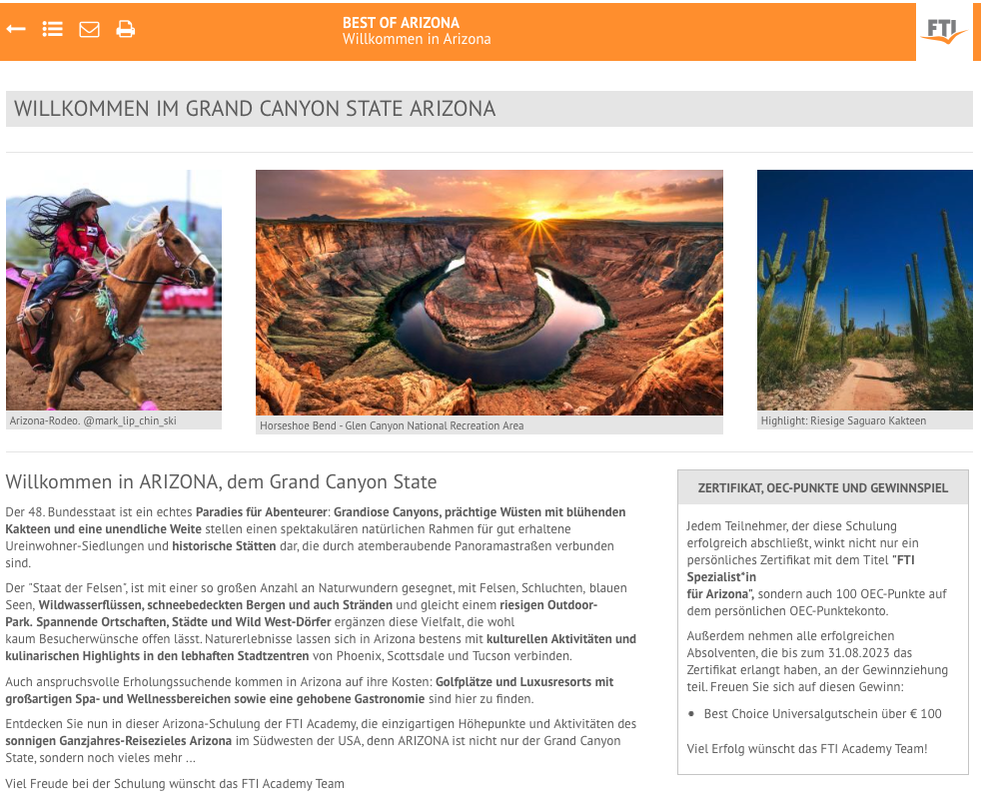
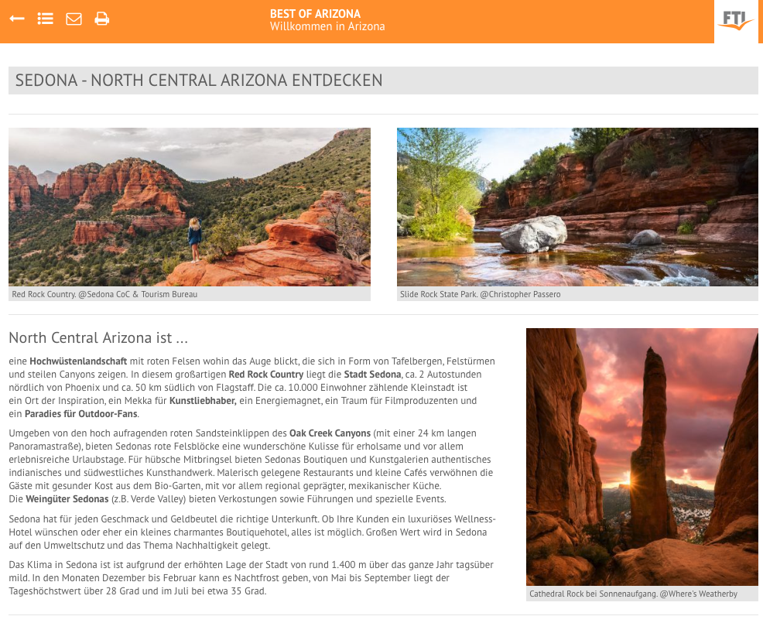
TOUR OPERATOR MARKETING
FTI Touristik – Launch on April 25th, 2023
FTI Arizona Academy (duration: 8 months)
B2B e-elarning to train travel agents and enable them to consult their clients in a better way
Accessible for 14,000 registered travel agents
Average no. Of participants: 1,000
Inclusion of extended destination information, images, videos on 17 subpages with another topic per subpage + AZ product inclusion
Travel agents that complete the course and can answer the quiz questions at the end, receive a certificate
Certificates issued since launch: 440

Slide 15
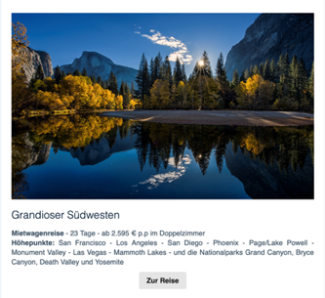
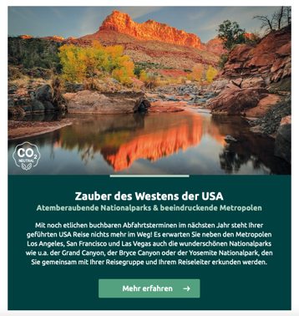
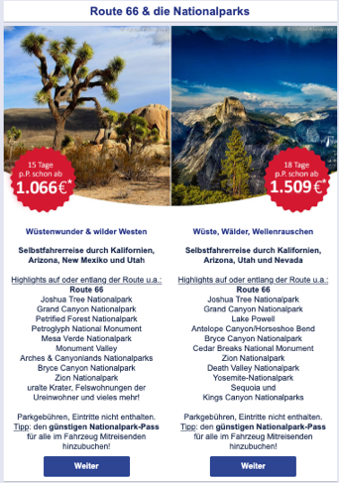
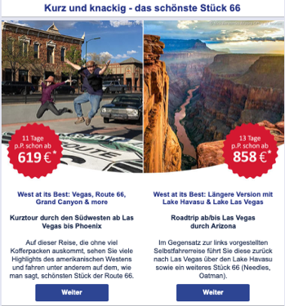
ADDED VALUE – NO MARKETING FUNDS USED
ARGUS Reisen – Consumer newsletter featuring their 23-days “Grandioser Southwest” self-drive incl. 2 nights in AZ (July 2022)
Explorer World of Travel – Consumer newsletter promoting their 16-days Western USA and National Park itinerary “Zauber des Westens der USA” incl. 2 nights in AZ (August 2022)
USA-Reisen.de – Consumer newsletter featuring a Route 66 guide and according product with four itineraries that include overnights in Arizona (August 2022)

Slide 16
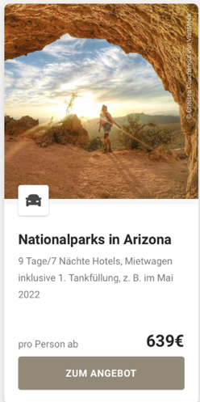
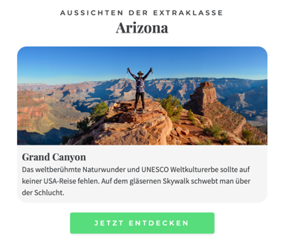
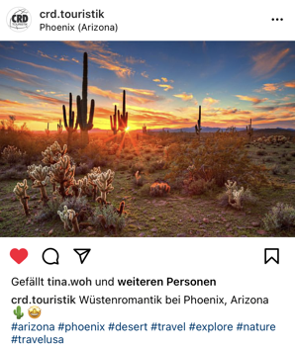
ADDED VALUE – NO MARKETING FUNDS USED
CANUSA Touristik – Consumer newsletter featuring US National Park itineraries incl. their 7-nights Arizona National Parks tour (September 2022)
Tourlane – Consumer newsletter promoting their US highlights incl. Arizona and the Grand Canyon (September 2022)
CRD Touristik – Instagram post featuring Phoenix, AZ (September 2022)

Slide 17
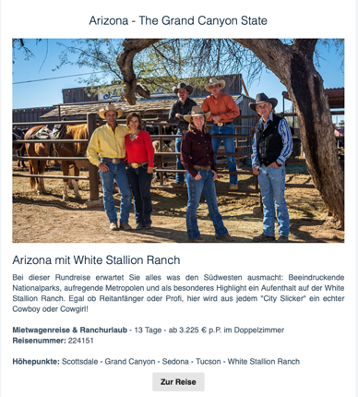
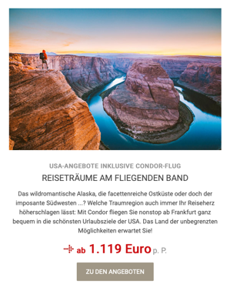
ADDED VALUE – NO MARKETING FUNDS USED
ARGUS Reisen – Consumer newsletter featuring a 12-nights AZ self-drive incl. White Stallion Ranch (October 2022)
CANUSA Touristik – Consumer newsletter featuring all Condor nonstop connections to the US incl. FRA-PHX (October 2022)
Explorer World of Travel – Consumer newsletter promoting their 16-days „Zauber des Westens“ itinerary incl. 3 nights in AZ (October 2022)

Slide 18
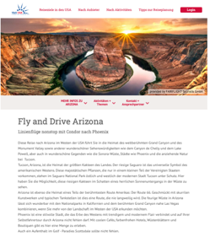
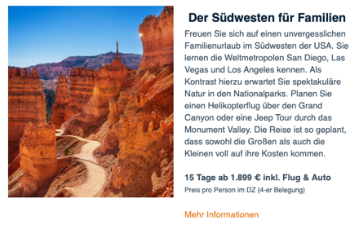
ADDED VALUE – NO MARKETING FUNDS USED
Fairflight Touristik – VUSA website post on the Fairflight account promoting their 14-days AZ itinerary (October 2022)
Explorer World of Travel – Consumer newsletter featuring a „USA National Parks & Metropolis“ fly-drive incl. 3 nights in AZ (November 2022)
Faszination Fernweh – Consumer newsletter promoting their „Southwest for Families“ fly-drive incl. 1 night in AZ (December 2022)

Slide 19
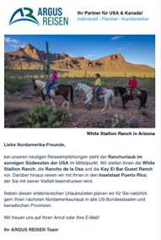
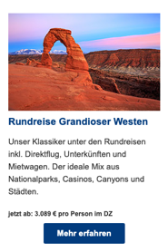
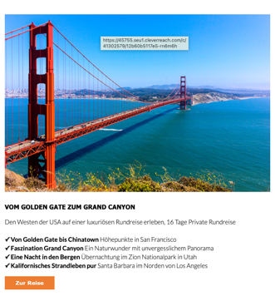
ADDED VALUE – NO MARKETING FUNDS USED
ARGUS Reisen – Consumer newsletter dedicated to ranch vacation incl. 3 AZ ranches (December 2022)
Fairflight Touristik – Consumer newsletter featuring a 20-days Southwest fly-drive incl nights in AZ (December 2022)
Windrose – Consumer newsletter promoting a 15-nights luxury Southwest itinerary incl. helicopter flight at the Grand Canyon (December 2022)

Slide 20
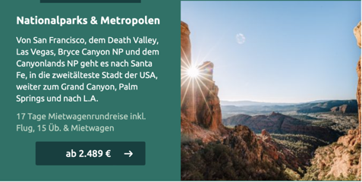
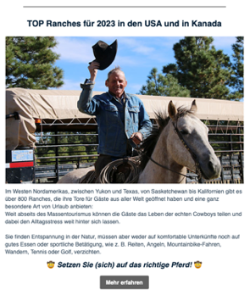
ADDED VALUE – NO MARKETING FUNDS USED
Explorer World of Travel – Consumer newsletter featuring their „USA National Parks & Metropolis“ fly-drive incl. 3 nights in AZ (December 2022)
CANUSA Touristik – Consumer newsletter promoting a 2-weeks RV self-drive incl. AZ through the Southwest (December 2022)
ARGUS Reisen – Consumer newsletter featuring their rop ranches incl. White Stallion Ranch (January 2023)

Slide 21
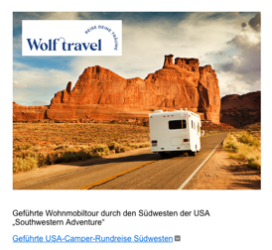
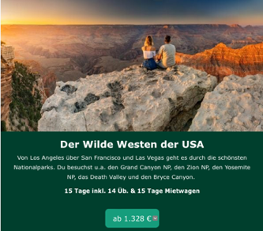
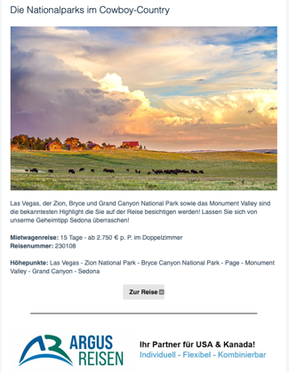
ADDED VALUE – NO MARKETING FUNDS USED
America Journal – Newsletter featuring a 24-days guided camper tour through the Southwest incl. 4 nights in AZ (January 2023)
Explorer World of Travel – Consumer newsletter featuring their 14-nights self-drive „The Wild West“ incl. 1 night in AZ (January 2023)
ARGUS Reisen – Consumer newsletter featuring a National Park self-drive incl. 3 nights in AZ (January 2023)

Slide 22
ADDED VALUE – NO MARKETING FUNDS USED
Faszination Fernweh – Consumer newsletter promoting their „Highlights of the Southwest“ itinerary incl. 3 nights in AZ (February 2023)
Explorer World of Travel – Consumer newsletter featuring a „Legendary Route 66“ itinerary and a „Wild West“ tour incl. several overnights in AZ (February 2023)
360° USA Magazine – Facebook post feauring AZ (February 2023)

Slide 23
ADDED VALUE – NO MARKETING FUNDS USED
Ruck Zuck Urlaub – Instagram post featuring the Grand canyon to create awareness for AZ (March 2023)
Condor – Facebook ad and web banner ads (March 2023)
Knecht Reisen – Consumer newsletter featuring two itineraries including 3-4 nights in AZ (April 2023)

Slide 24
ADDED VALUE – NO MARKETING FUNDS USED
Condor – Two consumer newsletters featuring their PHX connections from Germany incl. FRA-PHX (May 2023)
Faszination Fernweh – Consumer newsletter promoting a Southwest itinerary incl. 3 nights in AZ (May 2023)
ARGUS Reisen – Consumer newsletter featuring Tombstone Monument Guest Ranch (May 2023)

Slide 25
ADDED VALUE – NO MARKETING FUNDS USED
ARGUS Reisen – Consumer newsletter featuring a Route 66 itinerary including several overnights in AZ (May 2023)
USA-Reisen.de – Consumer newsletter promoting two exclusive AZ itineraries (May 2023)
CANUSA Touristik – Consumer newsletter featuring RV itinerary suggestions including AZ (June 2023)

Slide 26
ADDED VALUE – NO MARKETING FUNDS USED
CRD Touristik – Facebook post featuring Arizona‘s Dude Ranches and cowboy culture (June 2023)
Lufthansa – Consumer newsletter promoting Route 66 itineray suggestions incl. Petrified Forest National Park (June 2023)

Slide 27
BI-MONTHLY TRADE NEWSLETTERS
Recipients: Trade partners from the German-speaking markets
 | TOPIC | NO. OF RECIPIENTS | OPENING RATE
August 2022 | Arizona‘s Dude Ranches | 312 | 45.5%
October 2022 | Arizona‘s Warm Winter Destinations | 360 | 39.7%
December 2022 | What‘s new in Arizona in 2023? | 354 | 43,1%
February 2023 | Pro Sports in Arizona | 428 | 36.0%
April 2023 | Arizona‘s Summer Getaways for Families | 469 | 41.4%
June 2023 | Experiencing American Indian Tribes in Arizona | 522 | tba

Slide 28
DESTINATION WEBINARS IN FY 2023
„Arizona‘s Dude Ranches“ December 6th, 2022
56 registrations – 34 actual participants
Registrants that were not able to participate requested the recording of the webinar
TMR sent a follow up email to all registrants with travel trade resources that are useful for their daily business
The webinar had been promoted in the VUSA newsletter, in a TMR/AOT newsletter and on an online platform featuring trade training opportunities

Slide 29
VISIT USA GERMANY ACTIVITIES
Trade newsletters (approx. 22,400 recipients)
TIMING | TOPIC
August 2022 | Arizona‘s Dude Ranches
September 2022 | First Appreciate AZ Day
November 2021 | Arizona‘s sustainability efforts Promotion of Dude Ranches webinar with registration link
December 2022 | Hotel openings in 2023
February 2023 | Pro sports in Arizona
April 2023 | Our personal favorite spot
May 2023 | Peralta Regional Park
June 2022 | Free cultural, arts, and outdoor activities

Slide 30
VISIT USA GERMANY ACTIVITIES
Website posts on the German VUSA page
TIMING | TOPICS | VIEWS
July 2022 | Arizona‘s Dude Ranches Stargazing in Arizona | 73 53
August 2022 | Maswick South Lodge Castle Hot Springs | 59 68
September 2022 | Arizona‘s art-lined street First Appreciate AZ Day | 46 84
October 2022 | New Arizona Offcial State Travel Guide Arizona‘s warm winter destinations Backland Eco-Resort | 61 38 59
November 2022 | Arizona Tribal Brochure Announcement of Dude Ranches webinar planned for Dec 6, 2022 | 55 37

Slide 31
VISIT USA GERMANY ACTIVITIES
Website posts – cont‘d
TIMING | TOPICS | VIEWS
December 2022 | Recording of Dude Ranches webinar from Dec 6, 2022 PHX Sky Harbor International Airport being industry leader in sustainability New in 2023: Mattel Adventure Park | 16 24 26
January 2023 | Arizona: Perfect golfing destination Itinerary suggestion: Bucket List Northern Arizona | 25 21
February 2023 | New opening: The Eddy Hotel Re-opening: Mii Amo | 9 7
March 2023 | Peralta Regional Park Adventurous Antelope Canyon Tours with new services | 8 9

Slide 32
VISIT USA GERMANY ACTIVITIES
Website posts – cont‘d
TIMING | TOPICS | VIEWS
April 2023 | Opening: Omni Tempe Hotel at ASU New Boutique Accommocation in summer 2023: Air Village | 9 8
May 2023 | Reopening of Grand Canyon North Rim in June 2023 Return of seasonal Condor nonstop flight to PHX | tba
June 2023 | Free activities in Arizona New AquaRidge Waterpark in Phoenix New cashless fee system at Saguaro National Park | tba
TOTAL VIEWS IN FY 2023 |  | 815*
TOTAL VIEWS SINCE WEBISTE LAUNCH IN MARCH 2022 |  | 1,805*
*Not all numbers since April 2023 have been recorded yet

Slide 33
VISIT USA GERMANY ACTIVITIES
Website posts – Samples

Slide 34
VISIT USA GERMANY & SWITZERLAND ACTIVITIES
Trade Events
TIMING | EVENT DESCRIPTION | NO. OF ATTENDENTS / NO. OF PEOPLE TRAINED
October 2022 | Trade networking event in Hamburg Trade networking event in Munich Breakfast & Lunch Workshops in Hanover Breakfast & Lunch Workshops in Cologne | 40 23 24 23
January 2023 | Visit USA Switzerland: „Island Hopping“ | 67
May 2023 | Workshop roadshow event in Aachen Workshop roadshow event in Münster | 78
TOTAL VIEWS IN FY 2023 |  | 255

Slide 35
VISIT USA GERMANY & SWITZERLAND ACTIVITIES
Trade Events – Impressions

Slide 36
TRADE FAM TRIP
May 25th – 29th, 2023
Post-IPW trip with Condor nonstop flight back to FRA
Participants: 5 German tour operators
Destinations visited: Sedona, Flagstaff, Petrified Forest National Park, Chinle, Fort MacDowell, Gilbert, Queen Creek
Except one tour oeprator, none of tthem had ever been to Arizona before the fam trip and TMR received great feedback.
One tour operator is working on a new itinerary for their website to extend their AZ portfolio, while another one created a presentation after the tour to train her colleagues.

Slide 37
ADDITIONAL TMR SERVICES THROUGHOUT FY23
Continuous communication with trade partners from the German-speaking markets
Constant market analysis and sharing of relevant industry news with AOT to identify efficient marketing opportunities
Providing trade partners with German Arizona trade resources (sales sheet, itineraries, newsletter)
Continuously sourcing additional direct consumer opportunities to create awareness and promote Arizona‘s diversity
Fulfillment of any brochure requests
TMR joined 9 IPW appointments with tour operators from the German-speaking market

Slide 38
KPI Summary Trade FY 2022
 | Jul-21 | Aug-21 | Sep-21 | Oct-21 | Nov-21 | Dec-21 | Jan-22 | Feb-22 | Mar-22 | Apr-22 | May-22 | Jun-22
Sales Calls | 22 | 17 | 10 | 8 | 16 | 17 | 16 | 17 | 16 | 13 | 16 | 13
Training Seminars | 0 | 0 | 0 | 2 | 0 | 1 | 6 | 1 | 1 | 0 | 2 | 0
Total # of people present at training seminars* | 0 | 0 | 0 | 47 | 0 | 37 | 67 | 74 | 54 | 0 | 381 | 0
Tradeshow Appointments** | 0 | 0 | 13 | 0 | 0 | 0 | 0 | 0 | 0 | 0 | 23 | 0
Fam Trips | 0 | 0 | 0 | 0 | 0 | 0 | 0 | 0 | 0 | 0 | 1 | 0
# of FAM attendees | 0 | 0 | 0 | 0 | 0 | 0 | 0 | 0 | 0 | 0 | 5 | 0
TOTAL REACH | 22 | 17 | 23 | 55 | 16 | 54 | 83 | 91 | 16 | 13 | 425 | 13 | 828

Slide 39
MARKET OUTLOOK FOR GERMANY
Most tour operators had significantly exceeded their 2019 sales levels in Q1/2023 already.
Flight pricing is still an issue, while rental car availability and pricing is almost back to pre-pandemic level.
Although 2022/2023 tourism business was much better than expected, 2024 might be crucial: DUe to the need for travel, People have spent the travel budget they had saved over the pandemic, but with inflation, higher utility & living costs travel budget could be much lower in 2024. People might not consider long-haul trips every year anymore.
Recommended course of action:
Continuous efforts in the market are needed to stay competitive – destinations invest high volumes into international marketing
B2B2C marketing approach is as important as B2B

Slide 40
THANK YOU!
Simone Kreckel, Account Manager
Arizona Office of Tourism
c/o TravelMarketing Romberg
s.saxer@travelmarketing.de

