Slide 1
AOT Social Media in China
FY23 Presented by China Luxury Advisors

Slide 2
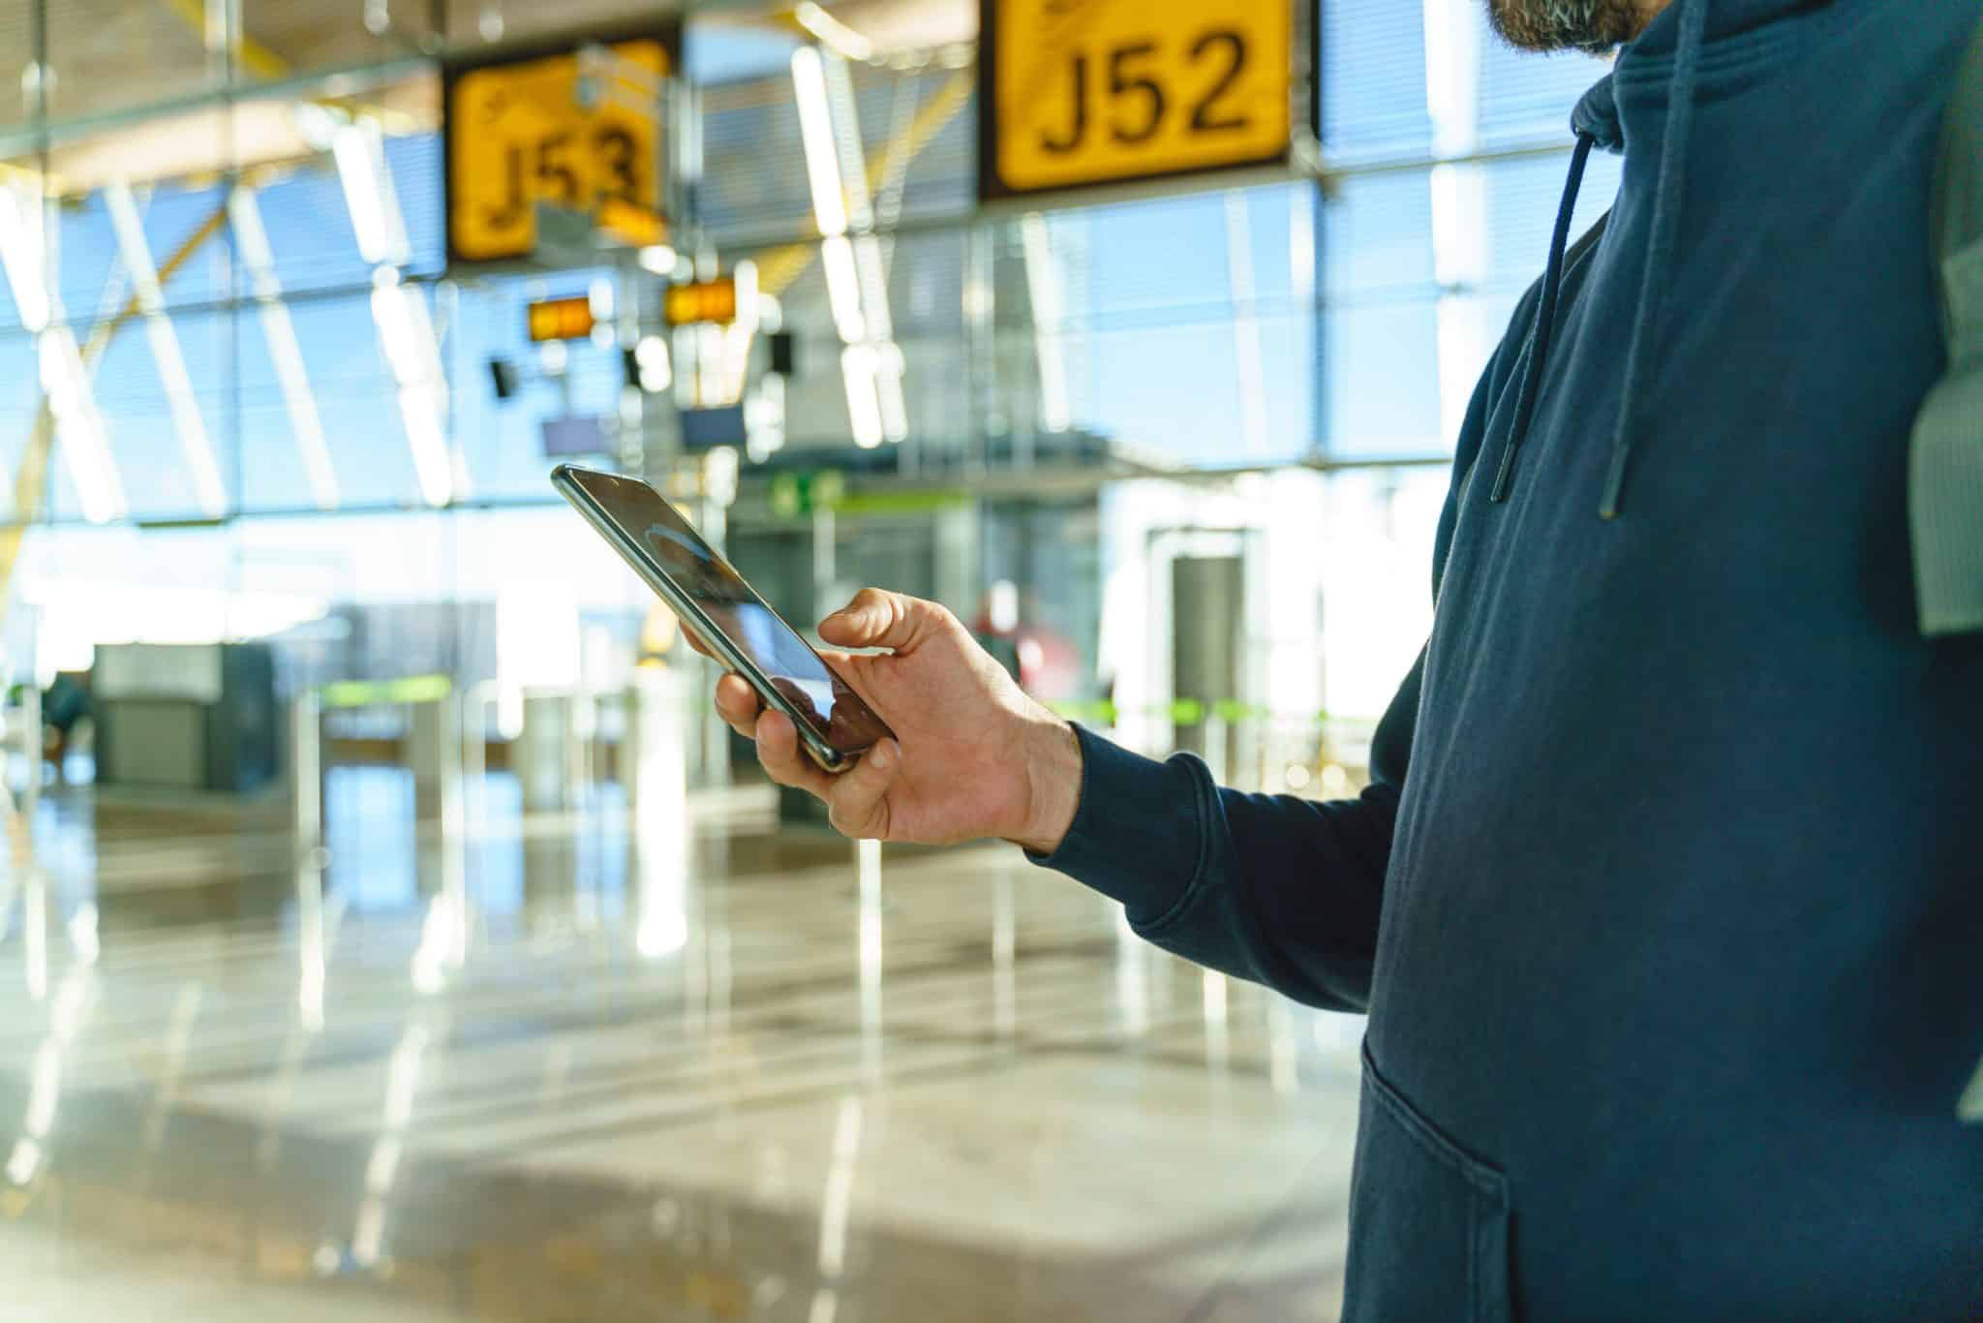
China Travel Trends FY23
Experience Oriented
Rebound tourists are planning their trip around experiences. Outdoor and scenic trips remain the most popular travel theme. Culture & history, beaches & resorts, and health & wellness gained more attention—solidifying the trend for experience-driven travel.
Mobile technologies and social media are at the core of the Chinese consumers’ daily life. In the first half of 2022, Chinese consumers spent 30 percent of their mobile internet time engaging with short videos. Besides looking for travel inspirations online, digital payment usage experienced significant growth too.
Hyper Digitized
Outdoor tourism continues to grow. Camping & glamping has gained popularity (with a compound annual growth rate of 16.2% in the past 5 years), especially among younger generations, including millennials and Gen Z, who are seeking experiential and adventure-based travel.
Outdoor Boom
Chinese travelers are also keen to explore the world and embark on novel experiences in unfamiliar destinations. Survey respondents were looking forward to visiting new attractions. Instead of revisiting destinations, 45 percent of respondents picked short trips to new sites as their number one choice, followed by long trips to new sites as their second choice.
Exploration
Enthusiasts
Source: McKinsey & Company; China Tourism Academy

Slide 3
Social Media Strategies FY23
Focus on travel inspiration
Educate the market and provide practical information for intended travelers via in-depth content
Create a more engaging social media platform for Chinese consumers to share their Arizona stories and experiences
Continue to expand Arizona’s WeChat Channel with more engaging & informative video content
Target Chinese consumers based in North America for regional travel via programmatic ads on Chinese websites & apps
Start to target Chinese consumers based in Mainland China for international travel via WeChat ads

Slide 4
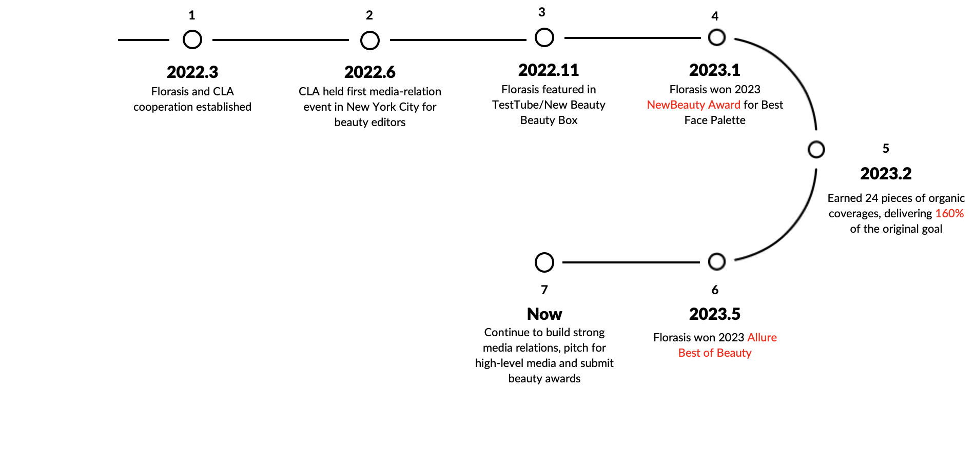
CLA Service Timeline
Project Milestones

Slide 5
FY23 By Numbers
78.7K
8.7K
7.3M
Weibo Followers
WeChat Subscribers
Combined Social Impressions
23
24
271
9.4K
Pieces of Weibo posts created
WeChat articles posted
Video content localized
Combined user interactions
5

Slide 6
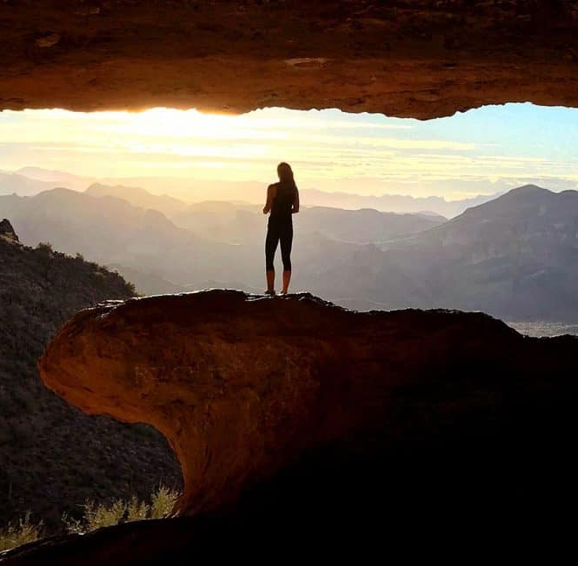
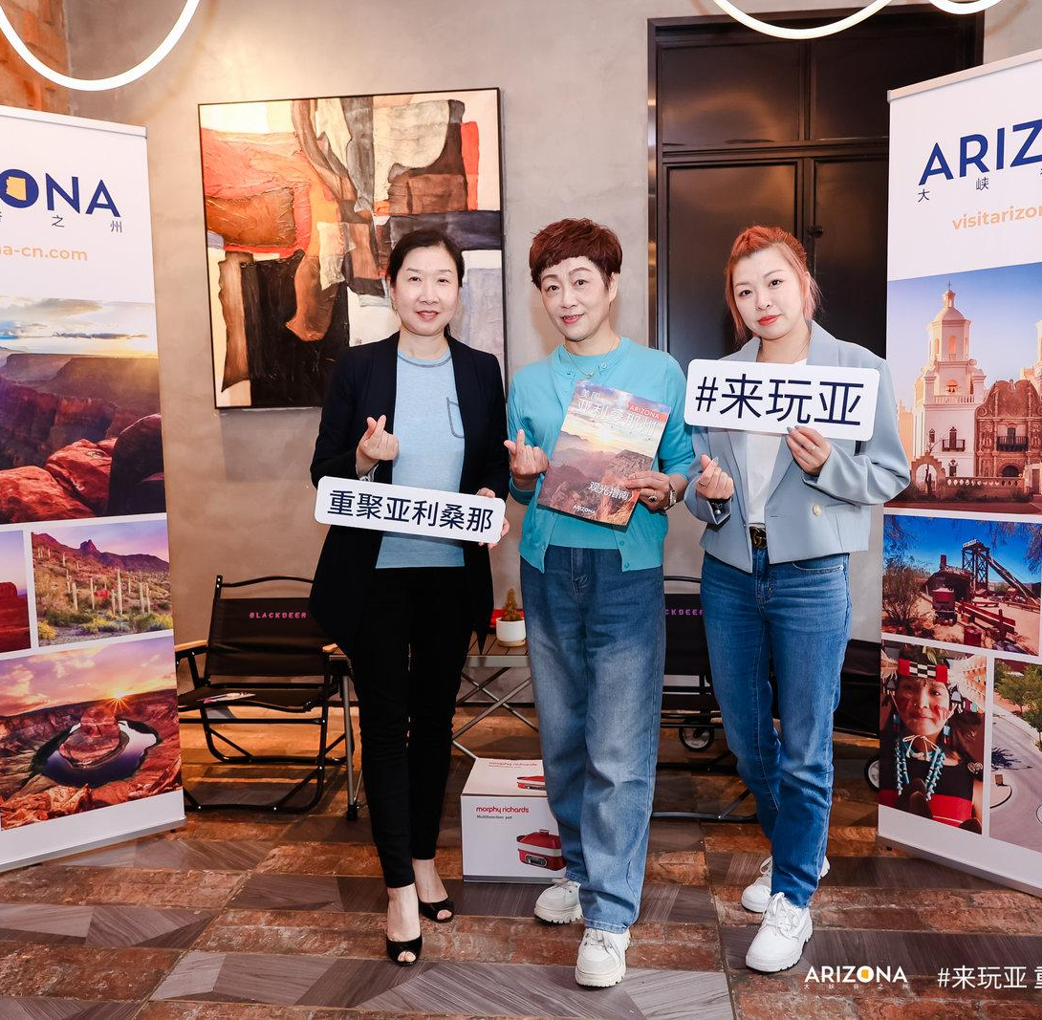
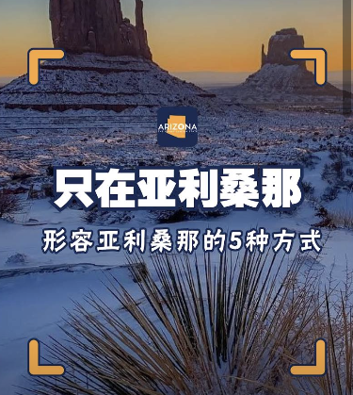
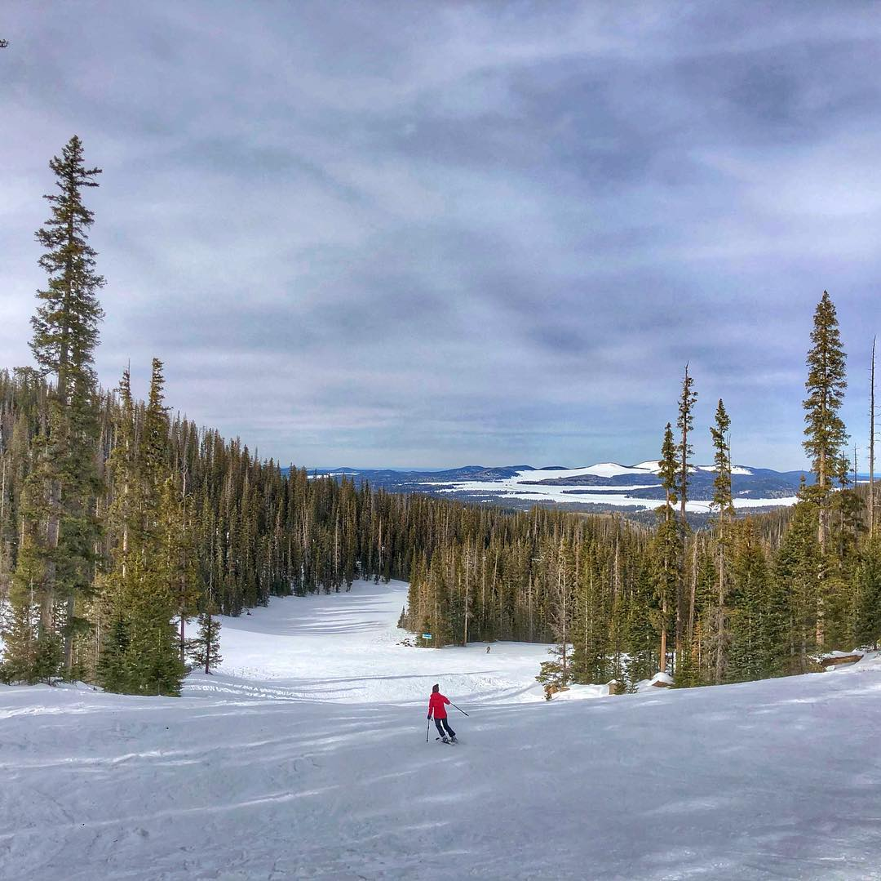
Top Performing Social Posts
WeChat Official Account |  | WeChat Channel |  | Weibo
Going Underground: Arizona’s Caves, Caverns & Mines | Beijing/Shanghai VIP Luncheon Events | 5 Ways to Describe Arizona | Route 66 Episode 2: Winslow - Holbrook | Chinese New Year Greetings + Traveler Type Quiz | Ski Season in Arizona
Reads: 1,585 Shares: 25 Date: 5/28/2023 | Reads: 841 Shares: 22 Date: 5/3/2023 | Views: 1,868 Engagements: 78 Date: 12/29/2022 | Views: 1,836 Engagements: 80 Date: 8/25/2023 | Impressions: 478,000 Engagements: 556 | Impressions: 479,000 Engagements: 222

Slide 7
Domestic to International: A Two-Pronged Approach
While outbound travel from China was still restricted, we launched a round of programmatic ads targeting Chinese consumers based in North America in the second half of 2022, in order to increase travel intent among local Chinese residences and drive traffic to Arizona’s Chinese webpage for trip planning.
With outbound travel increasing in 2023 and more flights between the U.S. and China gradually recovering to pre-pandemic level, we launched the WeChat Banner Ads in April 2023 to increase the awareness of Arizona on the Chinese travel’s mind and inspire the travelers to “Rediscover Arizona”. Since the pause of the WeChat ads from the beginning of the pandemic, the restart of this round of WeChat ads achieved the best in ad performance.
377K
2,500
29M
241K
4,765
U.S. Domestic
Impressions
China
Impressions
Ad Clicks
New WeChat
Followers
Website Visits

Slide 8
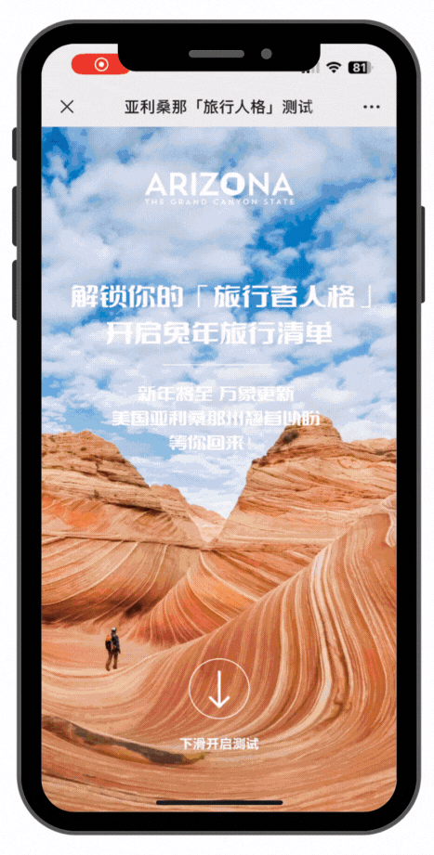
Interactive CNY Traveler Quiz
CLA crafted the Traveler Quiz with Arizona Office of Tourism to celebrate 2023’s Lunar New Year and inspire Chinese consumers to visit Arizona in the year of Rabbit. AOT and CLA launched this social media digital campaign featuring the “Traveler Quiz” on both WeChat and Weibo. With six questions in the quiz, consumers are able to get up to five different traveler types, each with a matching WeChat article serving as a travel guide and inspiration. The campaign gathered a decent number of impressions, participations, and positive discussions on AOT’s China social media platforms.
468K
570
1.3K
Total Impressions
Total Engagement
Quiz page visits

