Slide 1
China Market Update FY23
Submitted by AVIAREPS China
June 30, 2023

Slide 2
China Market Overview
China Market Size
Population: 1,455,044,800 (April 2023)
China population is equivalent to 18.47% of the total world population
60.8 % of the population is urban (Up from 35.7% in 2000)
The median age in China is 38.4 years
Source: National Bureau of Statistics, Xinhua

Slide 3
China Market Overview
Key Economic Indicators
Economy Size:
world’s second-largest economy by gross domestic product (GDP), a position China has held since 2010
world’s largest by purchasing power parity (PPP), since 2014
China’s GDP is larger than the combined of the next four economies
Japan
Germany
the United Kingdom
India
Economy Growth:
3% GDP growth in 2022; 8.08% in 2021 and 2.24% in 2020 (the only major economy worldwide with positive growth in 2020).
China's economic growth in Q1 2023 rebounded to a stronger-than-expected 4.5% year-on-year, economic growth is projected to accelerate further in the second quarter, and China is on track to achieving its GDP growth target of over 5% in 2023.
Source: https://www.worldeconomics.com/Rankings/Economies-By-Size

Slide 4
China Market Overview
Key Economic Indicators
Rising Disposable Incomes:
China disposable income per capita grew 5% in 2022 (€5,005)
$4.8 trillion of household savings accumulated during the pandemic
Soaring Middle Class:
By 2022, more than 75% China’s urban consumers earn $9,000 - $34,000 a year
920 million, 67.2% of China’s population
Source: McKinsey Consulting

Slide 5
China Outbound Travel Market Update
Chinese Borders Fully Re-opened
Since January 8th, all barriers for outbound travel have finally been removed by the government
Passports are now being issued regularly
Starting March 15th, China fully resumed inbound travel and reinstated valid multi entry Chinese visas
The waiting times for visa applications at US Consulates can take anywhere from 30 to 180 days, but these timeframes are subject to change on a daily basis as the US consulates continue to increase their staffing levels and train Visa officers
9 million Chinese already hold 10-year U.S. tourist visas and can travel to Arizona immediately
U.S. lifted COVID testing requirement on all flights from China
Travelers to China are only required to take self-antigen tests within 48 hours of departure without check by airlines and only self-reporting upon arrival
Source: China Outbound Tourism Research Institute, China Daily, U.S. Embassy Beijing, Trip.com

Slide 6
China Outbound Travel Market Update
Chinese Outbound Travel Demand
Chinese New Year Travel
May Day Holiday Travel
2.87 million international arrivals and departures
Overall outbound bookings increased 640% year-on-year
A total of 274 million visits, an increase of more than 19% for the same period in 2019
The ticket sales of domestic scenic spots skyrocketed by 900% from last year and 200% compared with the same holiday in 2019
Outbound travel orders increased nearly 700%, the number of outbound air tickets and hotel orders surging by nearly 900% and 450%, respectively
Source: China Daily, Trip.com

Slide 7
China Outbound Travel Market Update
China Outbound Travel Trends
PENT-UP DEMAND
72% of China’s outbound travelers intend to take an overseas trip in 2023
40% of Chinese travelers now indicate they want their next trip to be international.
The China Tourism Academy projects 90 million outbound trips will be taken this year by Chinese, a 300% increase from last year.
By 2030 outbound will reach 228 million or double pre-pandemic levels
FREQUENCY
47%
46%
intend to extend the
DURATION of their overseas trips
intend to
increase their travel SPEND
Source: UBS Evidence Lab / What China Reopening Could Mean for US and Europe / 19 January 2023

Slide 8
China Market Overview
New Mentalities & Trends of The Chinese Visitors
Health And Safety Are Foremost Factors
There has been a significant increase in eco-tourism and wellness-based tourism. Since the pandemic, physical and mental health awareness has increased. This is part of a broader trend among younger tourists seeking socially conscious and sustainable tourism that supports the local community and environment.
Chinese visitors won’t consider venturing near war zones or risky areas for safety reasons, like the current conflict between the Ukraine and Russia.

Slide 9
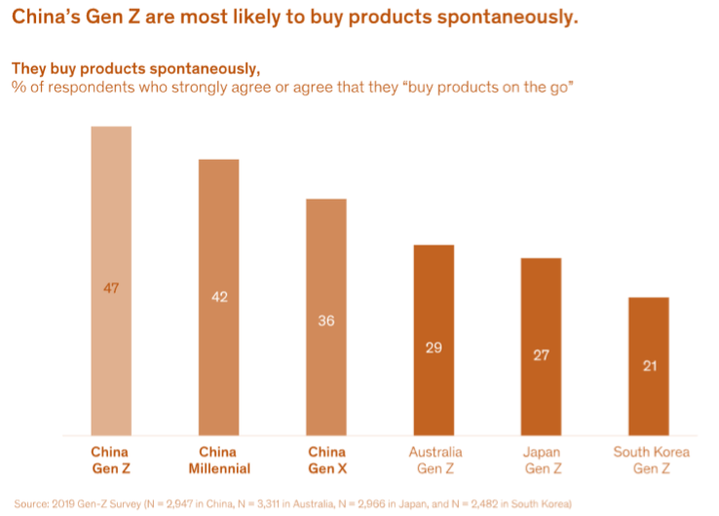
China Market Overview
New Mentalities & Trends of The Chinese Visitors - CONT.
Go Back To Outdoor Nature Spaces To Relax, To Slow Down
Millennials and Gen-Zers in China, which dominate the upcoming generation of tourists, seek different experiences when traveling. Chinese tourists nowadays engage more with natural destinations through a variety of activities, such as photography, acquiring natural knowledge, and exercise, etc. Hiking and camping have become popular new ways to get closer to nature. Millennial and Gen Z tourists from China are more independent travelers. They seek local experiences over the packaged sightseeing tours with large groups that appeal mainly to rural and older generations of Chinese tourists.

Slide 10
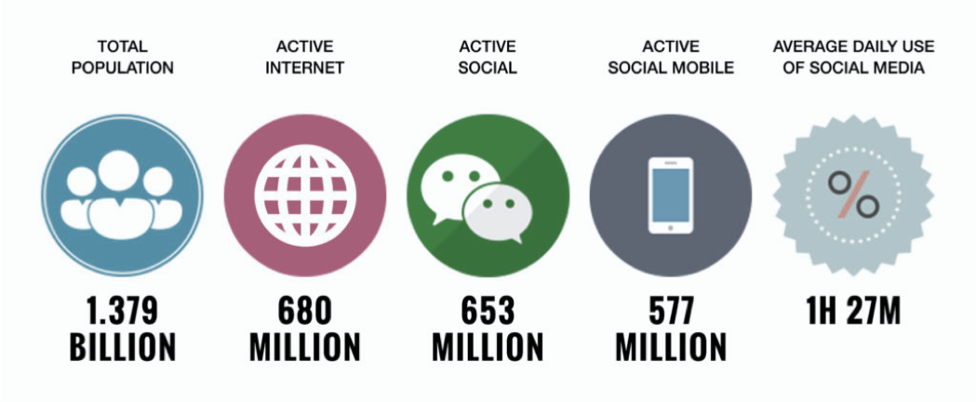
China Market Overview
New Mentalities & Trends of The Chinese Visitors - CONT.
Smartphone And Social Media Are Everything!
Digitalization: The growing use of digital technologies is expected to make travel more convenient and personalized for Chinese tourists. Mobile payments, online booking platforms, and social media are playing an increasingly important role in the travel industry.

Slide 11
China Market Overview
WHAT’S HOT IN 2023
XIAOHONGSHU
THE CHINESE INSTAGRAM
Xiaohongshu is also called Little Red Book or RED. 80% of the community on Xiaohongshu are female.
BILIBILI
THE COMMUNITY VIRILITY
Bilibili is often considered to be the Chinese YouTube, with 172 million monthly users.
KUAISHOU
THE BOOMING TREND IN SHORT VIDEOS
Kuaishou is a great alternative to Douyin for short videos. In 2021, Kuaishou reached 308 million daily users and active users on the platform spend an average of more than 100 minutes daily on its main app.

Slide 12
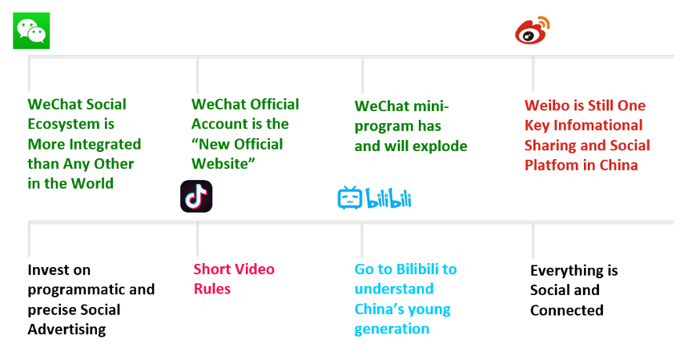
China Market Overview
8 TAKEAWAYS FROM CHINESE SOCIAL MEDIA

Slide 13
Current Challenges
Airlift
Current Challenges Airlift
Origin Airport | Destination Airport | Operating Airline | DepCount | Operating Airline Capacity | Seats per Operation
PVG | DTW | DL | 132 | 40,392 | 306
PVG | SEA | DL | 190 | 53,390 | 281
PVG | DFW | AA | 158 | 41,691 | 264
PVG | JFK | MU | 150 | 47,100 | 314
CAN | JFK | CZ | 52 | 18,720 | 360
PEK | JFK | CA | 19 | 6,935 | 365
PEK | LAX | CA | 130 | 44,237 | 340
XMN | LAX | MF | 136 | 38,896 | 286
CAN | LAX | CZ | 83 | 29,304 | 353
SZX | LAX | CA | 52 | 16,901 | 325
PVG | LAX | MU | 33 | 10,362 | 314
PVG | SFO | UA | 321 | 111,249 | 347

Slide 14
Current Challenges
Group Travel Ban
Current Challenges Airlift
On February 6th, China allowed travel agencies to re-shelf group and FIT packages to 20 countries of all packaged outbound travel products including to Thailand, Indonesia, Cambodia, Maldives, Sri Lanka, the Philippines, Malaysia, Singapore, Laos, the United Arab Emirates, Egypt, Kenya, South Africa, Russia, Switzerland, Hungary, New Zealand, Fiji, Cuba and Argentina
Another 40 countries starting March 15th as the second batch of destinations to which outbound group tours are approved.
FITs worldwide are completely re-opened!

Slide 15
Opportunities
Airlift
Airlift
U.S. FLIGHT RESTORATION: China and the U.S. agreed during Secretary Blinken’s visit to China earlier this month to increase airlift and further facilitate people-to-people exchanges between the two countries.
This is being widely viewed by the industry as the key to increasing frequencies between the U.S. and China this summer.
UNITED AIRLINES: following Secretary Blinken’s visit to Beijing, the China team connected with the China office of United Airlines to gauge their reaction to the visit, and have been informed confidentially that United’s flight restoration steps are likely to be as follows, timing still to be determined:
Increase PVG (Shanghai) to SFO route to daily
Restore PEK (Beijing) to SFO route daily
Consider launching an additional PEK (Beijing) to LAX service

Slide 16
Opportunities
Group Travel
Current Challenges Airlift
The in-market tour operators are being creative with some workarounds including selling piecemeal/”tailormade” trips.
Agencies are creating demand for group bookings by creating itineraries and groups and then calling clients. They also decouple package elements, selling air or hotels separately, so it doesn’t look like an actual packaged tour.
Friends and family also form mini groups traveling on tailored-made itineraries that operators can sell.
Some major state-owned tour operator, such as CYTS had posted U.S. group product posters and advertisements with price and itinerary clearly stated.

Slide 17
China Travel Trade

Slide 18
Our On-going Stragegy - Travel Trade
Face to face sales calls
In-house trainings and online webinars
Brand USA China Mission
U.S. Embassy roadshows
Extend stay length in Arizona for both groups and FITs
China Sales Mission / China VIP events
Trade Shows: IPW 2024 / ITB China
Coops with major OTAs
* What’s New - Receptive tour operator FAM

Slide 19
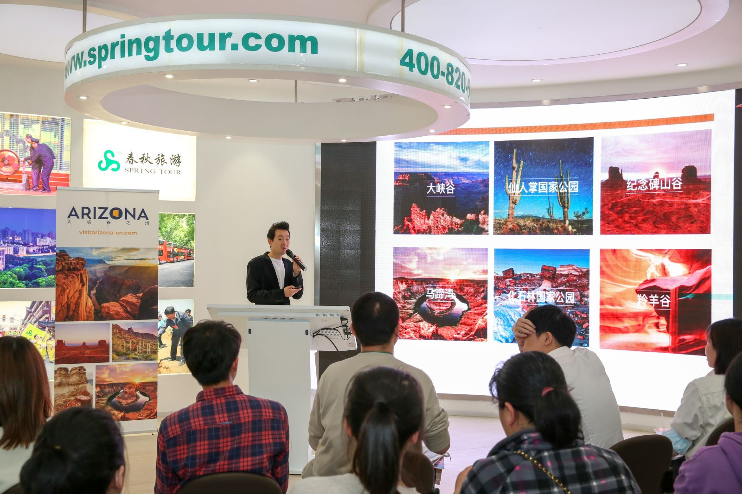
China Market Travel Trade
FY23 Sales & Marketing Overview:
Number of trade Fams hosted: 0 (due to Zero COVID policy)
Number of trade shows / exhibitions participated in: 5
Number of trainings/webinars: 85
Number of agent staff trained: 475
Number of offline VIP events: 2
Number of trade enrolled in Mini-program: 148
Number of trade completed online training course: 41

Slide 20
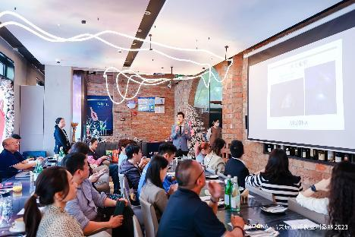
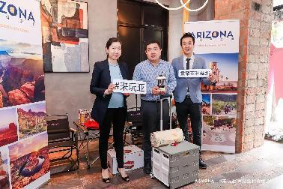
FY 23 Travel Trade Activities
AOT China Mini Gathering Shanghai Event
AOT Shanghai office organized the mini-gathering event on April 19, inviting 16 travel trade partners and 8 media partners
AOT Shanghai Team conducted the Arizona destination PPT which including the major tourism resources of Arizona and the latest tourism news, as well as the Appreciate AZ program and the tourist resources of Williams.
Different themes and highlights including National Parks, Outdoor, Road trip, dark sky, food and wine are also introduced to help travel trade better develop in-depth Arizona products and visiting more cities in Arizona.
One outdoor KOL and one gastronomy KOL were invited to share their respective itineraries and travel experiences in Arizona. Outdoor adventure video produced by KOL Xiaobaozi and Arizona destination videos were broadcast before and during the luncheon.

Slide 21
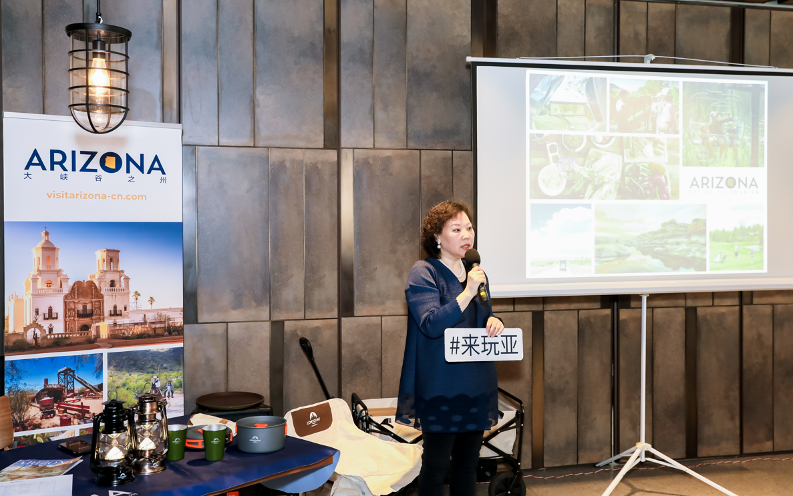
FY 23 Travel Trade Activities
AOT China Mini Gathering Beijing Event
AOT Beijing office organized the mini-gathering event on April 18, inviting 15 travel trade partners and 9 media partners
KOL Xiaobaozi, who presented a video of his deep outdoor trip to Arizona and shared his travel experience with everyone at the meeting
Beijing team delivered a PPT presentation, introducing the main tourism resources of Arizona and the recent tourism trends, including the Appreciate AZ program and the Williams tourist resource

Slide 22
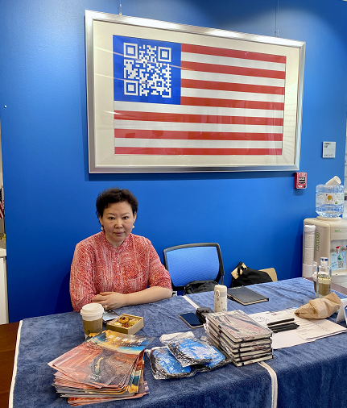
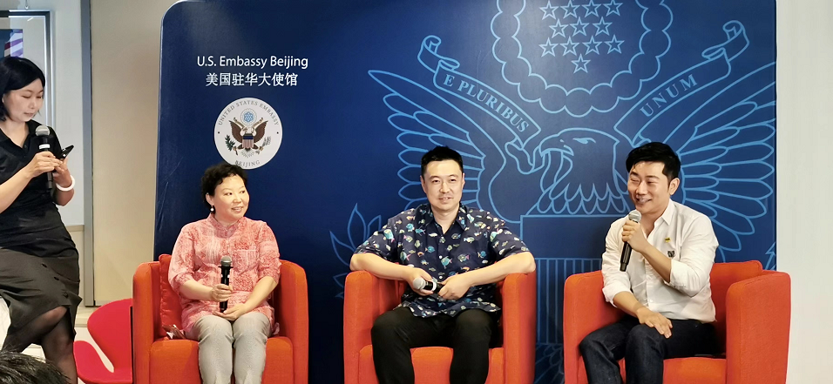
FY 23 Travel Trade Activities
US Embassy Beijing Roadshow 2022
On July 16, 2022, AOT Beijing attended the event organized by the Commercial Counselors’ Office of the U.S. Embassy in China
The U.S Embassy invited 30 representatives from 20 Chinese companies attended the B2B event. AOT had in-depth discussion with Tuniu, Mafengwo, Wenjing Holiday, Caissa, JD Travel, Sparkle, Ctrip, On the way, Beijing New Oriental, National Tourism (Media) , Utour, Qunar
AOT Beijing team, showed the beautiful videos of Arizona and deliver the destination presentation in the panel discussion session

Slide 23
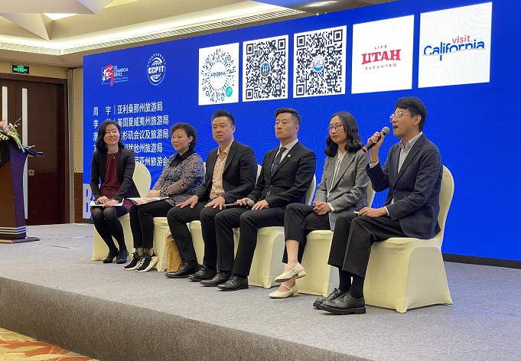
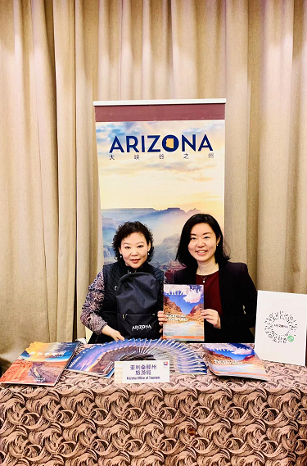
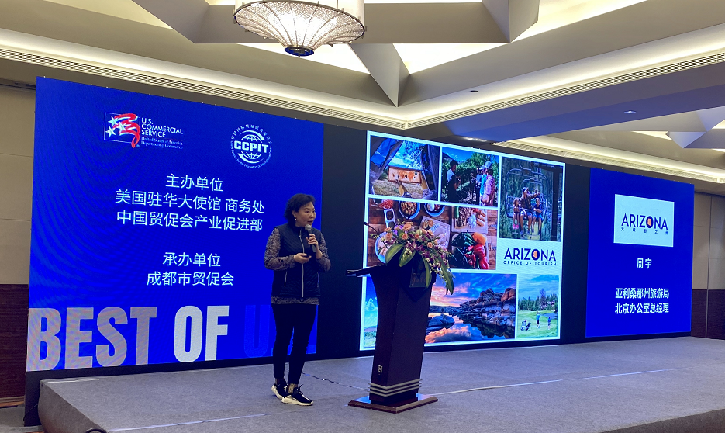
FY 23 Travel Trade Activities
The Best of U.S Chengdu Roadshow
On March 21, 2023, the Commercial Counselor's Office of the US Embassy in China held the 2023 Beauty in America Roadshow in Chengdu
U.S. travel service providers and DMOs including AOT China do panel discussions for the morning session, and destination training in the afternoon
Continue to enhance the brand awareness of Arizona in Southwest China and position Arizona as a top and active tourist destination in the United States in the eyes of industry partners through high-quality training and contacts

Slide 24
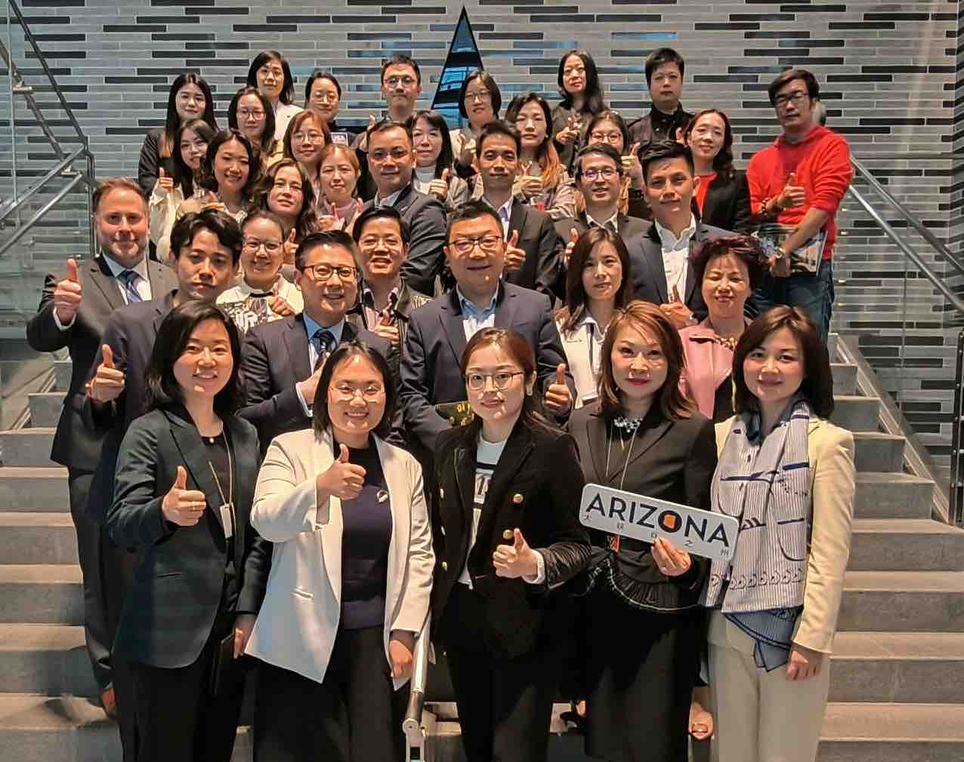
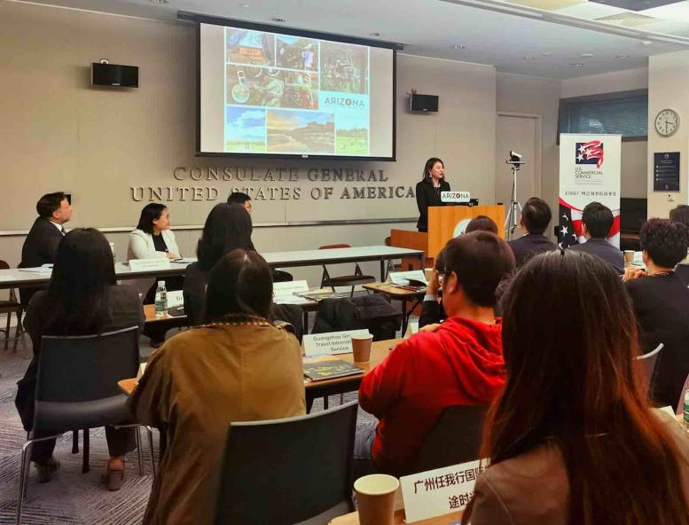
FY 23 Travel Trade Activities
Travel & Tourism Industry Roundtable in Guangzhou
The U.S. Department of Commerce, International Trade Administration, of the U.S. Consulate General Guangzhou organized the first South China Travel & Tourism Industry Roundtable since the pandemic on March 29, 2023. The roundtable included representatives of airlines, DMOs, Visa section officials and South China industry participants.
Arizona Office of Tourism (AOT) China was invited to participate to share destination updates and industry trends with all South China partners. The AOT China team had a great opportunity to present Arizona destination and travel resource introductions to the tourism industry, to encourage and create more possibilities for future cooperation and exploration. It shared the AOT expert mini-program with all attending industry partners as well as in the WeChat group of this roundtable.
Over 23 travel agencies from Guangzhou and surrounding areas with outbound U.S. tourism business attended the roundtable. The Visa officers presented latest information.

Slide 25
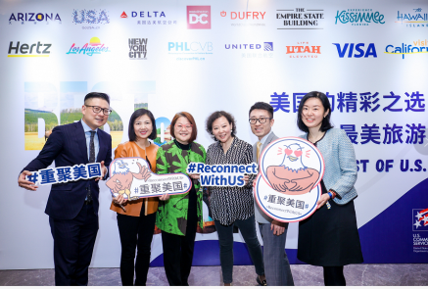
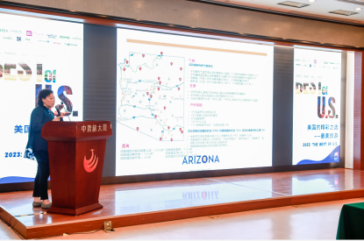
FY 23 Travel Trade Activities
The Best of U.S Beijing Roadshow
Welcome Chinese tourists #ReconnectWithUS# reception held on April 11, 16 US tourism destinations and local trade partners gathered together to talk about Reuniting America in the post-COVID-19 era
“The Best of U.S” Beijing Roadshow on April 12, in the one-to-one meeting in the morning, AOT China team had an in-depth discussion with 30 travel agencies, introduced the latest tourism resources and discussed the advance design of products
Afternoon training session organized by China Youth Travel and the US National Tourism Administration, AOT Beijing team shared the destination presentation to more than 70 sales staff and distributors of CYTS

Slide 26
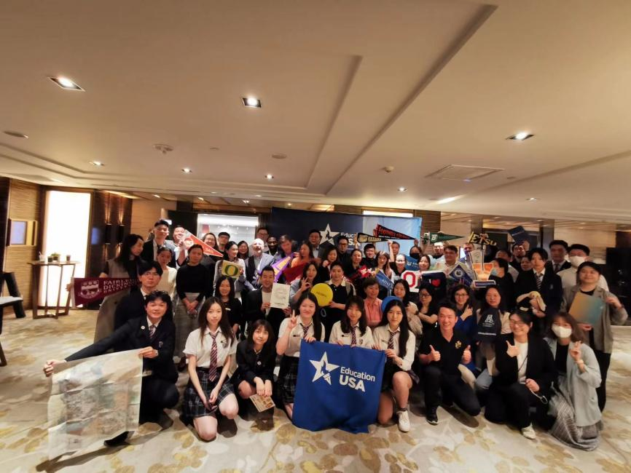
FY 23 Travel Trade Activities
Education USA College Fair Shanghai
AOT China attended U.S. College Fair in Shanghai on May 13th, with more than 500 parents and students attended who’s targeting to study in the U.S.
Chinese students ranked No.1 and represent 30%+ of the total international students for the U.S.
Both the University of Arizona and Arizona State University together with 30+ Universities in the U.S. participated in the Fair.
AOT China shared tourism highlights and recommended itinerary for the parents and students who’s going to visit Arizona. Arizona brochures and maps are also distributed during the event.

Slide 27
China Media Relations

Slide 28
Our On-going Stragegy - PR
Position Arizona as a world-class aspirational destination and increase existing awareness. Taking advantage of
Arizona’s nature resources, actively promote lesser-known attractions, introduce creative ways to travel in
Arizona to the media.
Pursue upscale magazines, online media, video portal and social channels to integrate with continuous in-market
programs, and generate in-depth coverage which encourage readers’ to stay longer when travel in Arizona.
Prioritize on Content Marketing - The media landscape in China has dramatic shift to social platform, we will
unitize our extensive media database both offline and online, for contents marketing. Our goal is to continue
creating high-quality in-depth contents to showcase what makes Arizona unique and in-compteable, including
videos, images and other assets e.g well prepared itineraries, travel stories to feed our travel trade partners’
owned social media channels as well as all key media’s official channels, and eventually leveraging from their
respective followers and consumers database.
* What’s New - FIT/Fly-Drive theme focused Press FAM

Slide 29
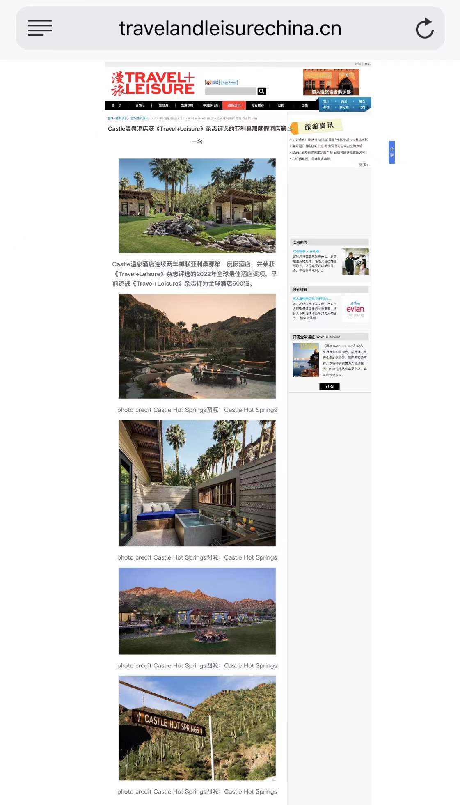
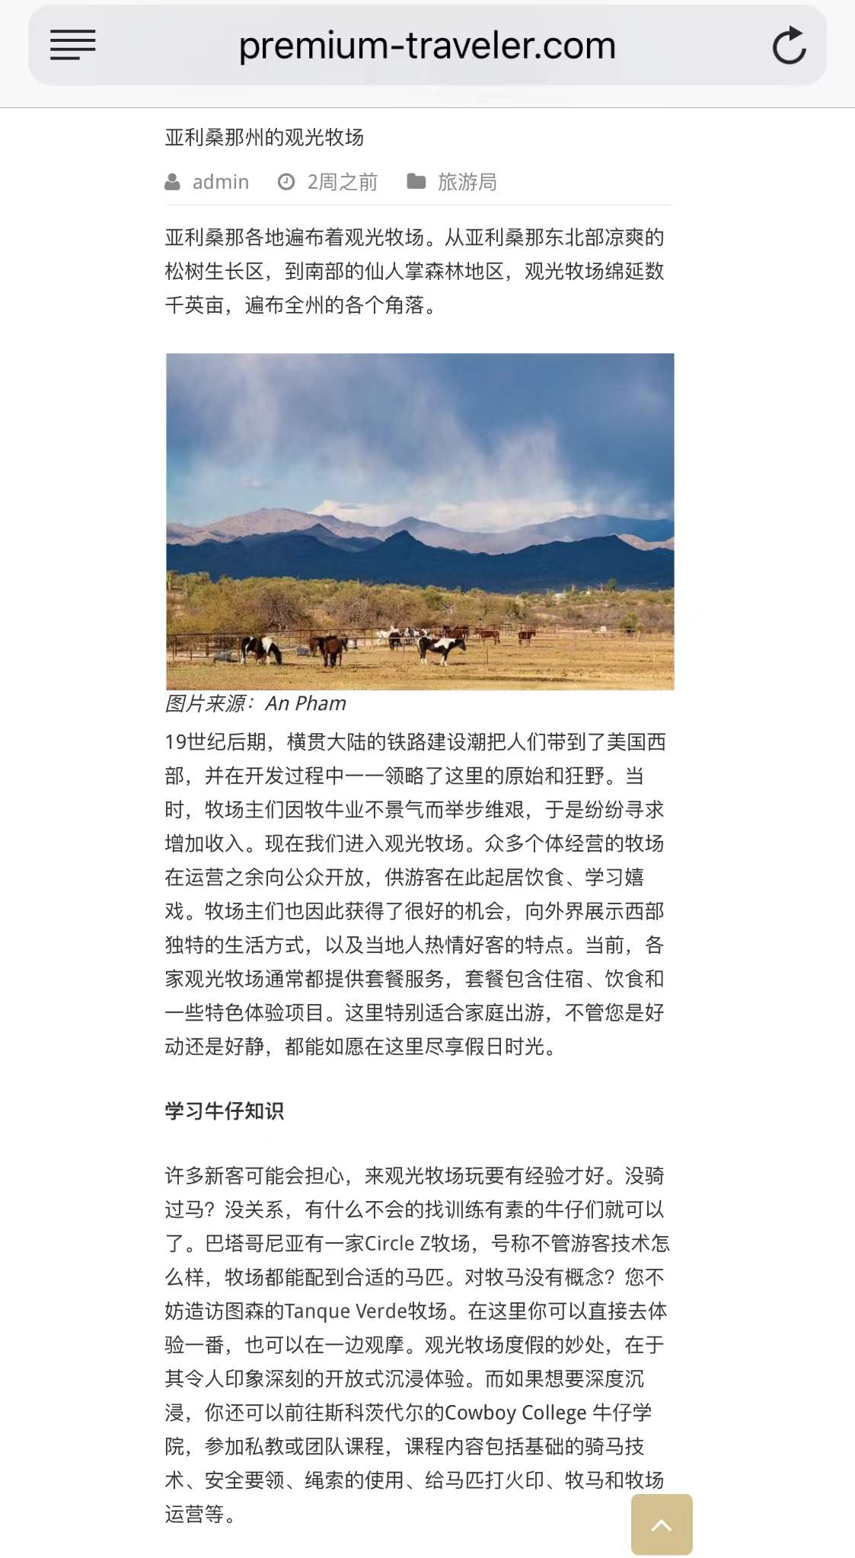
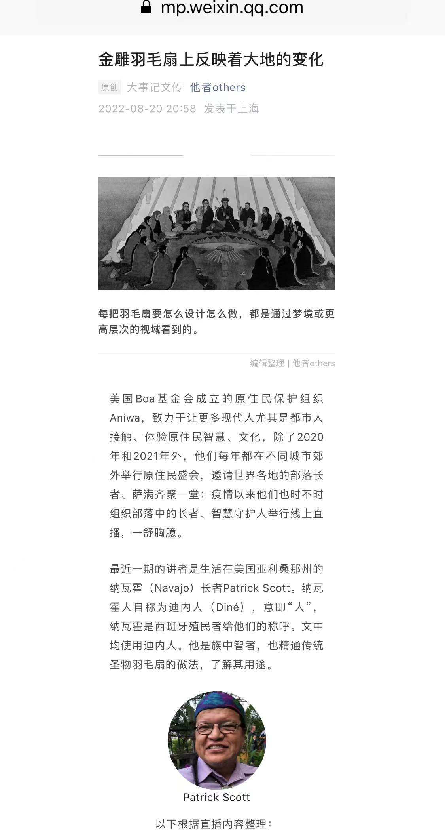
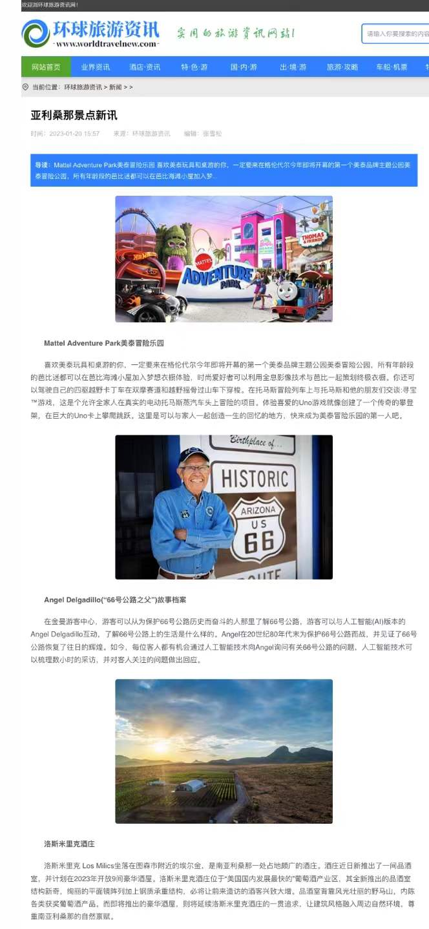
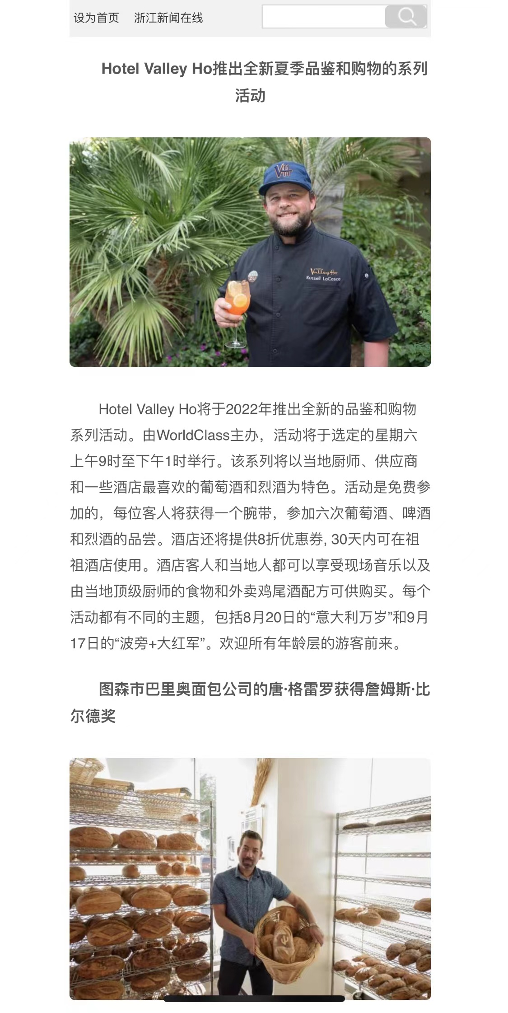
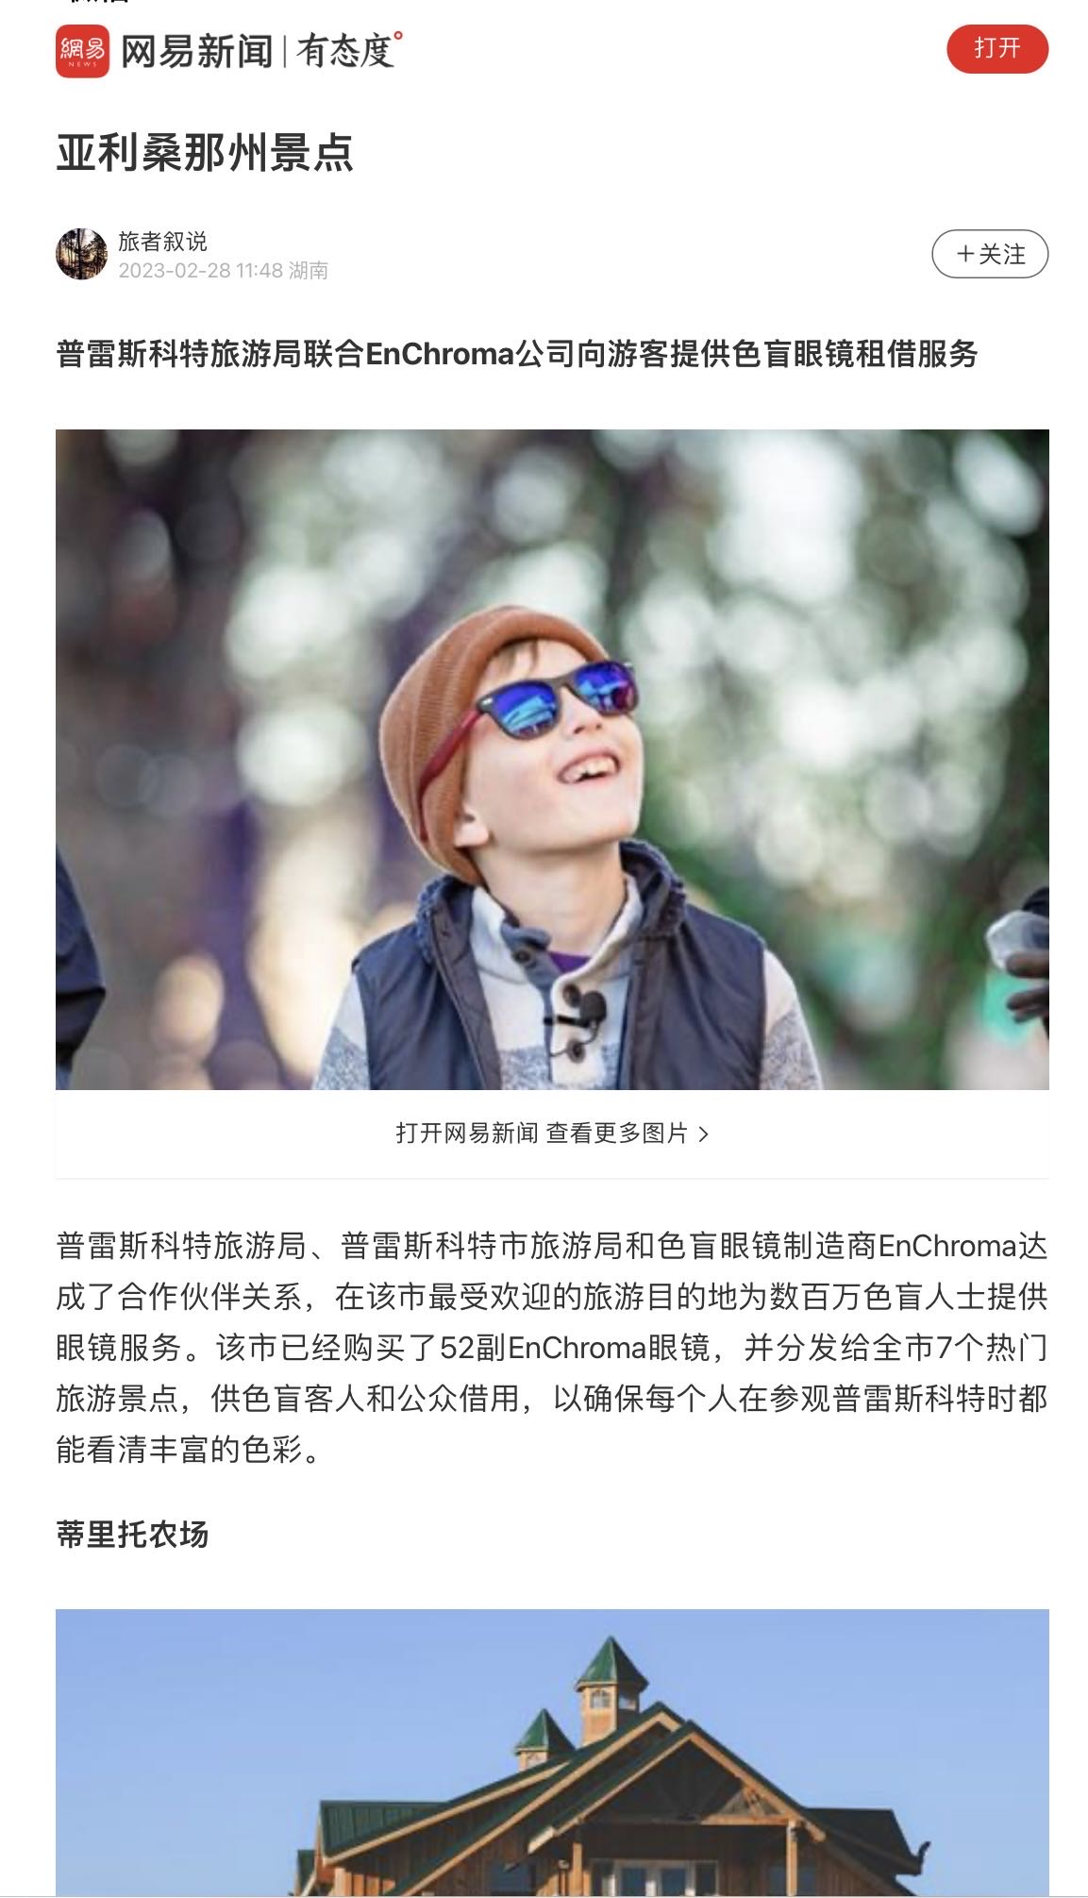
FY 23 Media Activities
Media Publicity: AD Value US$1 million (as of June 2023)
Number of Impressions: 81.5 million (as of June 2023)

Slide 30
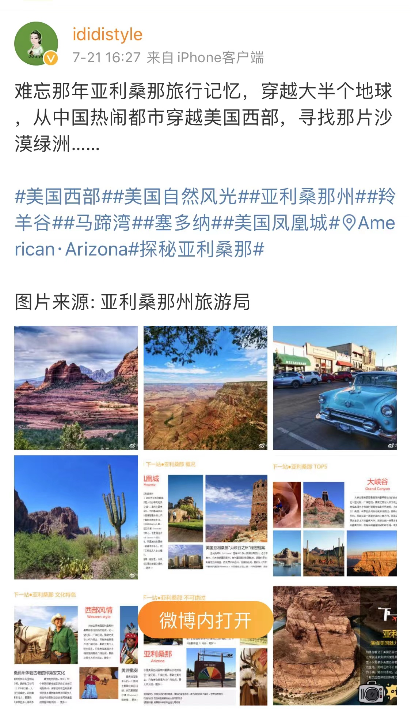
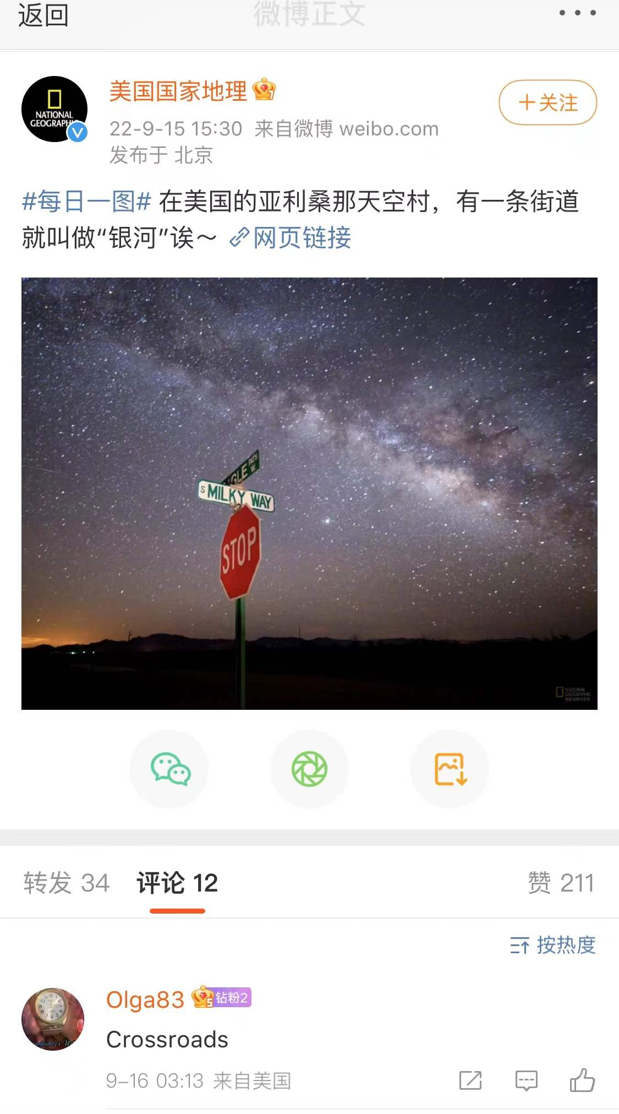
FY 23 Media Activities
Media Publicity

Slide 31
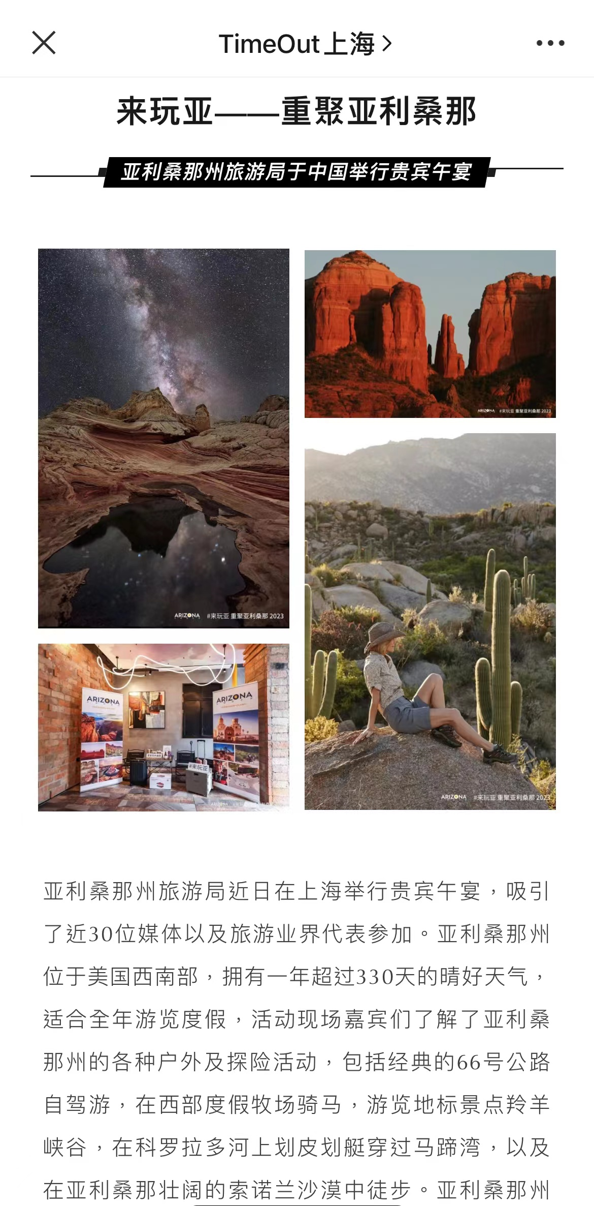
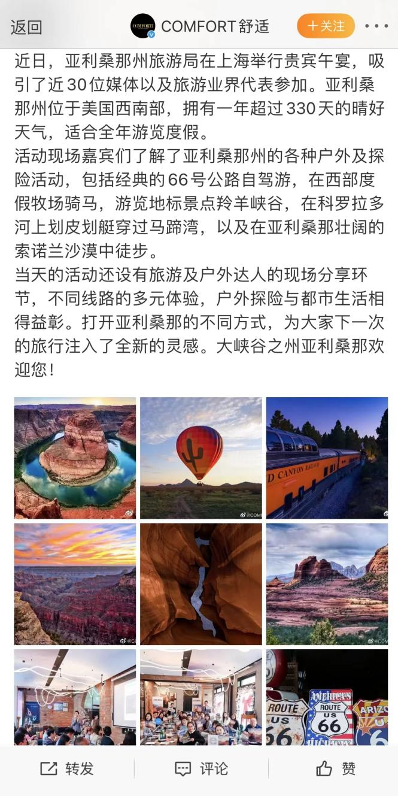
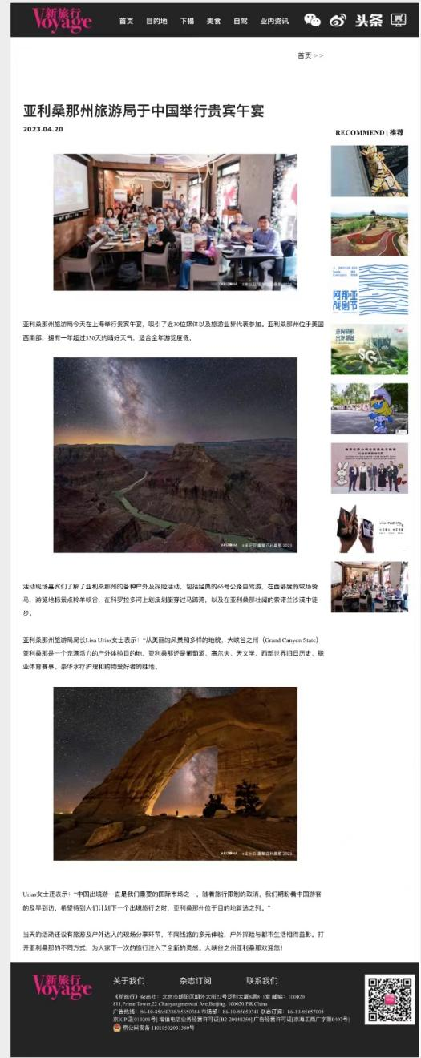
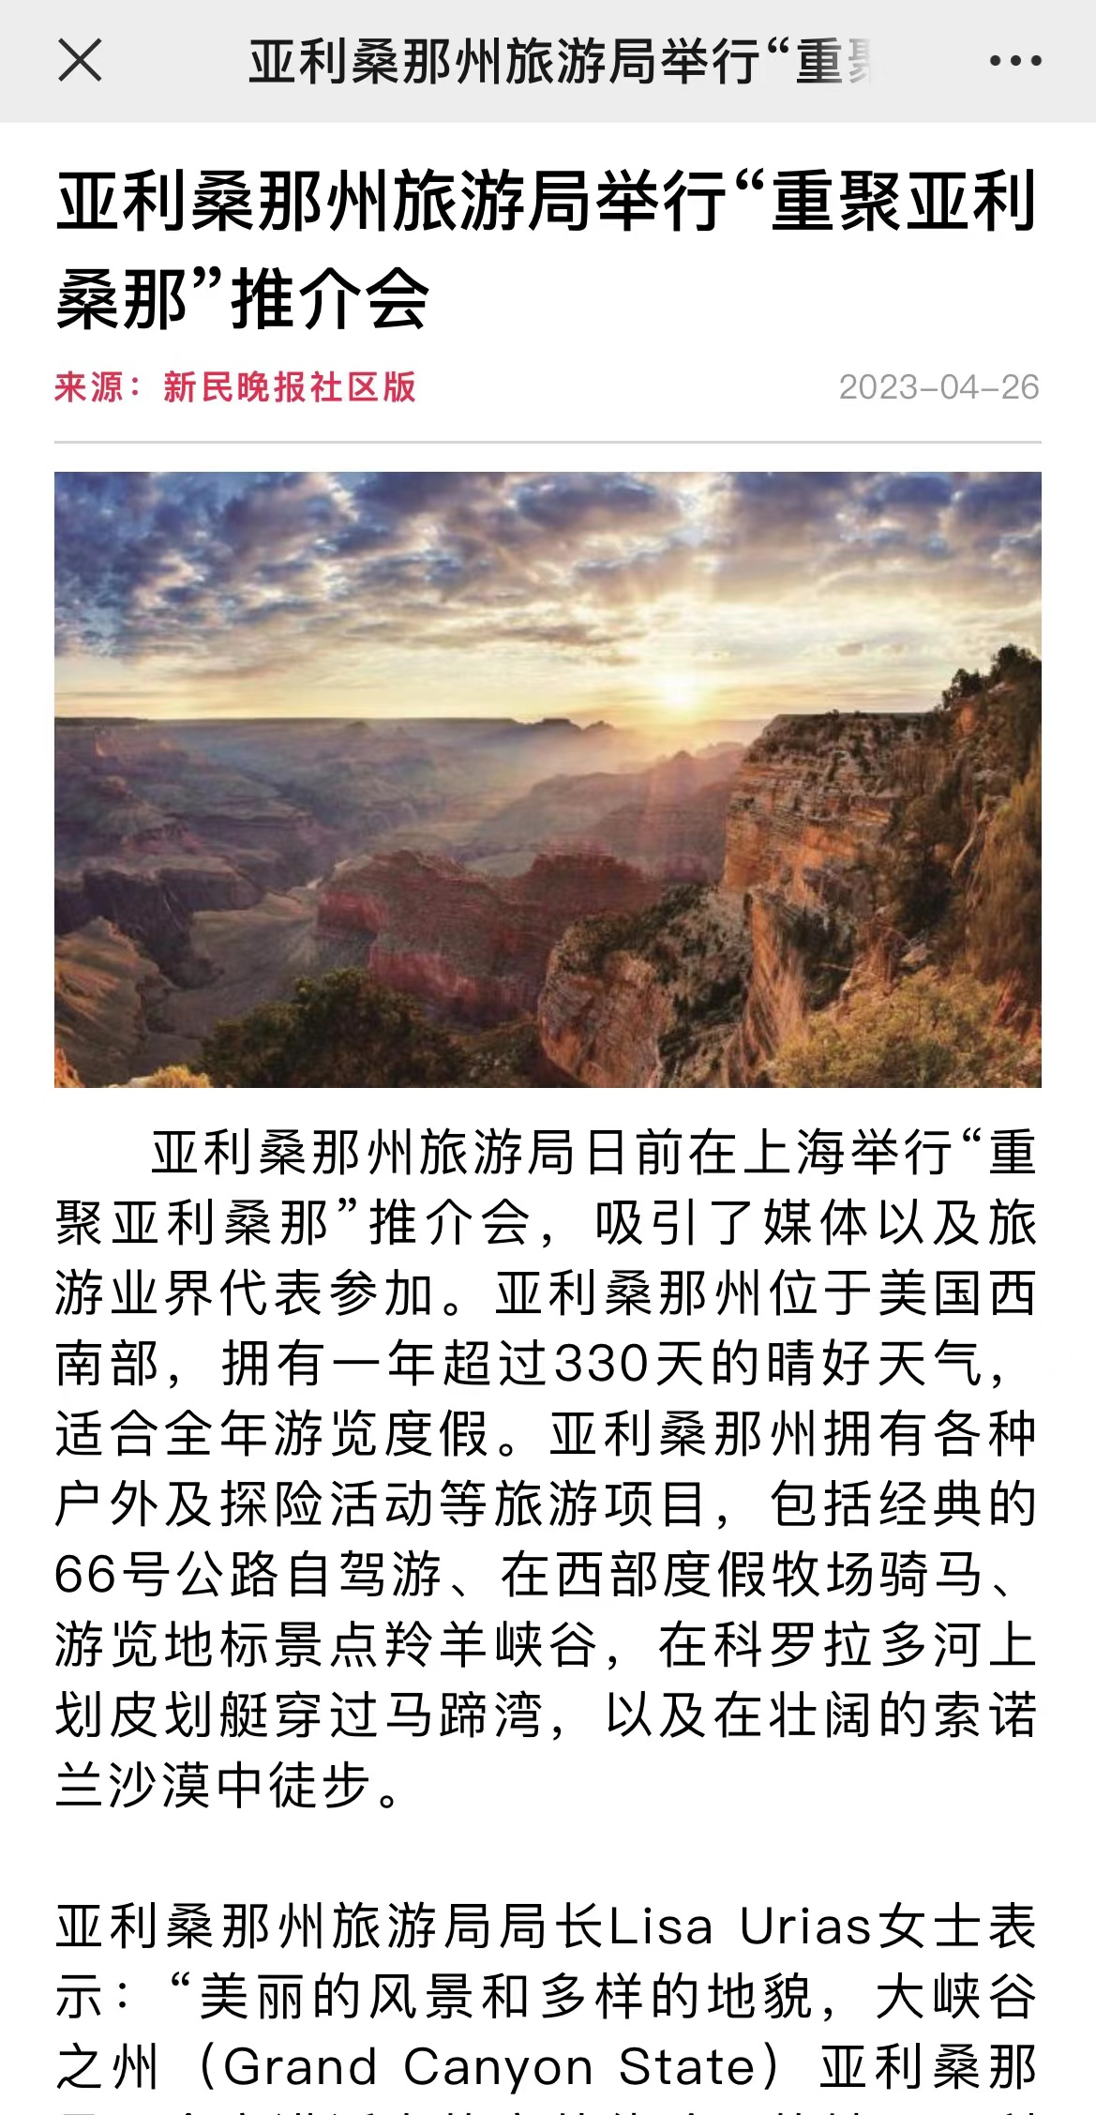
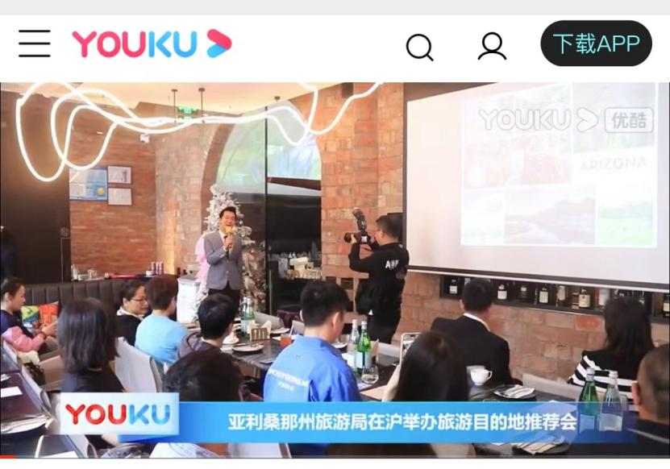
Mini-gathering VIP client event in Beijing and Shanghai
Media Publicity: AD Value US$62,900
Number of Impressions: 2.31 million

Slide 32
Thank You
Shanghai Office
Tina Yao, General Manager
Email: tyao@aviareps.com
Kevin Zhou, Travel Trade Marketing Director
Email: kzhou@aviareps.com
Jane Dong, Public Relations Director
Email: jdong@aviareps.com
Beijing Office
Cynthia Zhou, General Manager
Email: czhou@aviareps.com
Anita Yu, Public Relations Manager
Email: ayu@aviareps.com

