Slide 1
FY23 Canada
GCOT ’23
July 2023

Slide 2
CANADA AT A GLANCE
Inflation
As per Statistics Canada, The Consumer Price Index — a broad-based measure of inflation — fell to 3.4 percent in May from 4.4 percent in April (Toronto Star)
Despite the financial challenges posed by inflation and high gas prices, a significant majority of Canadians remain determined to embark on road trips this summer. The Angus Reid Forum, the 2023 edition of the annual Toyota Canada Summer Road Trip Survey found 74% of those polled are still planning a road trip, but fuel efficiency and other ways to cut costs are very much top of mind this year. (Toyota.ca)
Canadian Dollar
Up-to-date retail sales numbers from Statistics Canada that despite high prices and dire warnings about debt loads, Canadians remain in the mood to shop. The data agency reported that retailers took in $65.9 billion in April. That's an increase of 1.1 percent from March's level. (CBC)
Canada's economy regained momentum in May after stalling in April, Statistics Canada data showed. While April's growth underperformed expectations, the strong forecast for May aligns with signs that the economy is keeping hotter than anticipated despite a record-pace monetary tightening cycle by the Bank of Canada. (Reuters)
Workforce
Employment increased by 43,000 among core-aged men (aged 25 to 54) in May, following a gain of 18,000 in April and little variation in February and March. Employment rose 19,000 for core-aged women in May, following three consecutive months of little change. (Statistics Canada)
As per Canada Revenue Agency, the average hourly wages rose 5.1 percent in May to CAD $33.25 (Daily Hive)

Slide 3
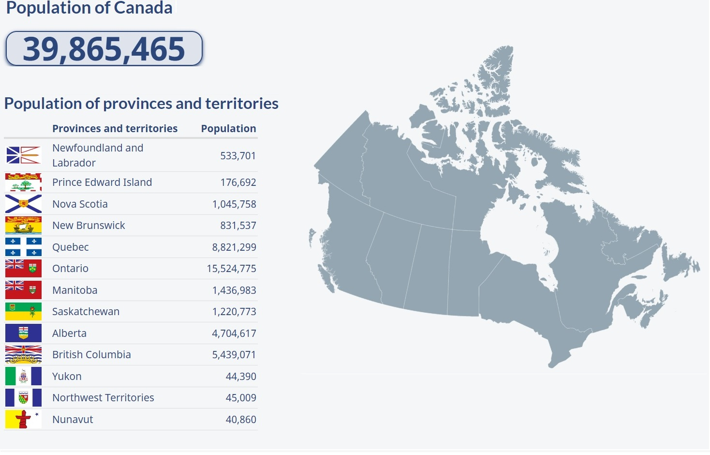
POPULATION OVERVIEW
Canada's population was estimated at 39,566,248 on January 1, 2023, after a record population growth of 1,050,110 people from January 1, 2022, to January 1, 2023.
This is the first year in Canadian history that had a population increase of over one million, and it also represents the greatest annual population growth rate (+2.7%) since 1957 (+3.3%).
For the year 2022, Canada welcomed 437,180 immigrants and saw a net increase in the number of non-permanent residents estimated at 607,782. In 2023, The Canadian Newcomer target would be at 465,000 (Canada.ca)
The numbers represent the highest levels on record, reflecting higher immigration targets and a record-breaking year for the processing of immigration applications at Immigration, Refugees and Citizenship Canada.

Slide 4
CANADIAN TRAVEL LANDSCAPE 2023 | GREAT NEWS!
Canadian residents returned from 2.5 million trips to the United States in February 2023, almost four times the number taken in February 2022 (686,300) and 81.6% of the pre-pandemic level from the same month in 2020. (Statistics Canada)
Tourism spending in Canada grew 2.6% to $20.8 Billion in the first quarter quarter of 2023, the eighth consecutive quarterly increase. (Statistics Canada)
Canadians continue to indulge in holidays despite higher flight prices and hotel costs. They are cutting back spending on goods, restaurants, groceries, and cars. (Royal Bank of Canada)

Slide 5
CANADIAN TRAVEL TRENDS 2023
Canadian searches for flights have now surpassed 2019 levels. According to the Head of Travel Industry at Google Canada, this trend reveals that Canadians are past “revenge travel” and are prioritizing travel as a core value. Travel Press
The majority 75% (Canadians) – listed relaxation and disconnecting as the primary incentive for taking a leisure trip, followed by adventure, which is almost twice as important for Canadians than for global travelers (41% vs 25%).
Newswire
Based on traveller demand, most of the destinations seeing the largest increases are all culture-rich cities. Increasing interest in arts and cultural festivities, major events back in full swing.
OpenJaw
Canadians are showing a desire to go on bucket list trips, since they haven’t travelled in three years, they have more money to spend on travel.
Travel Industry Today
New research from Booking.com reveals that 65% of Canadian travellers say they want to travel more sustainably over the coming 12 months and 70% confirm that travelling more sustainably is important to them.
Travelpress

Slide 6
Earned Media: July-June 2023
Total Impressions:
47,963,392 Total Ad Value: $1,017,861
Total Articles Generated:
106
Top-Tier Media Coverage Includes:
The Globe & Mail
The Globe & Mail
Vancouver Sun
Calgary Herald
Edmonton Journal
Toronto Sun
Ottawa Citizen
The Calgary Sun
Le Devoir
Daily Hive

Slide 7
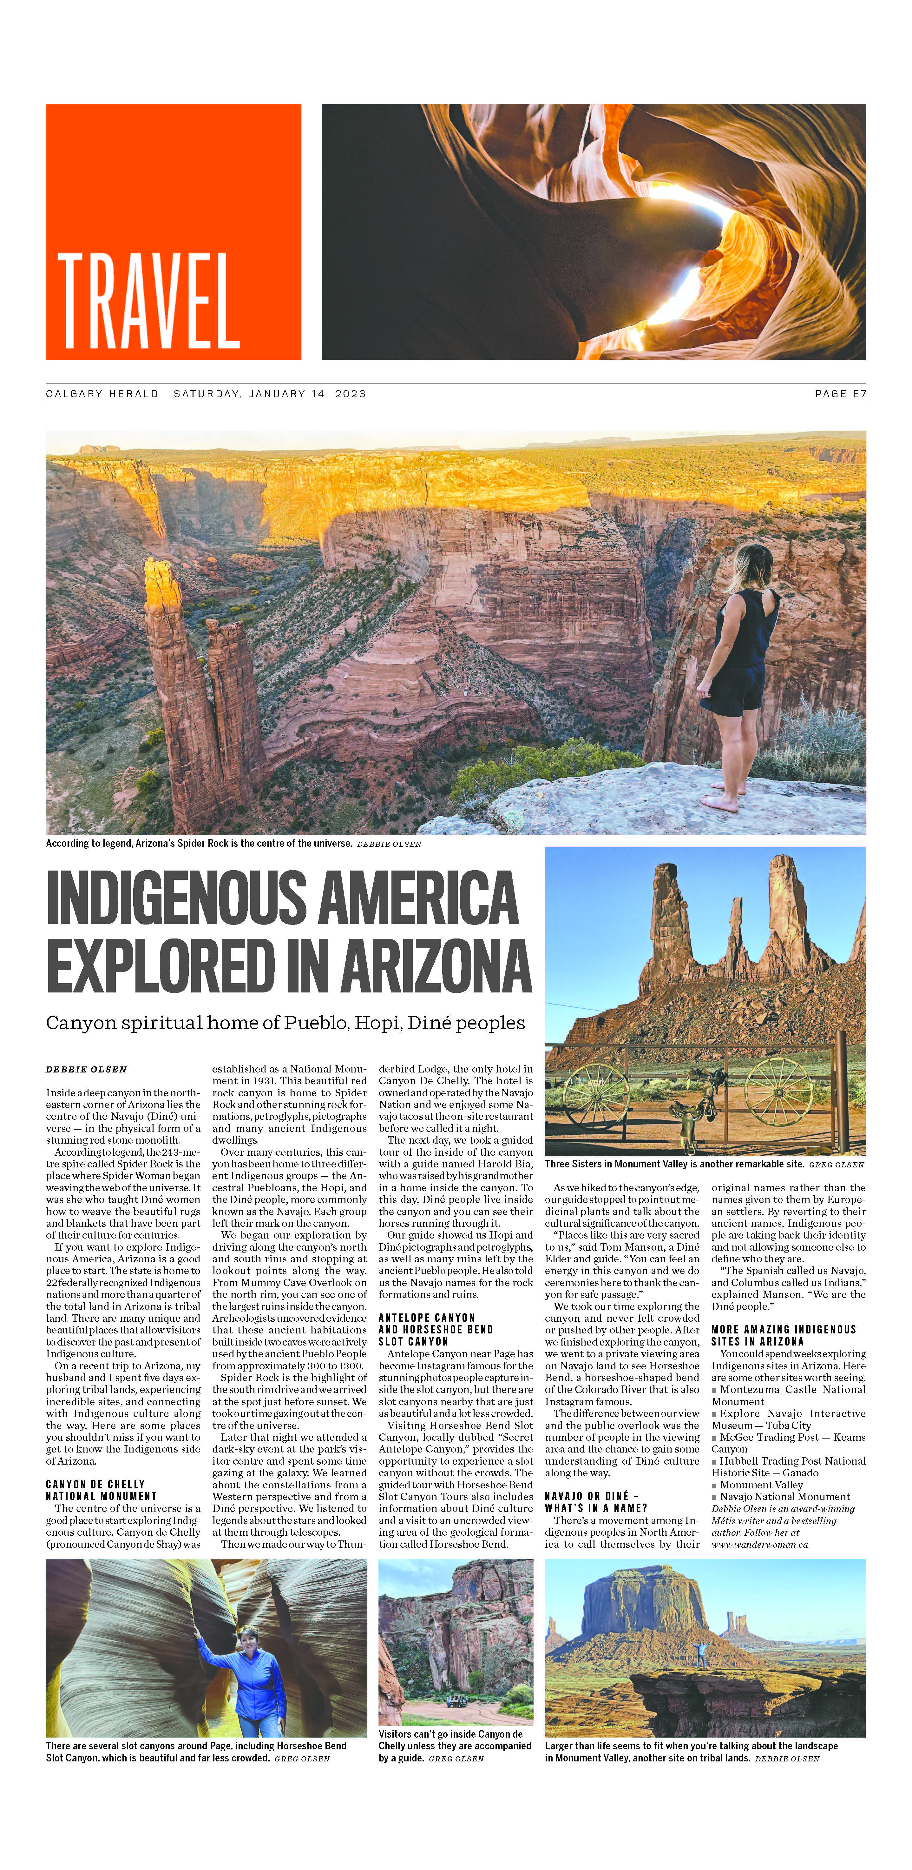
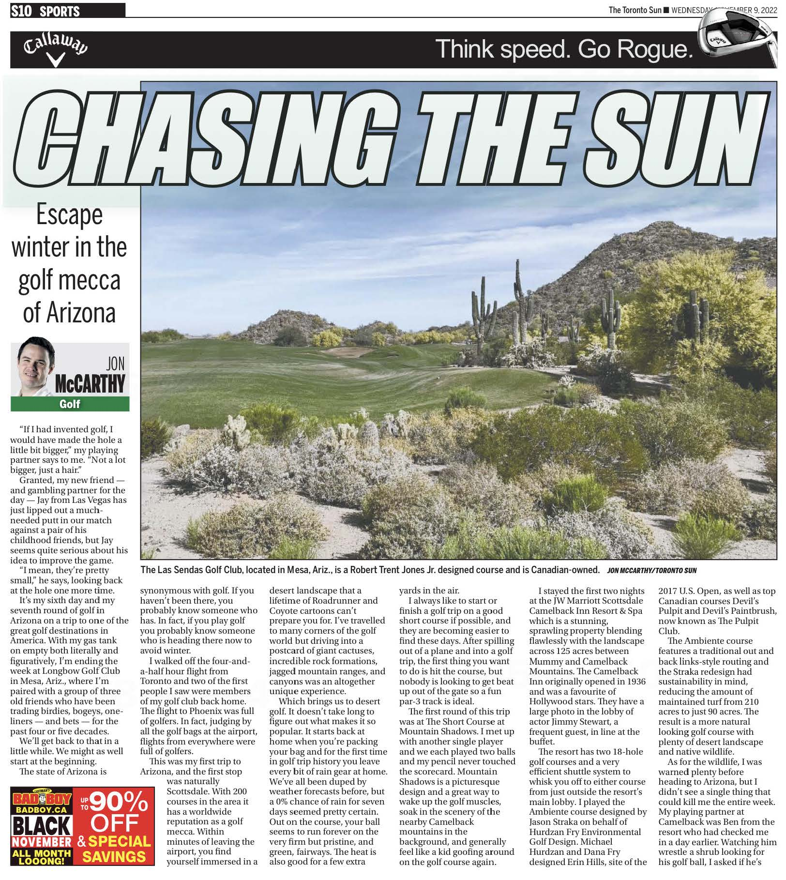
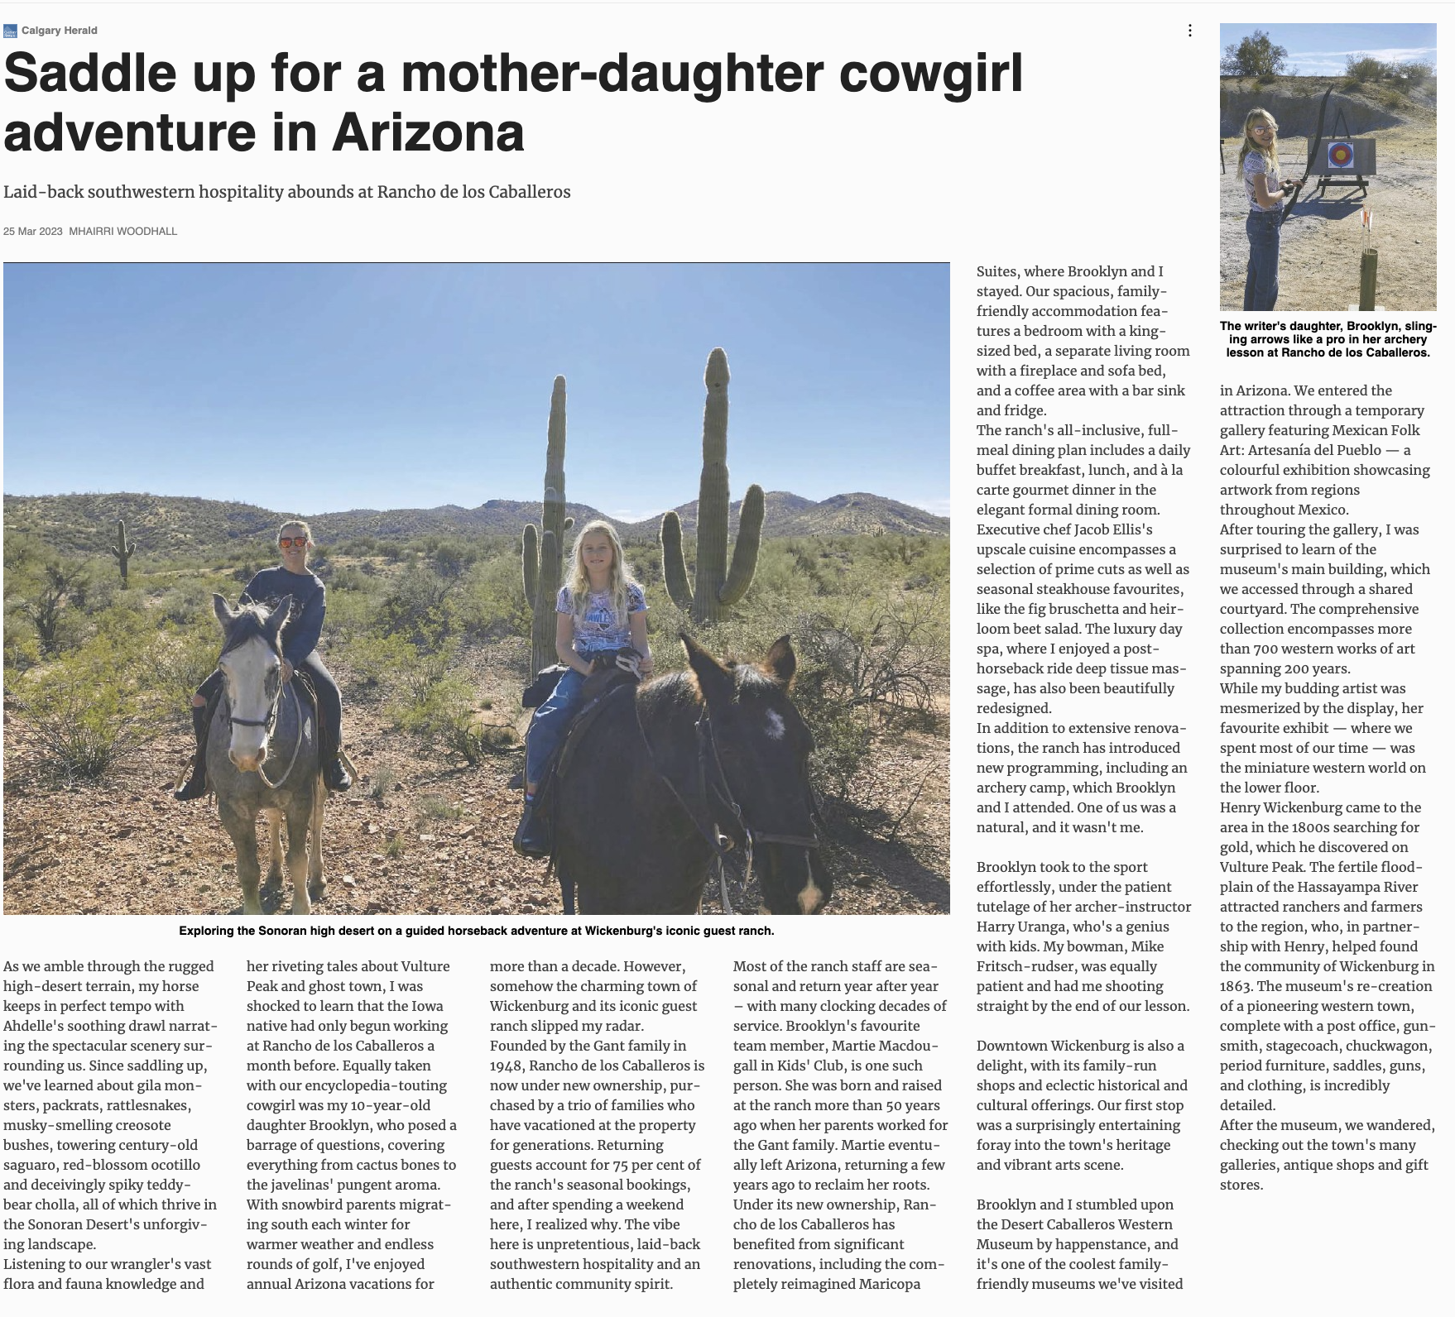
IPW 2023 | Best US Travel Destination Article by Debbie Olsen
Top Earned Media Articles | FY ‘22 –’23
Vancouver Sun
Le Devoir | Quebec
Calgary Herald & Vancouver Sun (Print) + Syndicated across 22 Postmedia Publications
Calgary Herald (Print) + Syndicated Across 6 Postmedia Publications
The Toronto Sun

Slide 8
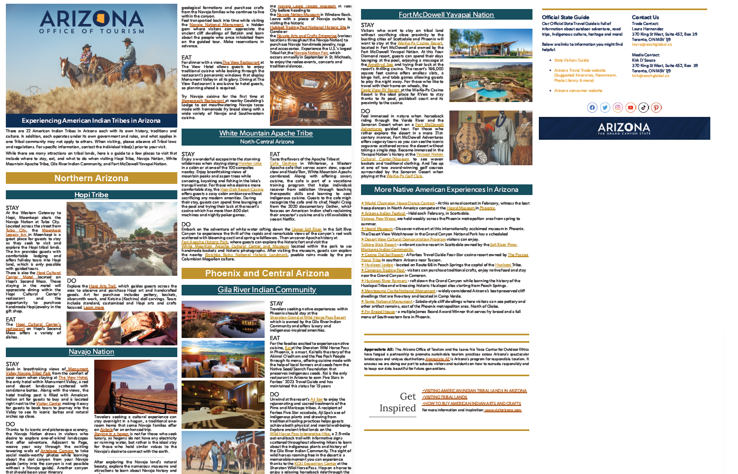
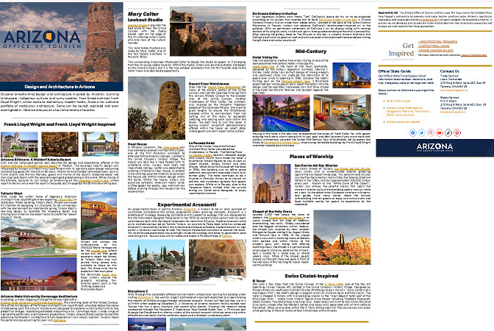
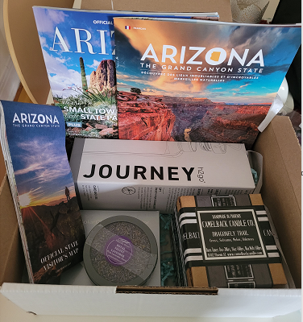
Canadian Trade Results
Key Performance Indicators: ​
Trade Leads, Sales calls, Trainings & Webinars​.
Sales calls​ : Completed 73 sales calls as we are still facing a post-pandemic recovery and constant economic inflation rates.
GOAL KPIs: 365 ​/Achieved: 399
Events & Trainings ​ We were successful in capturing the attention of an audience flooded with information by hosting 15 virtual trainings. We connected with agents from top-producing travel agencies, nationally and in both English and French. (ex: AMA, Group Voyages Quebec, CAA Quebec, Autentik USA, Travel Only, Toundra Voyage)
Webinars reached a total of 313 agents.
Canadian Trade Activities:
Newsletters: 12 English newsletters sent to 28,963 agents nationally.

Slide 9
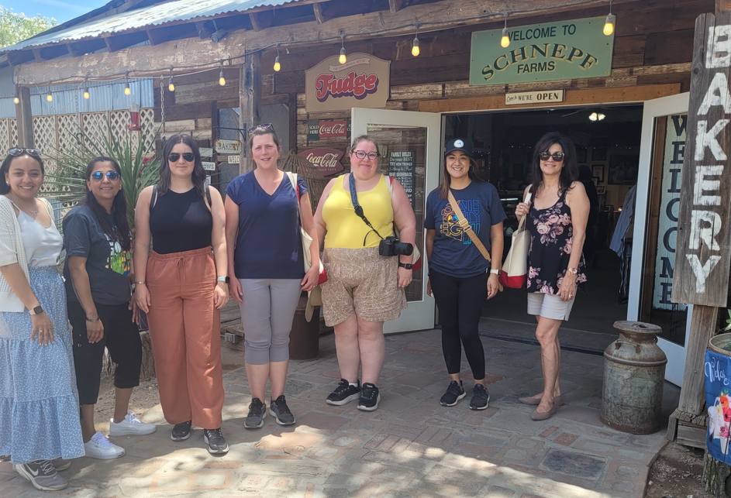
Canadian Trade Results
Trade Shows & Activations
CAA Manitoba B2B/B2C event – Successfully completed on September 17th,2023
1200 consumers attended the event & AOT attendance included a 20-minute presentation.
Our presentation had the highest attendance amongst the 5 others, with over 40 consumers attending, as well as 11 CAA Manitoba reservations staff
Vancouver Mission – Successfully completed on October 18 & 19, 2022
56 travel agents and airline representatives attended the event. More lift for Arizona sun-seekers, with new gateways opening-up
AMA Marketing Campaign –Targeting the right audience, using the right tools to increase conversion. (Tools Included dedicated articles, email, social media).
FAM Southern Arizona (Tucson, Benson Bisbee, Mesa)

