Slide 2
United Kingdom & Ireland
Visitation Numbers: 27,900
Spending: $24.8 Million

Slide 3
Integrated Marketing

Slide 4
Integrated Marketing: An Overview
Trade Engagement
Online Training Programme
Tour Operator Trainings
Newsletters
Events
Travel Bulletin Luxury Holidays Showcase
Sunrise Yoga Event
Consumer Promotions
Travel Counsellors Partnership

Slide 5
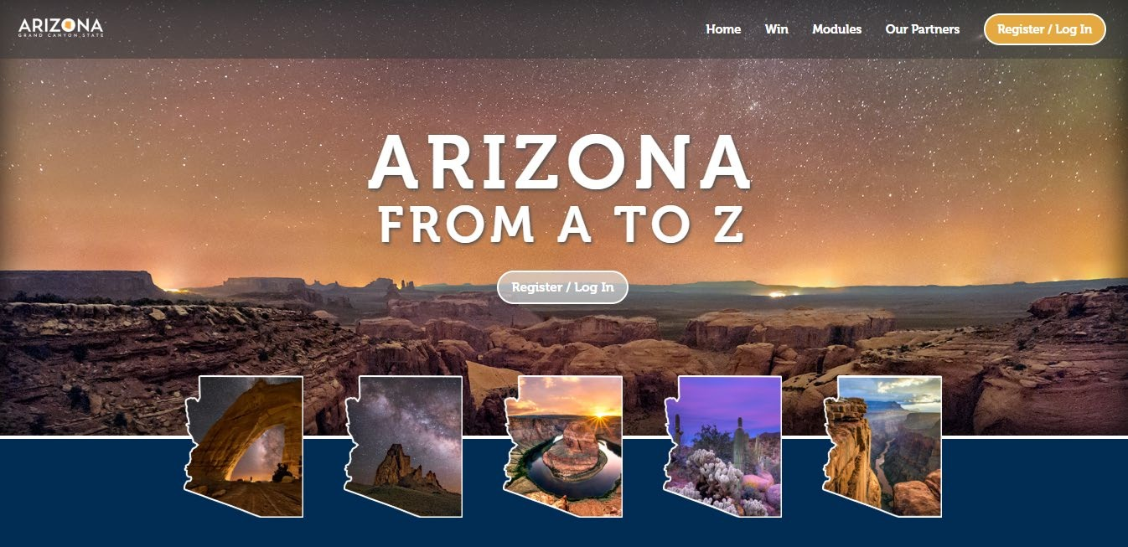
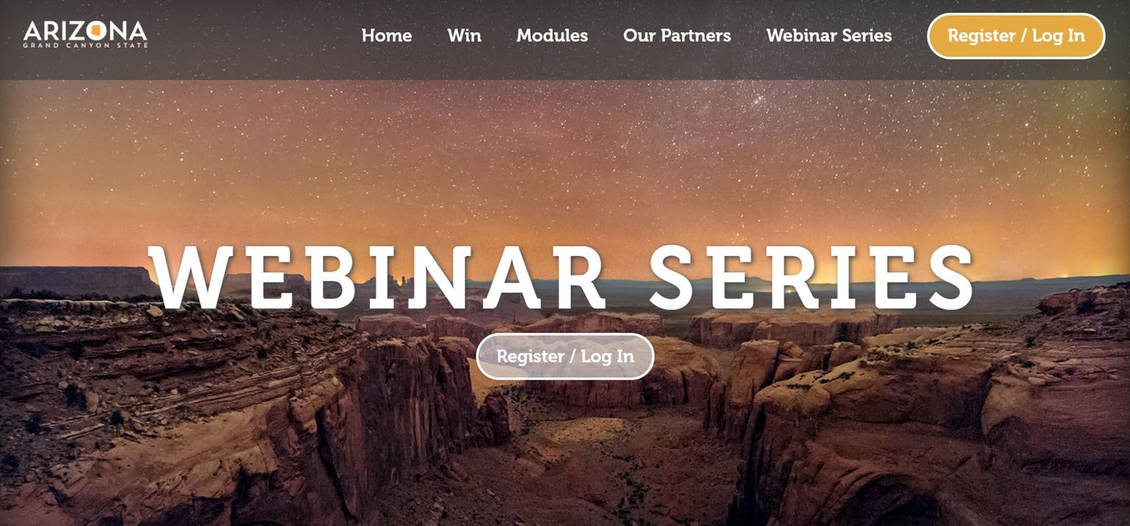
Online Training Programme
Arizona from A-Z. The highly visual, bespoke programme was designed to highlight AOT’s key features and lesser known regions of the state. The programme also features partners including Mesa City, Tucson, Flagstaff and Dos Cabezas Winery.
We have created 155 Arizona Expert Ambassadors who are not more confident and motivated to selling Arizona, and this number is increasing by the day.

Slide 6
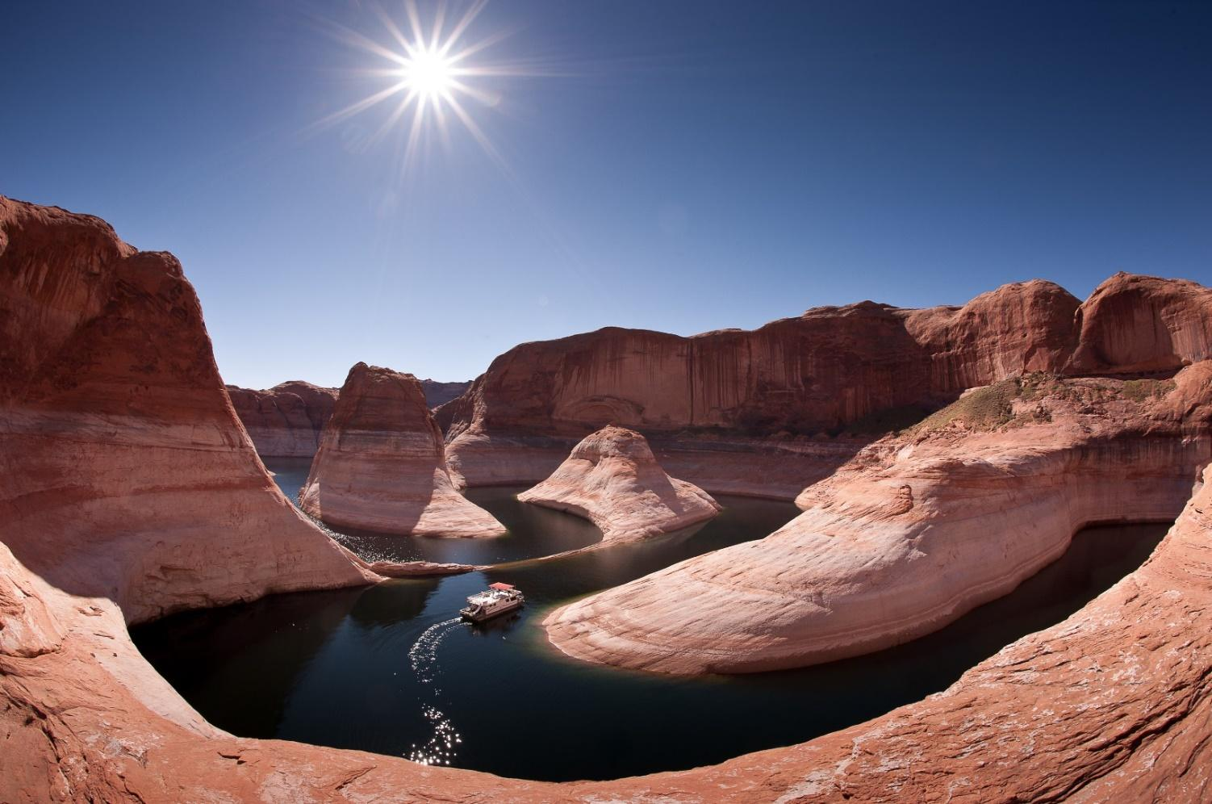
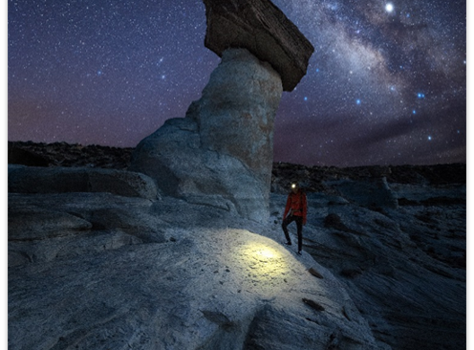
Tour Operator Trainings
Hills Balfour also conducted trainings with individual Tour Operators (TO) throughout the year and also hosted AOT run webinars open to agents from all companies. Please see information below on key trainings;
Travel Bulletin Luxury Holidays Showcase – 50 attendees
Hills Balfour partnered with Travel Bulletin, a key UK TO, to provide training for agents. Hills Balfour provided training across the luxury offerings in Arizona.
ITC Travel Group – 7 attendees
Hills Balfour partnered with ITC Travel Group to provide training on Arizona to their agents.
Sunrise Yoga Event - 11 attendees
Hills Balfour provided a luxury yoga event with yoga and training at the Sky Gardens

Slide 7
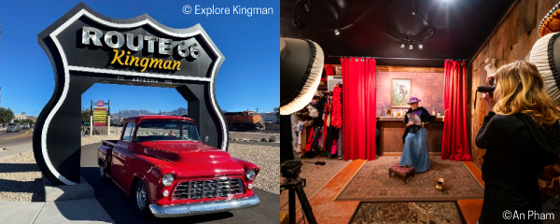
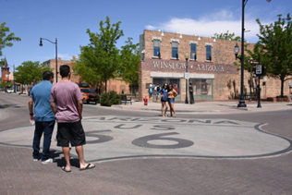
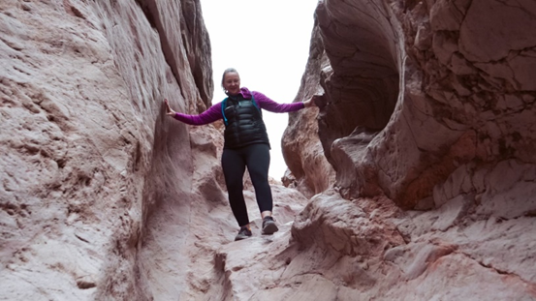
Trade Newsletters
From July 2021, Hills Balfour continued to draft and distribute trade newsletters. These newsletters have featured different themes, mentioned below, and are distributed to a database of 35,000 trade agents:
Craft Beer
Arizona’s Western Ways
Ghost Towns
Holidays
Sustainability
Arizona Gems
Birding and Gardening Tours
Wineries
National Parks
Accessibility
Hikes (Unique)
22 Summer Road Trip

Slide 8
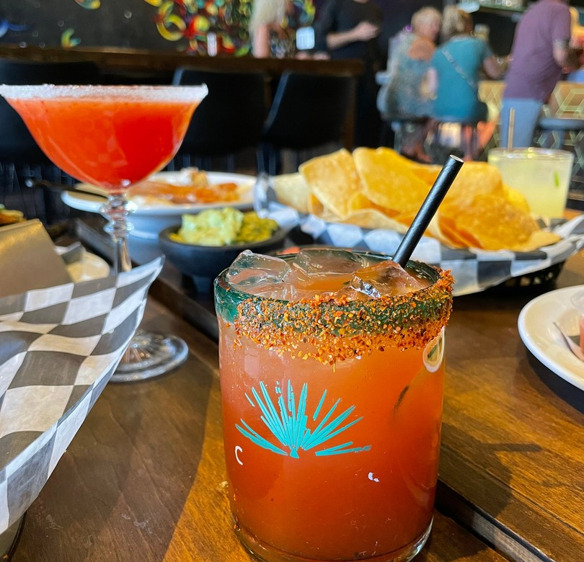
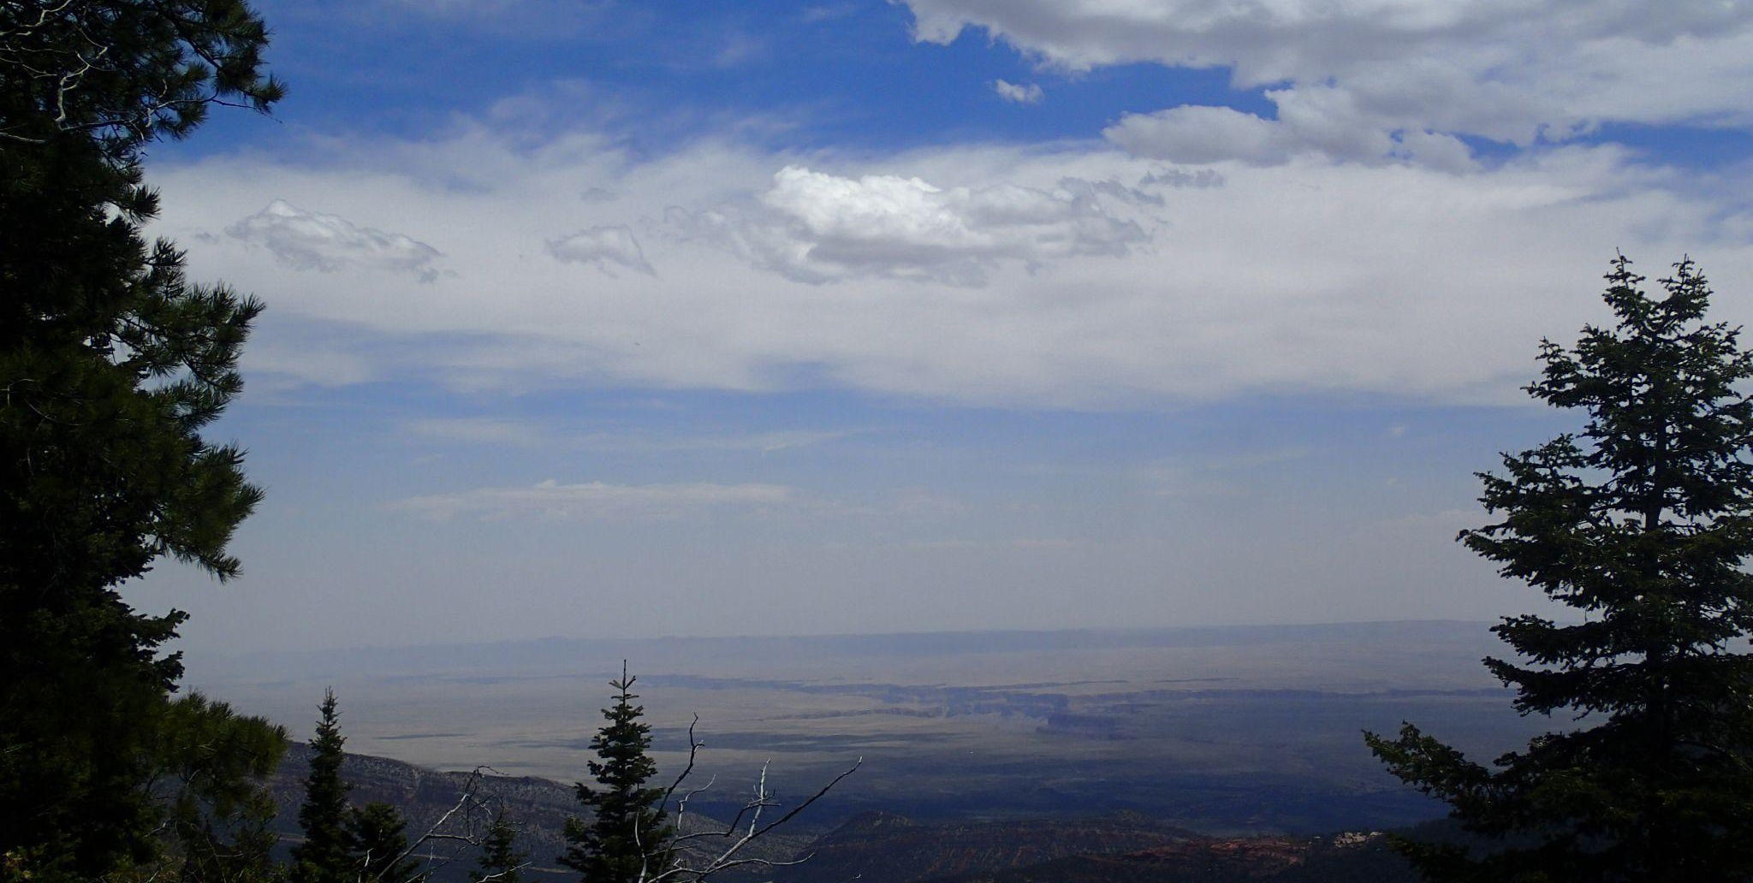
Consumer Promotions
Hills Balfour secured Joint Marketing Collaboration with Travel Counsellors. Travel Counsellors has a custom-built studio which is truly unique. Their TCTV streams live daily shows to TCs in all six countries, allowing them to hear and see first-hand industry updates, news, offers and product launches. Arizona UK to attend live or pre-recorded to participate in a takeover a dedicated 30-40 minute Arizona show.
We helped to create a dedicated solus email which featured product news & updates, inspirational blog content, offers and imagery that was sent to their active database of 337,000 customers.
Arizona received a bespoke destination guide to promote and highlight destination USPs which includes key information such as best time to visit, must-do activities, suggested hotels, itineraries, and more.
Hills Balfour along with Arizona Office of Tourism and their partners recorded live training and content to be shared across Travel Counsellors far reaching platform.

Slide 9
KPI Summary
 | Jul-21 | Aug-21 | Sep-21 | Oct-21 | Nov-21 | Dec-21 | Jan-22 | Feb-22 | Mar-22 | Apr-22 | May-22 | Jun-22
Sales Calls | 6 | 6 | 5 | 4 | 8 | 4 | 6 | 19 | 13 | 12 | 7 | 7
Training Seminars | 0 |  | 3 | 0 |  |  |  |  |  | 1 | 1 | 1
Total # of people present at training seminars | 0 | 5 (OTP) | 127 | 7 | 16 | 2 | 1 | 1 |  | 11 | 50 | 7
Tradeshow Appointments | 0 |  | 4 | 0 | 0 | 0 |  |  |  |  |  | 15
Trade Events |  | 1 |  | 0 | 0 | 0 |  | 1 |  | 1 | 1
FAM's | 0 |  |  | 0 | 0 | 0 |  |  |  |  | 1
# of FAM attendees | 0 |  |  | 0 | 0 | 0 |  |  |  |  | 10
Total Reach | 6 | 12 | 136 | 11 | 24 | 6 | 7 | 19 | 13 | 25 | 67 | 29
Total: 355

Slide 10
PUBLIC RELATIONS

Slide 11
Public Relations - Overview (1 July 2021 - 1 July 2022)
Total number of media hosted: 6
Total coverage AVE:
$ 3,570,769
Total circulation:
2,318,744,104
Total number of pieces:
88

Slide 12
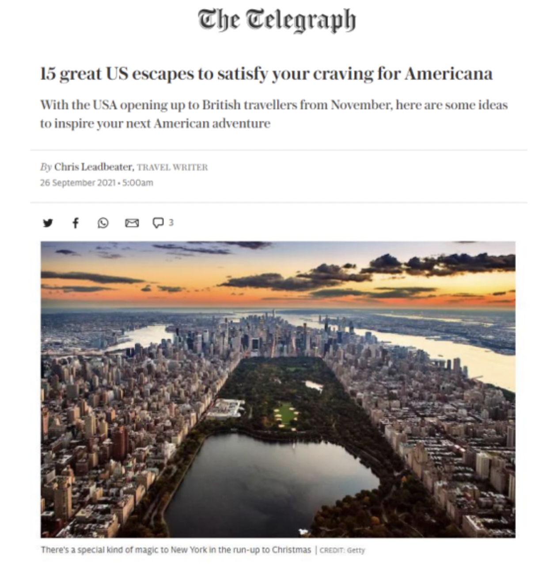
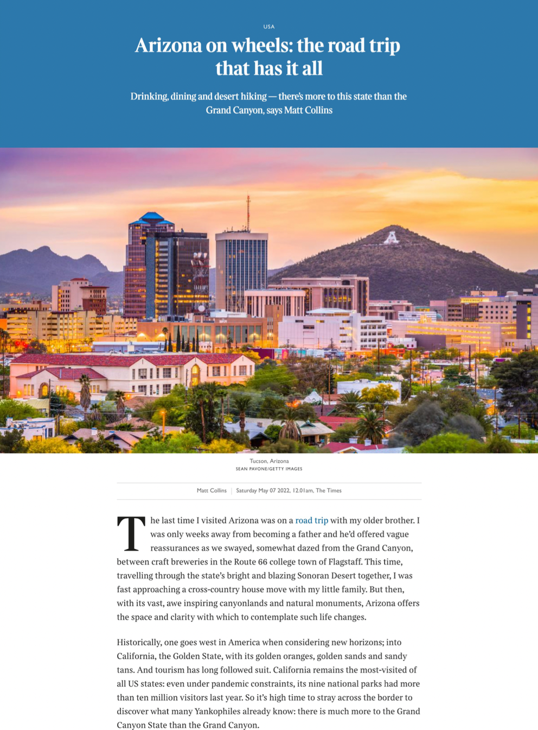
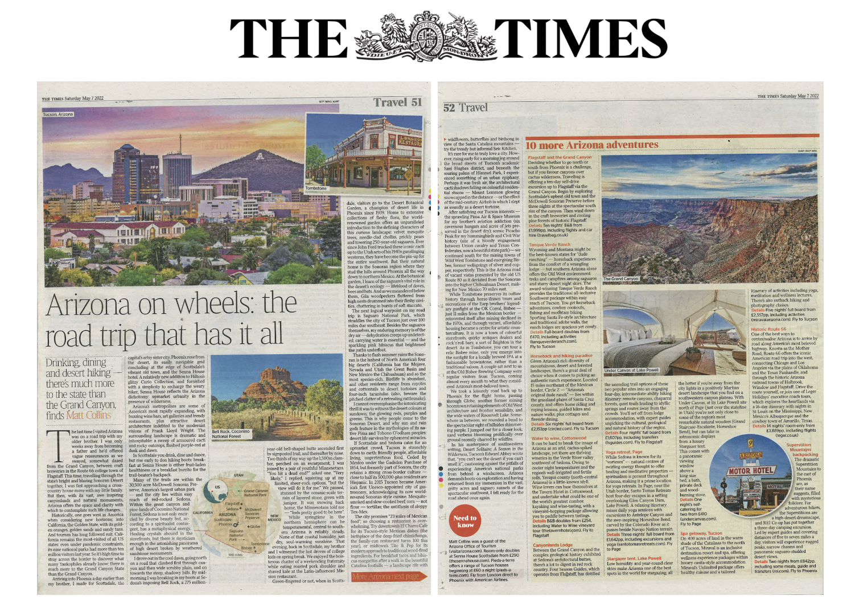
Coverage Highlights

Slide 13
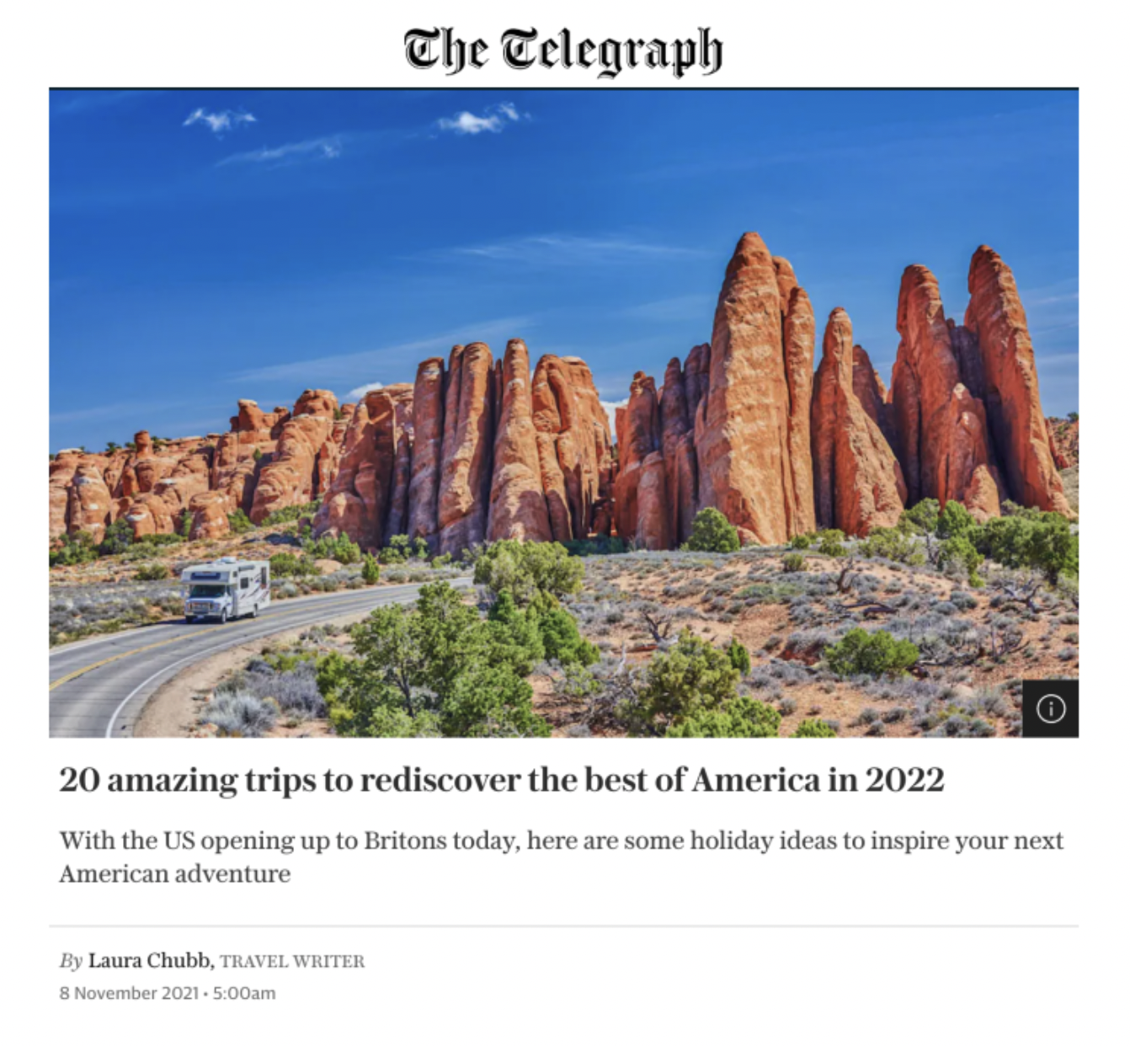
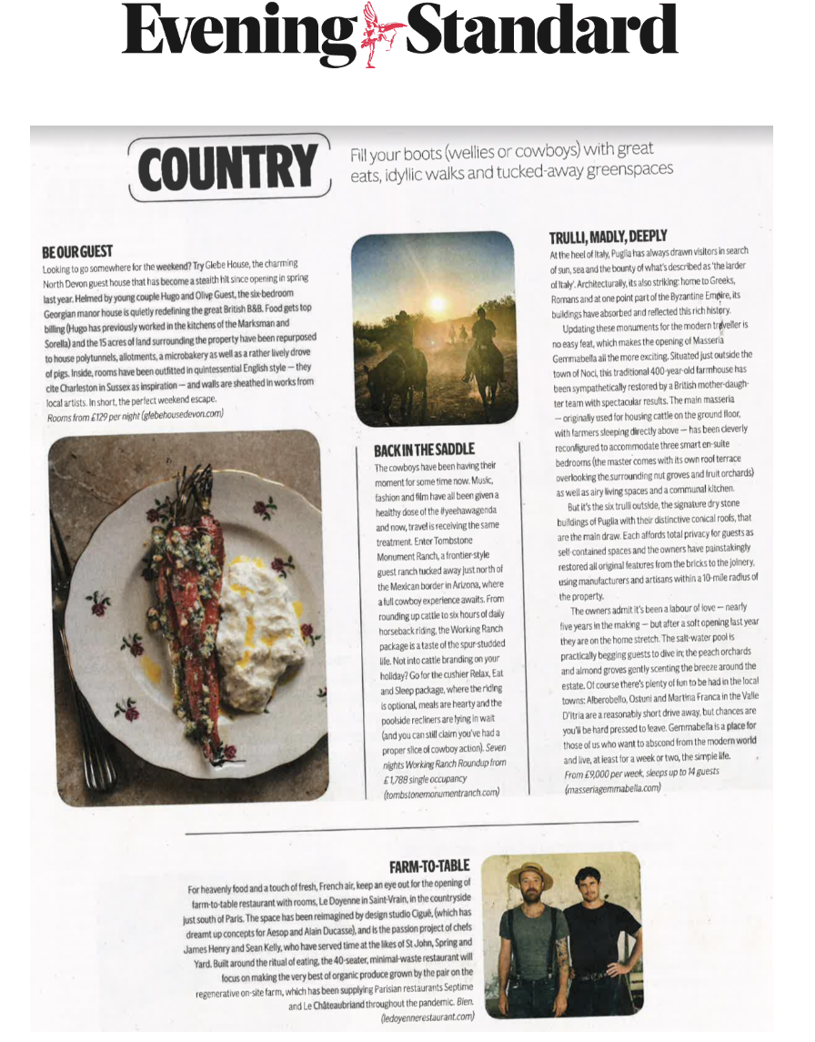
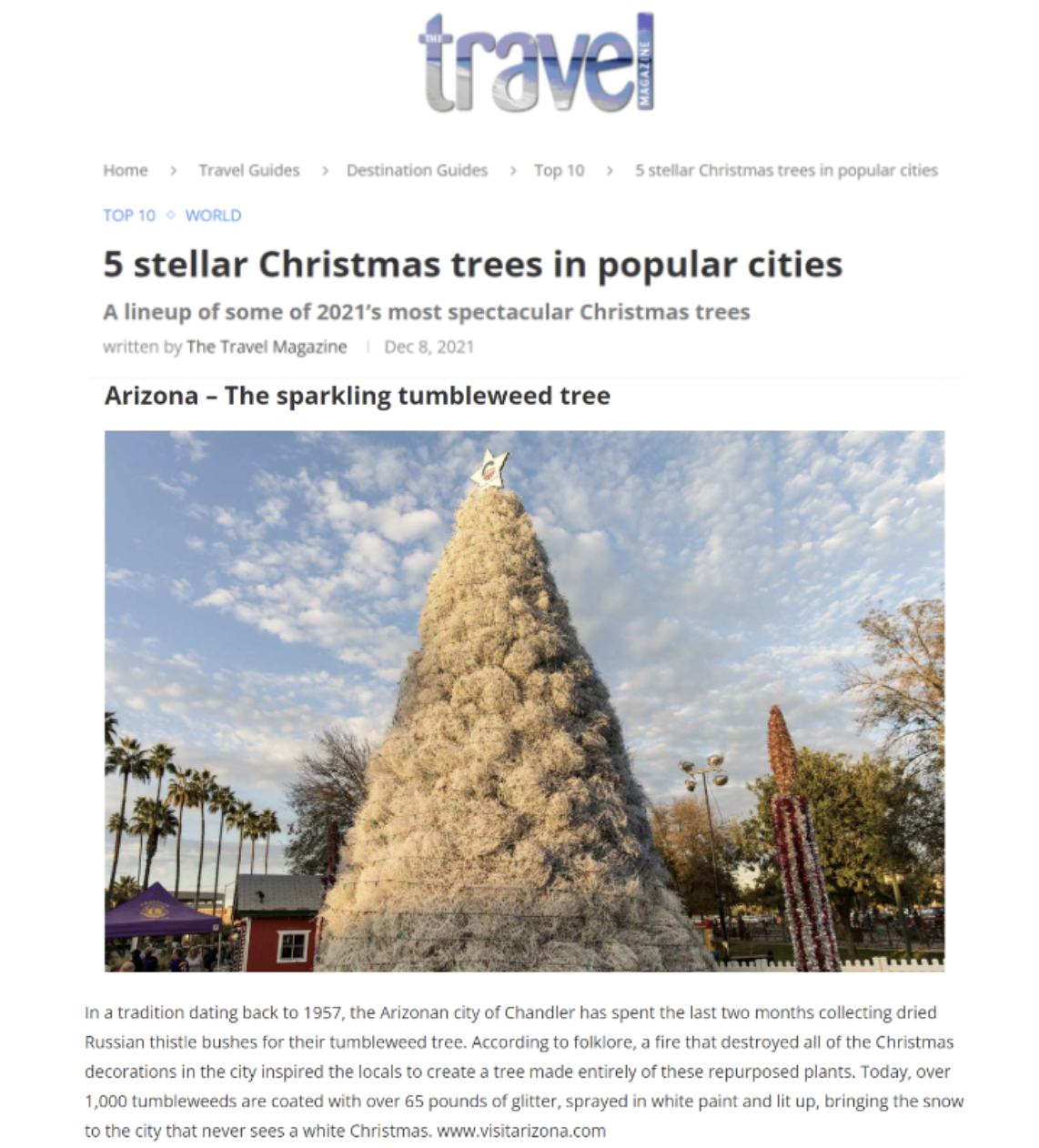
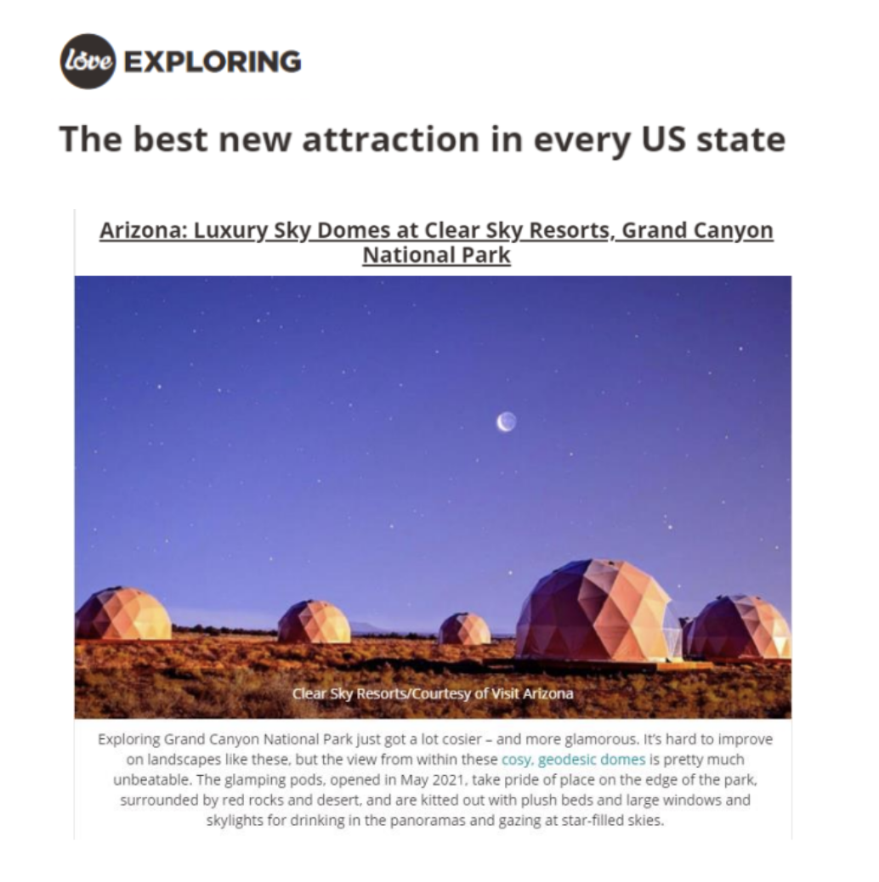
Coverage Highlights

Slide 14
Press Trip Overview
Individual visits:
Matt Collins – The Times
Group visits:
Hannah Ralph – BA Highlife
Ross McCarthy – Reach PLC
Lynne Kelleher – Sunday Independent (Ireland)
Nicola Tallant– Sunday World (Ireland)
Emily Thompson – DOSE

